Slide 1



Integrating climate change adaptation into development planning
Modules on
Monitoring and Evaluation (M&E)

Slide 2
Imprint
As a federally owned enterprise, GIZ supports the German Government in achieving its objectives in
the field of international cooperation for sustainable development.
Published by
Deutsche Gesellschaft für
Internationale Zusammenarbeit (GIZ) GmbH
Dag-Hammarskjöld-Weg 1-5
65760 Eschborn, Germany
T +49 61 96 79-0
F +49 61 96 79-1115
Contact
E climate@giz.de
I www.giz.de/climate
Responsible
Timo Leiter
Authors
Timo Leiter
Alfred Eberhardt
Julia Olivier
Michael Hoppe
Photo credits
© GIZ/Climate Protection Programme for Developing Countries; Climate Media Factory
Design
Ira Olaleye
Articles written by named authors do not
necessarily reflect the views of the editors.
June 2016

Slide 3
Terms of use
This training module has been developed by GIZ on behalf of BMUB and BMZ.
If you would like to adapt this presentation to your needs, please respect the following terms of use:
  The slide master and imprint are mandatory. They may neither be altered nor removed from the presentation.
  The GIZ logo must not be moved or removed. No other logos or further information may be placed in the header or footer area.
  If you wish to add your own content, please use the blank slide at the end of this presentation. (You can copy it to add slides).
  If you would like to make substantial changes to the content of this presentation, please contact climate@giz.de.

Slide 4

Training course „Integrating Climate Change Adaptation into Development Planning“
The training course has been developed by GIZ in cooperation with the OECD and on behalf of BMZ
It is based on the OECD policy guidance “Integrating Climate Change Adaptation into Development Co-operation” from 2009
There are ten modules (see next slide)
New modules have been added / updated on climate information (M2) and M&E (M6) in 2012 and 2013 on behalf of BMUB and BMZ; the M&E modules have been updated again in 2016
The M&E modules can be used together with the regular training or in a stand-alone format
Further information is available on www.AdaptationCommunity.net under Knowledge  Adaptation Training
Notes:
OECD Link: http://www.oecd.org/dac/environment-development/integratingclimatechangeadaptationintodevelopmentplanningapractice-orientedtrainingbasedontheoecdpolicyguidance.htm

Slide 5
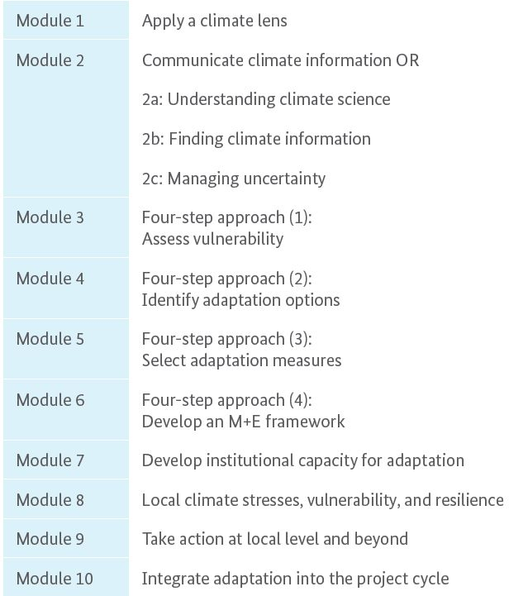
Overview of the 10 modules
Newly added in 2012; 2b updated 2013 to comply with ci:grasp 2.0
4 core modules of the OECD four step approach („climate proofing“)
Revisited and new modules 6a and 6b added in 2013, updated in 2016

Slide 6

Teaching method: Harvard case
Practice-oriented, interactive learning
Based on intensive examination and discussion of case situations of practical relevance to trainees
Stimulates active exploration and development of conclusions by the trainee, rather than ready-made teaching messages; Socratic method
Encourages the trainee to act and make decisions under uncertainty
Notes:
http://harvardmagazine.com/2003/09/making-the-case-html

Slide 7
Integrating CC adaptation into development planning –modules on monitoring and evaluation (M&E)
Traget group
individuals who are involved in designing monitoring and evaluation systems for adaptation at (sub)national level (Module 6a) or project/programme level (Module 6b)
Training materials
Training manual: describes the excercises for participants
Presentation slides: all slides of the introductory presentations
Trainer’s handbook: suggestions on how to run the sessions,
Handouts for every sessions
All materials can be downloaded at the OECD Environment and Development website. Additional materials are available on AdaptationCommunit.net under Knowledge  Monitoring and Evaluation and/or  Adaptation Training.
Notes:
Link to the M&E training materials on AdaptationCommunity:
https://gc21.giz.de/ibt/var/app/wp342deP/1443/index.php/knowledge/monitoring-evaluation/tools-and-training-material/

Slide 8
Integrating CC adaptation into development planning –modules on monitoring and evaluation (M&E)
The modules on adaptation M&E are:
Module 6: Introduction to adaptation M&E
Module 6a: M&E for adaptation at the national/subnational level
Module 6b: M&E for adaptation at the project/progamme level
The M&E Modules will make the trainees familiar with:
rationale, potential and challenges of M&E for adaptation,
processes to develop an effective M&E system as part of adaptation planning,
specific approaches for M&E at the national or project level,
developing adaptation-specific indicators.

Slide 9
Integrating CC adaptation into development planning –modules on monitoring and evaluation (M&E)
Training format
The M&E modules can be run:
As part of the full training course (as module 6) or
In a stand-alone format with an introduction to adaptation,
Modules 6a (national-level) and 6b (project-level) can be run independent of each other. Often times a course would focus on only one of the two.
The stand-alone format requires background knowledge on adaptation and preferably also on monitoring and evaluation.
Format | Modules | Time required
Stand alone M&E training | 6, 6a | 2 days
 | 6, 6b | 2 days
 | 6, 6a, 6b | 3 days
As part of OECD course | 1, 3-5, 6, 6a or b | 4.5 days
 | 1, 3-5, 6, 6a & 6b | 5 days
Notes:
Further information is available in the Trainer’s handbook on the new M&E modules which is available on AdaptationCommunity.net: https://gc21.giz.de/ibt/var/app/wp342deP/1443/index.php/knowledge/monitoring-evaluation-2/multi-level-adaptation-me/adaptation-me-training/

Slide 10
Overview of the M&E modules
M6: Introduction to adaptation M&E
1) Introduction to climate change and adaptation
2) Rationale, purposes and challenges of adaptation M&E
M6: Introduction to adaptation M&E
M6a: M&E at national level
3) Context: Policy, purpose and scale
4) Content: Focus and Indicators
5) Content: Indicator quality check
6) Operationalization
M6b: M&E at project level
9) Designing adaptation projects
10) Develop a results chain
11) Formulate indicators
M6a: M&E at national level
M6b: M&E at project level
M6a/b: Examples and application to practice
Examples and application to practicse
7/12) Real case examples
8/13) Application to participants‘ work context
Notes:
A detailed overview of the Modules and Sessions can be found in the Trainer’s Handbook.

Slide 11
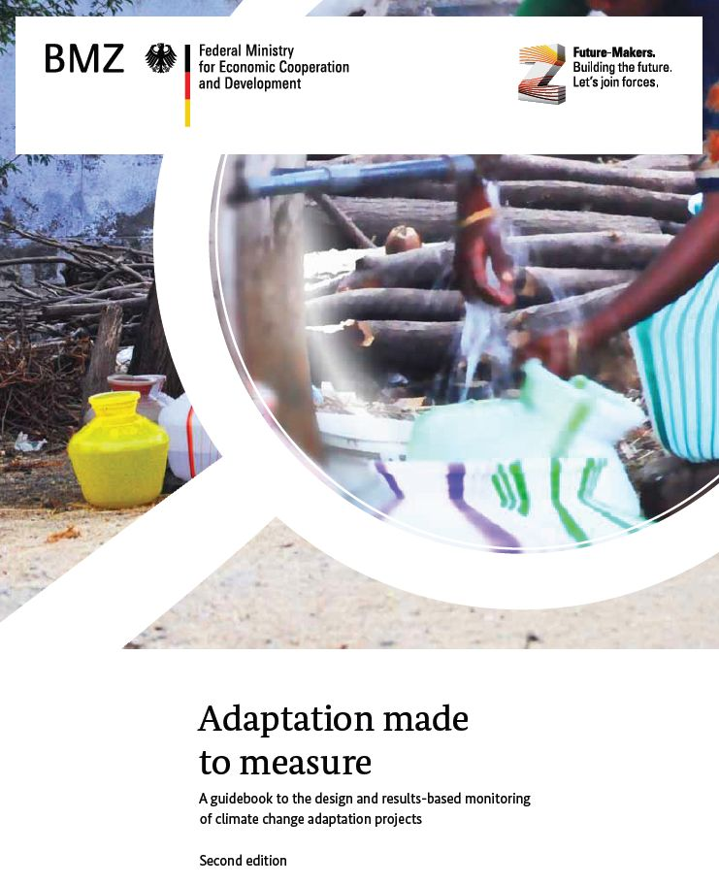

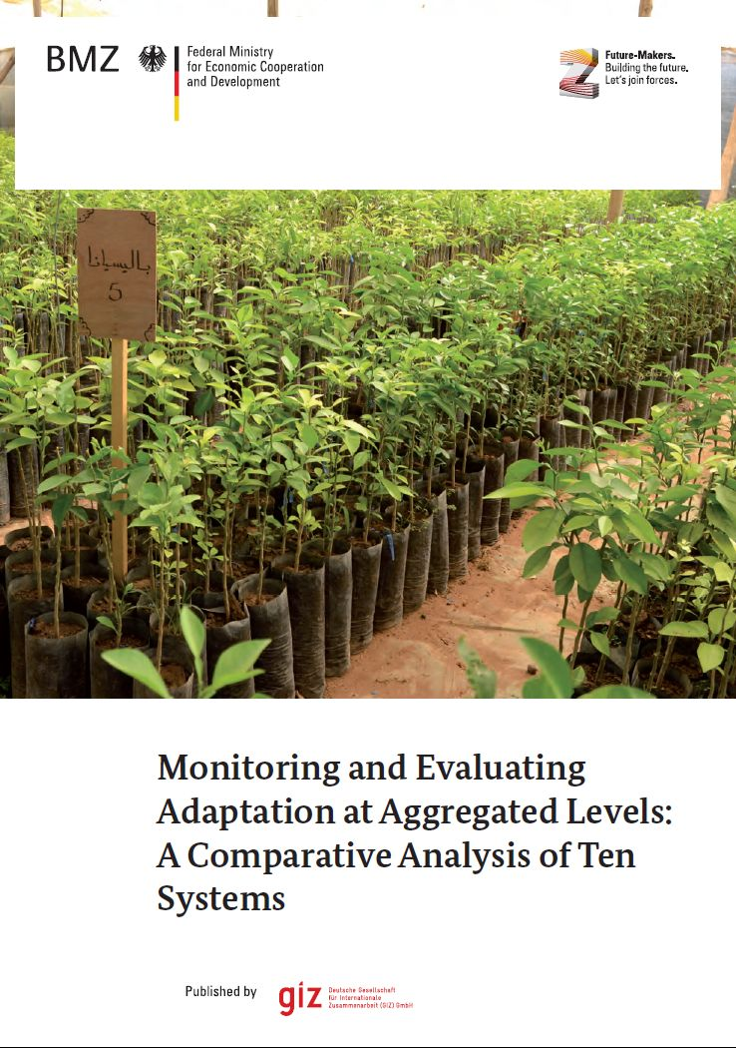
GIZ Publications and guidebooks
M6a: M&E at national level
M6b: M&E at project level
Download at:
Notes:
Available for download at AdaptationCommunity.net under Monitoring and Evaluation

Slide 12
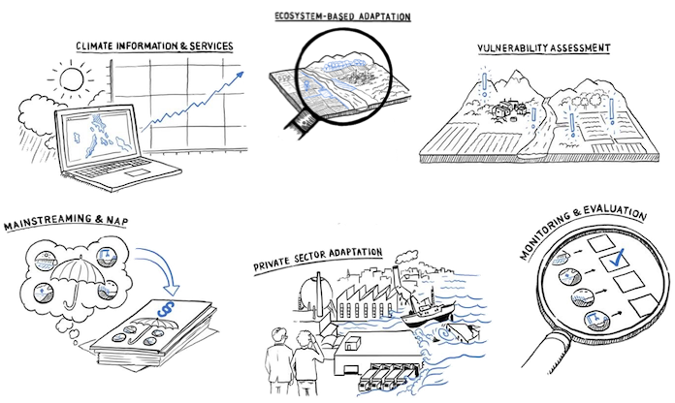
Download of publications, factsheets and webinar recordings on M&E: www.AdaptationCommunity.net
On the start page just click on the topic of interest, e.g. M&E

Slide 13
Module 6
Introduction to adaptation monitoring and evaluation (M&E)

Slide 14
Overview of Module 6
Introduction to adaptation M&E
Introduction to adaptation to climate change
Session | Title | Key content
1* | Introduction to adaptation | The Greenhouse effect What is adaptation? Adaptation and development
 | Action learning | Adaptation terminology
Module 6: Introduction to adaptation M&E
Session | Title | Key content
2 | Introduction to adaptation M&E | Rationale of CCA M&E Levels of application Challenges and opportunities
*Session 1 is only applicable in a stand-alone M&E training format
Notes:
A detailed overview of the Modules and Sessions can be found in the Trainer’s Handbook.

Slide 15
Module 6:
Introduction to adaptation M&E
Session 1:
Background and basic principles of climate change and adaptation
Note: This session has been developed for the stand-alone format. If the M&E modules are conducted as part of the full adaptation training (modules 1-5) this session does not apply.

Slide 16
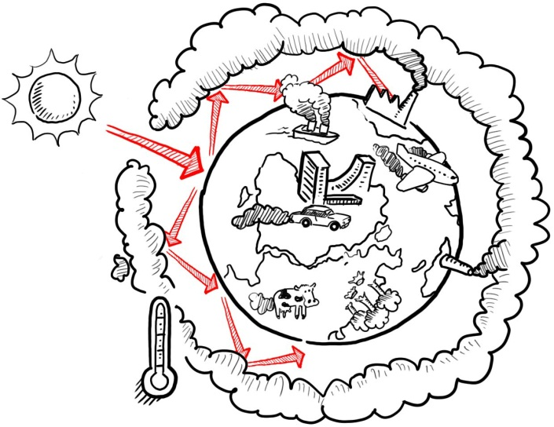
Notes on session 1: introduction to climate change
  This part is only relevant in case of the stand alone training
  The slides do only partially consider findings from the IPCC Fifith Assessment Report released in 2014 and 2015
  The introductory slides may be adjusted to reflect
    the particular needs and knowledge level of participants
    a particular geographical context (e.g. in terms of regional climate change impacts)
Notes:
World Bank Report Turn Down the Heat: http://climatechange.worldbank.org/sites/default/files/Turn_Down_the_heat_Why_a_4_degree_centrigrade_warmer_world_must_be_avoided.pdf
Regional impacts: http://www.worldbank.org/en/topic/climatechange/publication/turn-down-the-heat-climate-extremes-regional-impacts-resilience

Slide 17
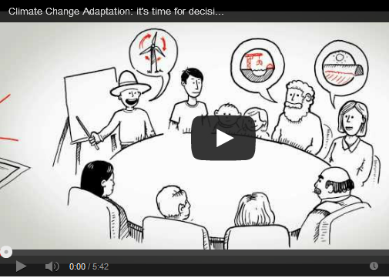
Additional resources on climate change
  The IPCC Fifth Assessment Report: http://www.ipcc.ch
  The recent World Bank Report „Turn Down the Heat“ and the complementing report on Regional Impacts provide a good overview on the consequences of climate change
  The animated movie “We know enough about climate change – it’s time for decision now!” is a five minute introduction to adaptation. It is available in 12 languages on www.AdaptationCommunity.net  Knowledge  5-Minute film about adaptation
Notes:
World Bank Report Turn Down the Heat: http://climatechange.worldbank.org/sites/default/files/Turn_Down_the_heat_Why_a_4_degree_centrigrade_warmer_world_must_be_avoided.pdf
Regional impacts: http://www.worldbank.org/en/topic/climatechange/publication/turn-down-the-heat-climate-extremes-regional-impacts-resilience

Slide 18
Climate change knowledge to date
Mean global temperature rose by 0.85°C between 1880 and 2012
Most warming occurred in recent decades following increased GHG emissions since the 1950s
Based on IPCC estimates, warming between +0.3°C and +4.8°C by 2100 is possible (relative to period 1986-2005)
Projections for sea level rise relative to the 1986-2005 period are +26 to +82 cm until 2100. Other estimations range up to 180 cm by 2100.
Source: IPCC Fifth Assessment Report Summary for Policymakers: http://www.ipcc.ch/
Jevrejeva et al (2014) “Upper limit for sea level projections by 2100”
Notes:
Point 3: +0.3°C is the lower limit of the likely range of RCP2.6; +4.8°C is the upper limit of the likely range of RCP8.5
Point 4: +26 to +55 is the likely range of RCP2.6 - +82 is the upper limit of RCP8.5; 180 cm from http://dx.doi.org/10.1088/1748-9326/9/10/104008

Slide 19
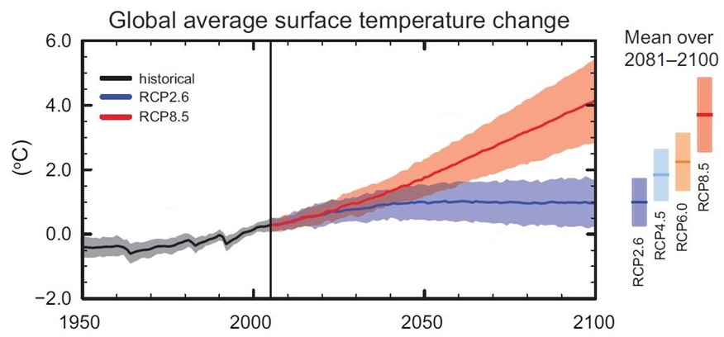
Source: IPCC Fifth Assessment Report Summary for Policymakers
http://www.climatechange2013.org/report/reports-graphic/report-graphics
Notes:
Key message:
We cannot clearly predict future of CC but have to make projections based on different scenarios. Scenarios are storylines about the future. They reflect different emission levels emitted by human activitiy.

Slide 20
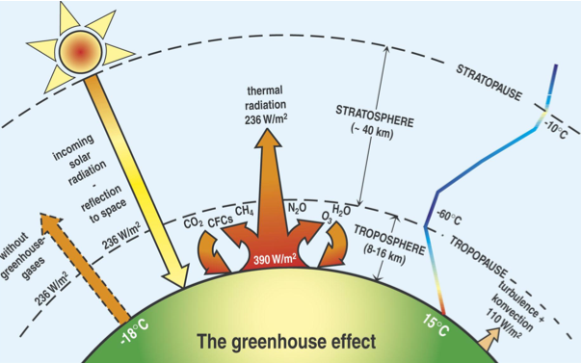
The Greenhouse Effect
Source | Latif, 2009
M 1 - Climate change background | Extras
Notes:
Source pic: Presentation by Mojib Latif/Hamburg Conference
Key message:
Thermal radiation is strongly influenced by concentration of GHG. This effect is the basis for the Greenhouse Effect.

Slide 21
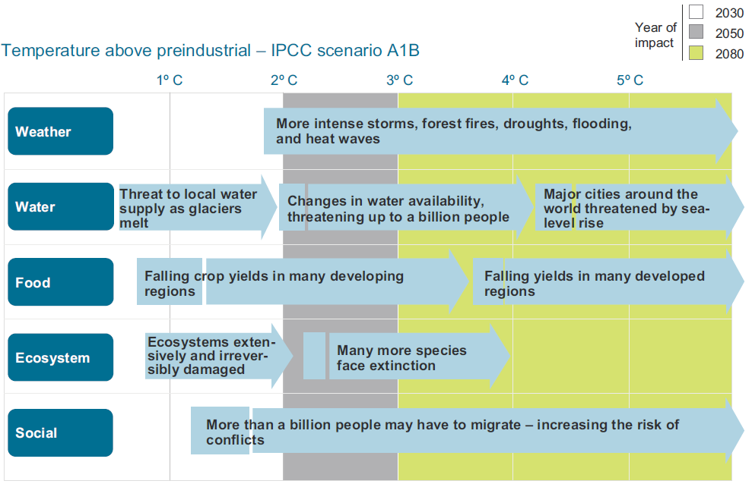
How warm will it get, and how bad will that be ?
Projected impacts
Impacts depend on the scale of change
Source | Shaping Climate Resilient Development. ECA 2009
M 1 - Climate change background | Page 7
Notes:
Key message:
The greater the level of greenhouse gas emissions, the greater the extent of climatic changes, and the stronger its impacts will be.

Slide 22
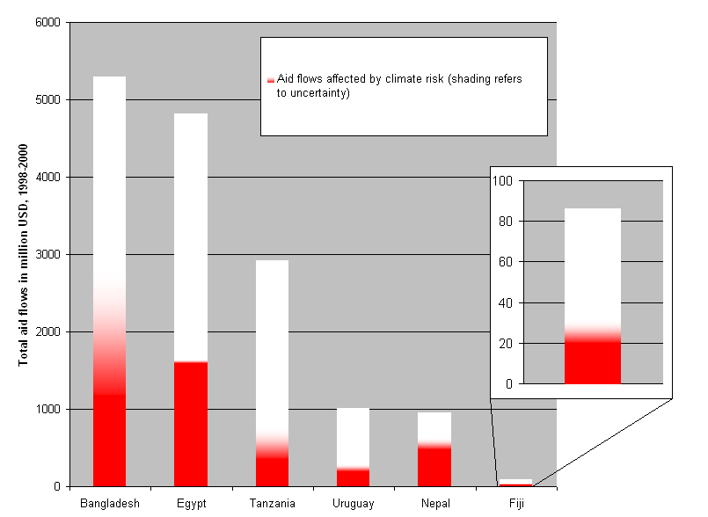
OECD analysis of DAC donor statistics
Aid flows affected by climate risk in red
Shaded areas indicate uncertainty.
Total aid flows in millions USD, 1998-2000
~30-60% of ODA potentially affected by climate change
Fiji
Bangladesh Egypt Tanzania Uruguay Nepal Fiji
Source: OECD, Bridge Over Troubled Waters (2005)
Notes:
Key message:
Development progress – as expressed here by aid flow – can be endangered to a significant part by CC. The extreme is Nepal (60 % endangered).

Slide 23
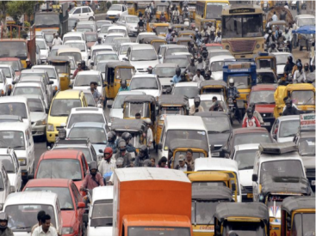
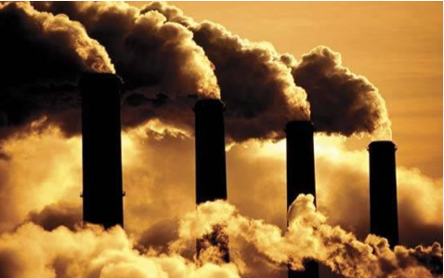
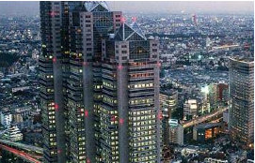

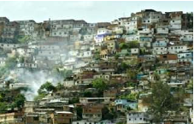

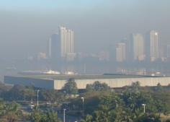
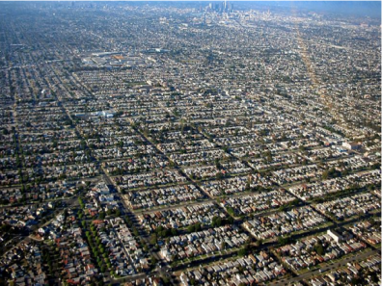
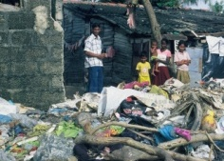
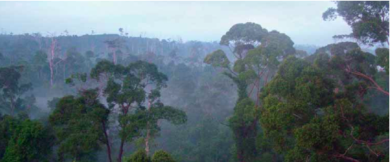
What are the causes?
M 1 - Climate change background | Page 3
Notes:
Key message:
There is a broad variety of causes for GHG increases due to human activity. The pictures provide an impression of how diverse these causes are.
Different picture source, no rights

Slide 24
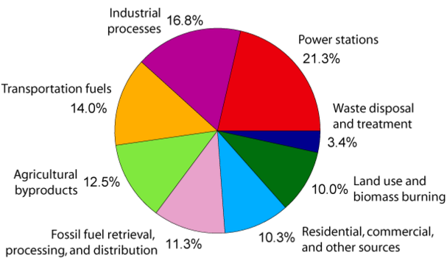
Human activities
Causes
GHG emission shares by source
Land use change
Deforestation
Land conversion to agriculture
Increase in sealed surface
Cars
Urbanisation
Air traffic
Transport
Freight
(Shipping/trucking)
Fertilizers
Agriculture
Burning fossil fuel
Chemicals
Industry
Energy production
Power
plants
Cement
Fugitive
Emissions
Waste
Heating
Electricity
Souce | Climate in Peril; IPCC
M 1 - Climate change background | Page 4
Notes:
Key message:
This slide transfers the general message of the previous slide into figures and statistics. However: The figures depend on country and framework conditions.

Slide 25
Defining adaptation
Adjustments in human and natural systems, in response to actual or expected climate stimuli or their effects, that moderate harm or exploit beneficial opportunities (IPCC, 2001).
Global climate change: change in mean global temperature, changes in regional temperature, rainfall, pressure, circulation, etc.
Mitigation: reduce emissions, reducing magnitude of CC
Adaptation: reduce vulnerability to CC impacts, reduce losses
Greenhouse gas emissions
Climate change impacts
◆ Adaptation and mitigation are complementary strategies
Source: UNDP PowerPoint
Notes:
Both mitigation and adaptation reduce the risks of climate change. Mitigation aims to limit climate change itself, by reducing the emissions of GHGs, for instance by promoting energy efficiency, the use of renewable energy such as solar and wind power, and avoiding deforestation. Adaptation consists of deliberate actions to reduce the adverse consequences, as well as to harness any beneficial opportunities.

Slide 26

How a specific location might be affected
Example: Coastal village
Hurricanes occur seasonally
Increasing air and sea temperatures, intense rain events
Some fish populations declining
Most households involved in fishing
Some households involved in small-scale farming
Basic wells provide access to groundwater
Adapted from USAID 2009
Notes:
Source: USAID (2009): Adapting to Coastal Climate Change: A guidebook for development planners
http://www.crc.uri.edu/download/CoastalAdaptationGuide.pdf

Slide 27
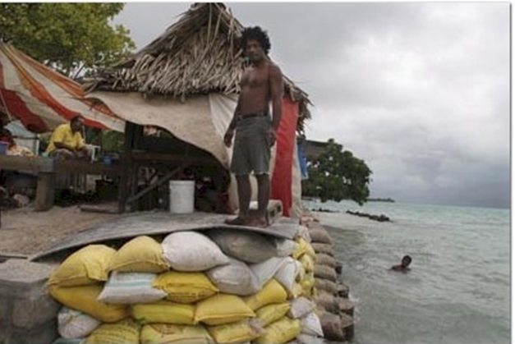
Adaptation options
Example: Coastal village
Outreach and education to community organizations about preparedness and response
Natural or physical infrastructure to protect settlements / arable land from storm surge
Evacuation planning or construction of shelters in the event of hurricanes
Improving fish storage
Enhanced construction standards and training of local carpenters and masons
Improving freshwater resources, through treatment or surface water access
Adapted from USAID 2009
Notes:
Source: USAID (2009): Adapting to Coastal Climate Change: A guidebook for development planners
http://www.crc.uri.edu/download/CoastalAdaptationGuide.pdf

Slide 28
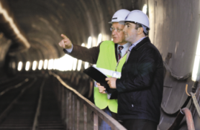
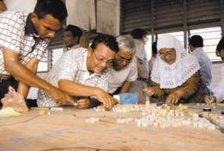
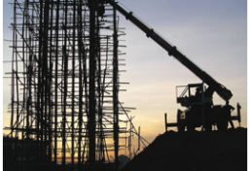
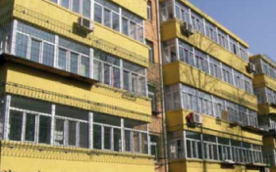
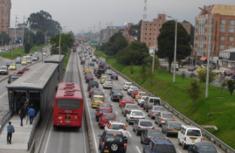
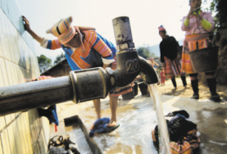


Possible solutions for adaptation are available
It is necessary to enable
them to happen

Slide 29
The basic adaptation planning process
The OECD policy guidance „Integrating climate change adaptation into development co-operation“ of 2009 suggests four steps:
Assessing vulnerability
Identifying adaptation options
Appraising adaptation options
Developing an M&E framework
These four steps form the basis of the adaptation training.
In addition, planning and implementation of adaptation options need to be addressed.

Slide 30
Corner Game: Challenges of implementing adaptation
Each corner of the room represents one of the categories of challenges and four groups should be formed -> choose your corner
What are the main challenges faced when addressing climate change in respect to the issues:
POLITICAL
/INSTITUTIONAL
SOCIAL
ECONOMIC
/FINANCIAL
TECHNICAL
Notes:
Each corner of the room represents one of the challenge categories. Four groups will be formed, and each group will work on one of the categories. In this group work, you are expected to discuss about the different aspects of the given challenge, and to visualize it for a later explanation to the other groups. Each group’s results will be then discussed with all participants.
Are there linkages among the different challenges?
What options exist for tackling them?

Slide 31
Module 6:
Introduction to adaptation M&E
Session 2:
Rationale for and challenges of adaptation M&E

Slide 32







What is Adaptation?
All this is adaptation, if…
… it helps coping with future climatic conditions
Notes:
Key message: Adaptation is not a narrow subject but can have different forms and manifestations covering a range of different sectors. All this is adaptation IF it helps coping with current and future climatic conditions.

Slide 33
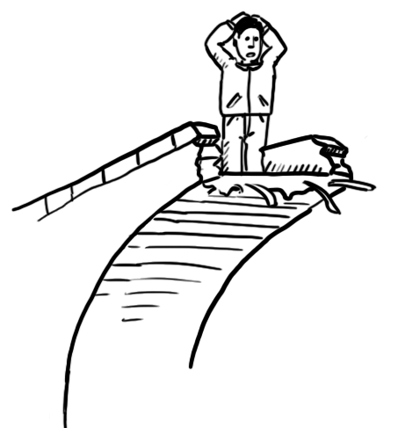


What do we want to measure?
development
adaptation
without climate change
=
vulnerability
with climate change
time
Notes:
Key message: How to measure the effects of adaptation? The ultimate aim would be reduced vulnerability. But vulnerability reduction cannot be measured universally because it is context specific and there is a great diversity of adaptation measures (different sectors etc) (refer to messages of previous slide: Diversity of what adaptation means).
It is also important to note: adaptation cannot reduce all negative effects from climate change, there are limits to adaptation.

Slide 34

Rationale for Adaptation M&E
Understand what works well
Support management under uncertainty
Accountability for climate finance
Comply with (inter)national reporting
STEERING
Learning
ACCOUNTABILITY
(Inter)national Reporting

Slide 35

Overview: Challenges of adaptation M&E
Uncertainty
In climate and socio-economic development
Long time horizon
Success of adaptation only visible after extended timeframe
Complexity
Entanglement with social and economic stressors
Context-dependent
No universal indicator
2020 - - - - -2050
Context-dependent
No universal indicator
What to monitor? Which indicators to use?
Notes:
Key message: The main challenges are mentioned here and will be explained / explored in the following slides.

Slide 36
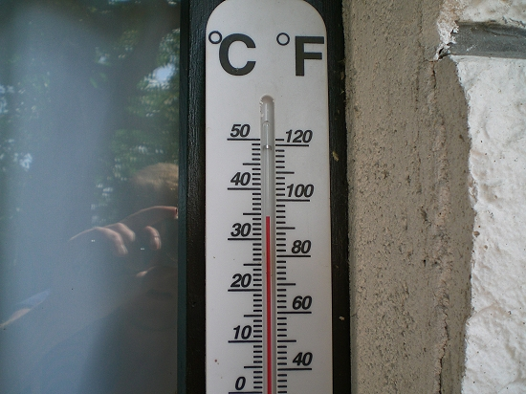

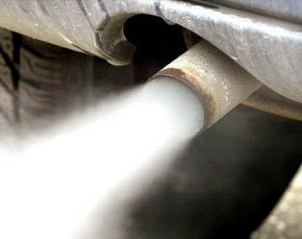
1- No single indicator for adaptation success
Temperature
Distance
???
Mitigation
Adaptation
Notes:
Key message: there is no universal indicator to measure adaptation success irrespective of context. For mitigation, the globally applicable metric is reduction of GHG (equivalents).

Slide 37
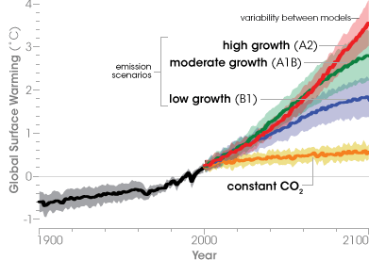
2- Uncertainty
In climate change adaptation we have to deal with uncertainties. Two examples:
  Moving baselines
  Unknown exact future development of climate parameters
  Relevant framework conditions (socio political) may change over time
  Unclear reference scenario
Variability between different
model
outputs per scenario
  Difficult to define a business-as-usual scenario under uncertainty
  What would have happened without the intervention?  need assumptions or scenarios
Variabilitiy between scenarios
Notes:
Uncertainty makes the measurement of adaptation challenging: there is uncertainty about the exact extent of local climate change and variability as well as uncertainty about the development of socio-economic parameters (particularly over longer time spans). These uncertainties also affect the counterfactual, i.e. what would have happened (over time) if the intervention had not been implemented.

Slide 38
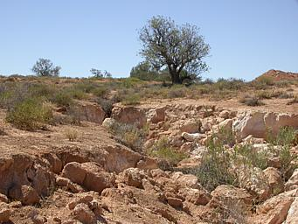
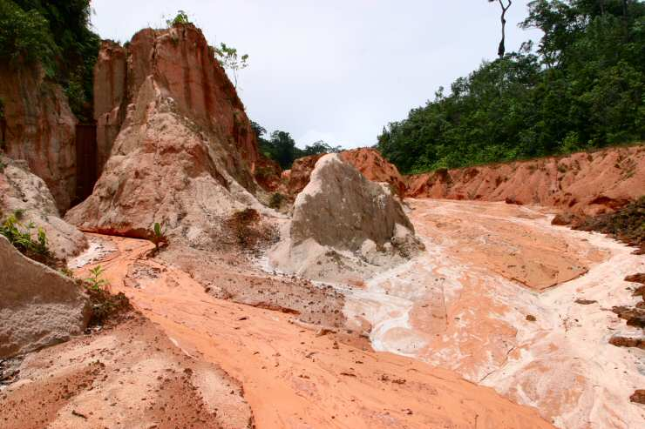
3- Complexity
e.g. soil erosion
  A climate change impact such as water scarcity can influence numerous sectors: cross-cutting, e.g. less water affects agriculture, forestry, natural resources, energy and the economy
  Climatic factors (changes in rainfall patterns) and non-climatic stressors (deforestation, inadequate agricultural practices, etc.) interact
  ➔ Complex cross-sectoral problems and measures
Notes:
Example of soil erosion: soil erosion has multiple causes that interact and together increase the extent of erosion. This could be climatic changes coupled with unsuitable land use practices or failing governance structures

Slide 39
4- Long time horizons
  Project lifetime
Measure X
Measure Y
20+ years
Measure Z
Climate Change
3-6 years
  Information on success
Notes:
It is challenging to assess the outcomes of adaptation after a short time period if climate change impacts only manifest over a much longer time span. For example, adaptation interventions could be seen as successful after three years, but implemented capacities or measures may be found insufficient at a later date because of increasing CC impacts or due to changed circumstances.

Slide 40
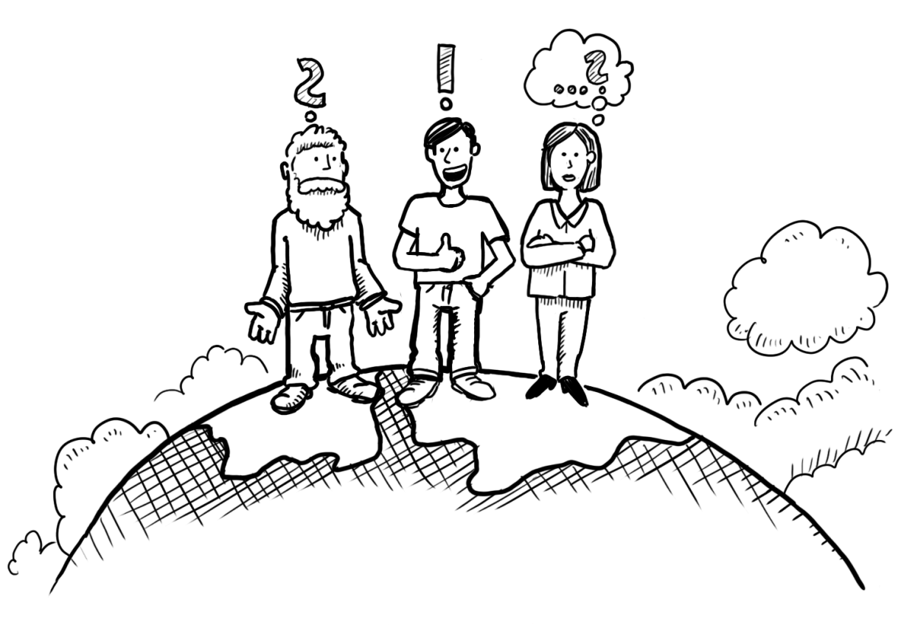
So, how can adaptation M&E be approached in practice?

Slide 41
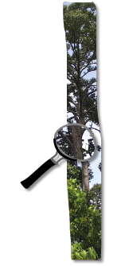
Adaptation M&E in practice
Due to the diversity of adaptation there is
no one size fits all approach to adaptation M&E.
Appropriate approaches depend on:
        The purpose of M&E
        The context and content of M&E
        Available capacities and resources
Notes:
For examples of different approaches to adaptation M&E at national level please see the IISD & GIZ (2013) comparative assessment study available for download here: https://gc21.giz.de/ibt/var/app/wp342deP/1443/?wpfb_dl=163

Slide 42
Purposes of an adaptation M&E system
Purpose | Related questions
Learning: producing knowledge about the evolving adaptation context, needs, and experiences | Are adaptation actions effective? How can adaptation be improved?
Accountability: reporting to stakeholders on progress and/or results | How to report to international conventions and national frameworks on adaptation?
Adaptive management: checking whether a policy or plan is on track and adjusting the course of action accordingly | Does implementation follow the intended paths?
◆ Purpose of the M&E system determines what should be measured

Slide 43
Levels of application
Portfolio level:
Overall performance of
numerous projects / interventions
National / state level:
National Adaptation Strategies / Plans; sectors
Project level:
Results of adaptation interventions
◆ Approaches to adaptation M&E differ between these levels
Notes:
KEY MESSAGE: There are 3 levels at which adaptation M&E takes place.
Project level: monitoring progress and measuring success of adaptation projects, measures and interventions. It includes M&E of multi-year adaptation projects as well as M&E of single adaptation measures such as the introduction of new crop varieties.
National level: monitoring progress and impacts of (sub)national adaptation efforts. This includes monitoring of National Adaptation Strategies and Plans/Planning (NAPs) as well as of national policies
Portfolio level: this is concerned with the performance and impact of climate portfolios, e.g. portfolios of bilateral or multilateral donor agencies or national climate change trust funds. Examples are the results framework of the Adaptation Fund or of the Pilot Project for Climate Resilience.

Slide 44
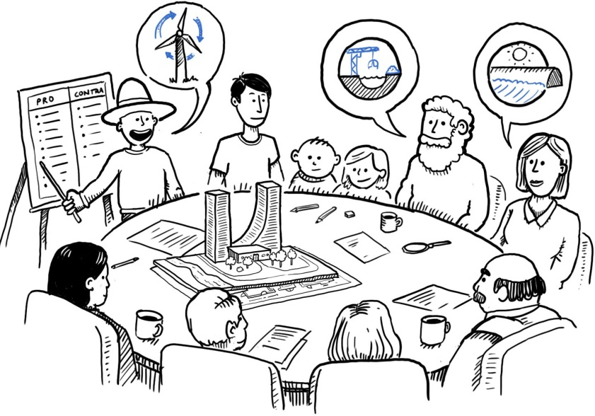
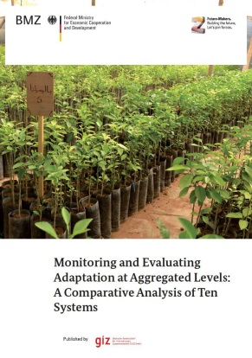
Context and capacities
  Political context
    interest of different parties and stakeholders
  Institutional structures
  Legal considerations
  Access to data and information
  Financial resources
For practical examples please see the M&E country factsheets of the study
Notes:
These factors need to be considered when setting up a national adaptation M&E system.
Link to the study: https://gc21.giz.de/ibt/var/app/wp342deP/1443/index.php/knowledge/monitoring-evaluation-2/national-level-adaptation-me/overview-and-analysis-of-10-national-adaptation-systems/

Slide 45
What approaches can be used for adaptation M&E?

Slide 46

What approaches can be used for adaptation M&E?
The Adaptation M&E Navigator helps to identify suitable M&E approaches by linking them to specific adaptation M&E purposes.
Each M&E approach is described in detail including limitations and resources needed to implement it.
Selection criteria may include:
  Process or outcome orientation
  Complexity of implementation
  Subjectivity of resulting information
  Application experience to date
The Adaptation M&E Navigator is available at www.AdaptationCommunity.net under “M&E”
A technical book chapter (open access) will appear in late 2016 (book title: Evaluating Climate Change Action for Sustainable Development, Publisher: Springer)
Notes:
Link to the Adaptation M&E Navigator: https://gc21.giz.de/ibt/var/app/wp342deP/1443/index.php/knowledge/monitoring-evaluation-2/multi-level-adaptation-me/adaptation-me-navigator/

Slide 47
Vulnerability factors
Adaptation response
Monitoring of
climate parameters
Public Expenditure Review
Tracking Adaptation Activities
Results Activities
Exposure
Sensitivity
Decreasing Sensitivity
Adaptation Activities
Performance Monitoring
Results-Based Monitoring
Potential Impact
Adaptative capacity
Increasing Adaptive Capacity
Adaptation Activities
Impact Evaluation
Climate Change Impact Monitoring
Vulnerability
Decreasing Vulnerability
Development & Adaptation Activities
(Repeated) Vulner-ability Assessments
Notes:
The slide presents different methods which can be employed for adaptation M&E (grey boxes).
Key message: Depending on the purpose of M&E quite differend methods can be applied. They are not mutually exclusive but can complement each other.

Slide 48
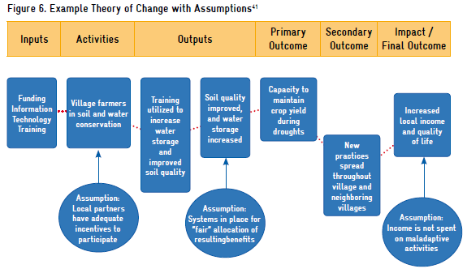
Example of a method for adaptation M&E: results chain
Annual income of small farmers per year.
Funds provided for training
No. of small scale dams under operation
Wheat yield of small farmers per year.
Notes:
Source: WIR/GIZ (2011): Making adaptation count.

Slide 49

Excercise
  Recall the challenges of adaptation M&E
  In pairs of two, reflect in how far you:
    have already encountered these challenges in your work context
    have found ways to deal with them?
  Refer to Matrix 1

Slide 50
Module 6a
M&E for adaptation at national / subnational level

Slide 51
Overview of Sessions
Module 6a
Sequence of sessions of module 6a (national-level M&E)
No. | Title | Key content
3 | Context | Policy context Purpose Scale(s)
4a | Content (I) | Focus Data & information Indicator formulation
4b | Content (II) | Indicator review
5 | Operationalisation | Institutional arrangements & resources Synthesis
6 | Products | Outputs & reporting
Notes:
Trainers, please refer to the Trainer‘s Handbook for further instructions about the sessions.

Slide 52
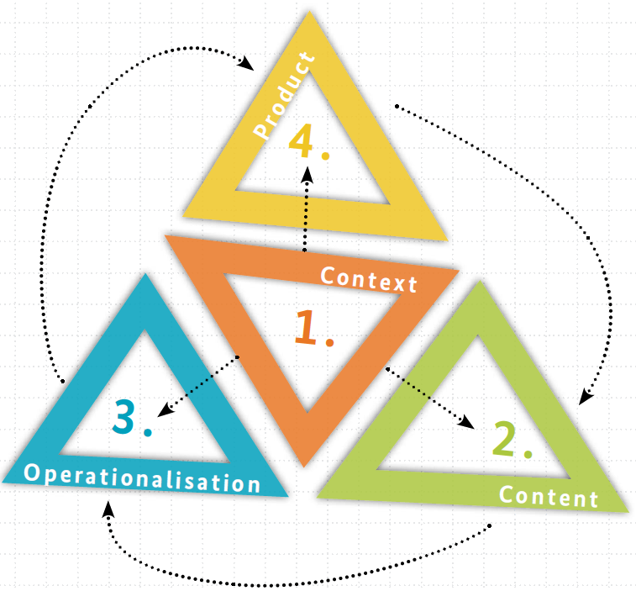
Four building blocks for setting up a national adaptation M&E system
Session 6
Reflect on how you will present outputs and results
Session 3
Reflect on the policy context
Identifiy the purpose and target users of the M&E system
Session 5
Reflect on institutions and resources
Explore how you can synthesise information
Make use of existing M&E systems
Session 4a & 4b
Decide if your focus is on process or outcomes
Identify data & information requirements
Define and review adaptation-specific indicators
Notes:
Further details can be found in GIZ’s national M&E Guidebook: https://gc21.giz.de/ibt/var/app/wp342deP/1443/wp-content/uploads/filebase/uploads/giz2015_Developing_national_adaptation_M&E_systems_-_A_guidebook.pdf

Slide 53
Session 3:
Context
No. | Title | Key content
3 | Context | Reflect the broader policy context and M&E environment Identify the purpose of the M&E system and its target users Determine the levels of application and/or aggregation

Slide 54
Four building blocks for setting up a national adaptation M&E system
Focus of session 3
Notes:
Further details can be found in GIZ’s national M&E Guidebook: https://gc21.giz.de/ibt/var/app/wp342deP/1443/wp-content/uploads/filebase/uploads/giz2015_Developing_national_adaptation_M&E_systems_-_A_guidebook.pdf

Slide 55

Broad spectrum of purpose & framework conditions
Examples:
  Monitoring results oriented implementation of National Climate Change Action Plan
Example: Philippines
Monitoring CC impacts and adaptation for priority sectors at national level
Example: Germany
Monitoring the mainstreaming of adaptation as well as development outcomes:
Example: Kenya
There is a diversity in national contexts
No one-size-fits-all solution for all these cases
See details in the study
Notes:
Comparative analysis of ten national adaptation M&E systems (IISD & GIZ , 2013): https://gc21.giz.de/ibt/var/app/wp342deP/1443/index.php/knowledge/monitoring-evaluation-2/national-level-adaptation-me/overview-and-analysis-of-10-national-adaptation-systems/

Slide 56
Policy context
Key questions:
What are policies and priorities related to adaptation and its M&E?
What mandate prompted the development of the M&E system?
Example: Morocco
Decentralized approach: Two regions have already set up adaptation M&E systems for two sectors by 2014 → Further regions will follow
National law on the right for information access facilitates data availability

Slide 57
Purposes of an adaptation M&E system
Purpose | Related questions
Learning: producing knowledge about the evolving adaptation context, needs, and experiences | Are adaptation actions effective? How can adaptation be improved?
Accountability: reporting to stakeholders on progress and/or results | How to report to international conventions and national frameworks on adaptation?
Adaptive management: checking whether a policy or plan is on track and adjusting the course of action accordingly | Does implementation follow the intended paths?
◆ Purpose of the M&E system determines what should be measured

Slide 58
Potential users of M&E results
Administrations at
(sub-)national level
Line/ sectoral ministries
Projects, programmes, implementers
Project implementing agencies, NGOs
Portfolio managers
International organisations,
Research institutions
Donor agencies
Funds
Territorial administrations at different levels
Coordinating ministries and political decision-makers
Information and knowledge management organisations
Universities and researchers

Slide 59
Scale(s): Levels of application and aggregation
Level of application at which results of the M&E system are expected to appear e.g. at national, sub-national, or local level.
Levels of aggregation at which data is collected:
  Horizontally, across thematic areas and sectors
  Vertically, across geographic scales
Example: Morocco
Sub-national application
The M&E system is piloted in two regions.
Horizontal aggregation
The M&E system draws on data from multiple sectors (water, agriculture, tourism, and biodiversity / forest).
Notes:
Identifying the levels of application and aggregation will help you define the scope of the M&E system and ensure that all relevant stakeholders are involved in its development and implementation.

Slide 60
Country Descriptions
Zanadu and Khoresia

Slide 61
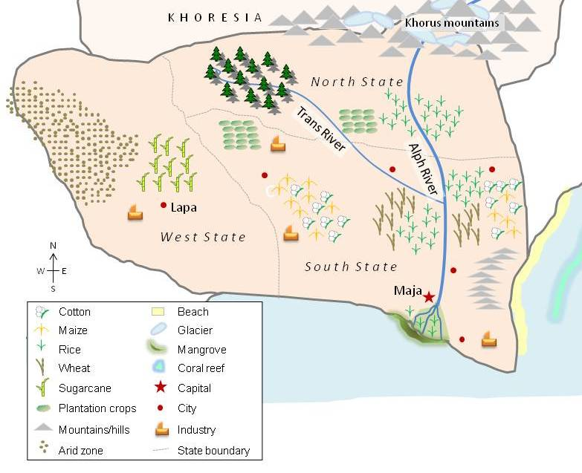
Map of Zanadu

Slide 62
Introduction to Zanadu
Projected climatic changes
High seasonal rainfall in summer, dry cool winter season
Rise in temperature by 2 ° C by 2050
Expected climate change impacts
Increasing incidence of droughts due to shortfall of rain
More frequent floods during summer
Reduced groundwater recharge
Maize and wheat yields depressed by temperature rise
Rice threatened with sterility by higher temperatures
Planning framework:
National Dev. Plan has been „climate proofed“
No adaptation strategy but selected adaptation measures

Slide 63
Introduction to Khoresia
Projected climatic changes
Higher number of hot days
Higher rain falls
Expected climate change impacts
Increasing floods
Increasing land slides
Melting glaciers
Changed run-off form snow melt
Maize and wheat yields negatively affected by rising temp.
Planning framework:
Comprehensive adaptation plan CCAPAK
National CC Policy Board established under President‘s office

Slide 64

Introduction to Khoresia
Khoresia:
Government wants to ensure that Climate Change Adaptation Plan of Action for Khoresia (CCAPAK) is implemented in a way that defined results will be achieved.
This is to be supported by a results-based M&E System.
Zanadu:
Pilot adaptation measures in agriculture and water management will be launched.
Government wants to develop pilot M&E systems for these measures to ensure effective implementation.
◆ First stage of M&E system development is the description of the context

Slide 65
Exercise S3
Your task:
You are member of the M&E expert group / advisory group supporting the Government.
Use Matrix 2 to answer the 4 key questions
Refer to exhibits 1a + 1b for key features of the adaptation process in the respective country.

Slide 66
Session 4a: Content (I)
No. | Title | Key content
4a | Content (I) | Decide if your focus is on monitoring process or outcomes (or both) Identify what type of data and information you require to fullfil the purpose of the M&E system Define indicators for adaptation responses and climate change impacts

Slide 67
Four building blocks for setting up a national adaptation M&E system
Focus of this session
Notes:
Further details can be found in GIZ’s national M&E Guidebook: https://gc21.giz.de/ibt/var/app/wp342deP/1443/wp-content/uploads/filebase/uploads/giz2015_Developing_national_adaptation_M&E_systems_-_A_guidebook.pdf

Slide 68
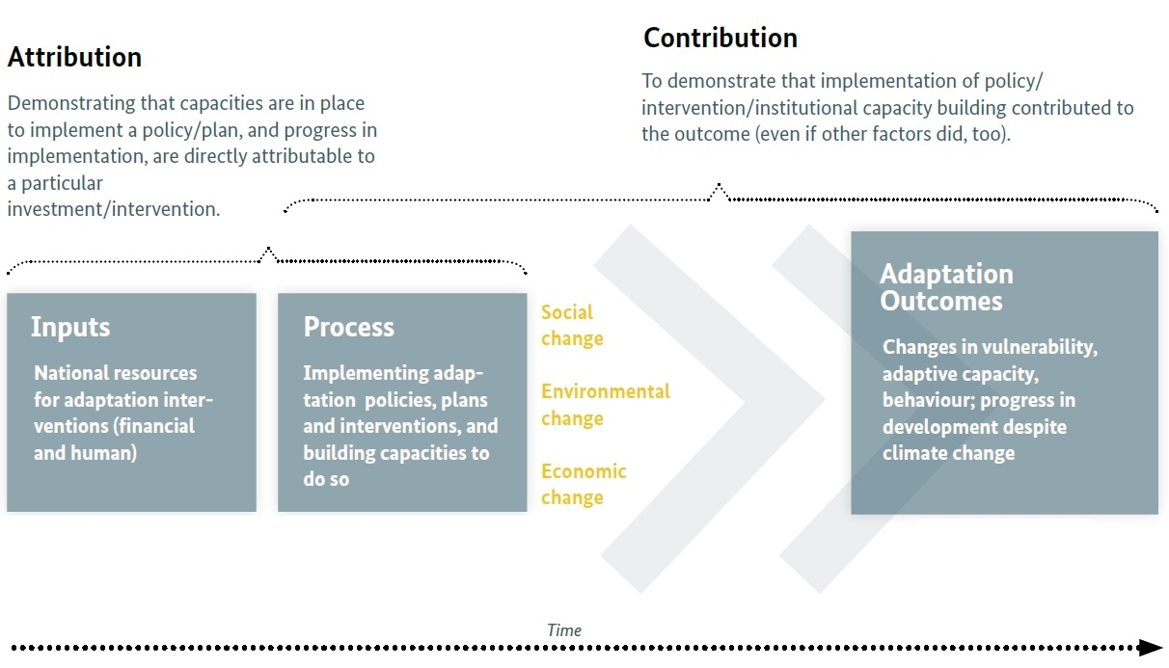
Focus: What should be monitored?
Notes:
National M&E of adaptation may focus on process and/or adaptation outcomes.
Many M&E systems reviewed to date take a hybrid approach, considering focus on both process and outcomes.
The focus of the adaptation M&E system is related to its purpose(s):
Process monitoring can help to inform any of the three purposes (learning, accountability, adaptive management) from the previous session. It is essential to support adaptive management, which requires checking that a policy, plan or intervention is on track.
A focus on adaptation outcomes refers to assessing changes that result from the implementation of adaptation policies/actions.

Slide 69
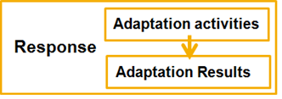
Focus: What should be monitored?
Adaptation measures
-
-
Graphic shows adaptation components according to the IPCC (2014)
Monitoring can focus on different components, e.g. on adaptation response or vulnerbility
+
Sensitivity
Coping & adaptive capacity
Hazard
Exposure
Vulnerability
Risk

Slide 70

Information
Most M&E systems use indicators to define what to measure
    but they are not compulsory for an M&E system
Indicators help to:
  describe an existing situation
  track changes over time
Every indicator needs:
  To fulfill quality criteria (valid, relevant, measurable etc – this will be the focus of session 5)
  A precise numerical baseline and target values.
  An objective way to verify its (quantitative) value

Slide 71
What to pay attention to when formulating an indicator
Context: Does the indicator inform the purpose and support the intended use?
Focus: Does the indicator track process and/or outcomes?
Baseline and targets: Has the baseline been determined and appropriate targets been set?
Sources of verification: Are they specified?
Data collection and analysis: What methods are used to acquire and process the necessary data / information?
Example of a specific and precise indicator:
The percentage of communities in the provinces X, Y and Z that have integrated into their community development plans measures to adapt to climate change is 50% in year 2017.
Notes:
An indicator is NOT specific if, for example, it is formulated as an objective and thus generates questions about how the expected results can be measured / checked; if it uses unclear formulations such as “sustainable result”.
Attention: not all indicators need targets - the goal of monitoring can also be to observe trends such as climate change impacts (as is done as part of the German adaptation M&E system)

Slide 72

Exercise
Your task:
You are member of the M&E expert group (Khoresia) or advisory group (Zanadu) supporting the Government.
Use Matrix 3a to identify the focus of the M&E system in your country. Refer back to your ideas on purpose from Session 3.
Use Matrix 3b or 3c to formulate possible indicators for the denoted climate change imapcts and responses
Further details on climate change impacts and
responses are shown in Exhibit 2a (Zanadu)
and 2b (Khoresia).

Slide 73
Session 4b: Content (II)
No. | Title | Key content
4b | Content (II) | Review and quality-check of adaptation-specific indicators

Slide 74
Four building blocks for setting up a national adaptation M&E system
Focus of this session
Notes:
Further details can be found in GIZ’s national M&E Guidebook: https://gc21.giz.de/ibt/var/app/wp342deP/1443/wp-content/uploads/filebase/uploads/giz2015_Developing_national_adaptation_M&E_systems_-_A_guidebook.pdf

Slide 75
Developing high-quality indicators
Adaptation indicators need to be able to clearly demonstrate
adaptation-specific results, i.e. the benefits of adaptation
Adaptation indicators need to comply with the same quality criteria as general development indicators do, e.g. validity and reliability
During indicator formulation it should already be considered:
  How the indicator can be measured (calculation and data collection method)
  If the necessary data is already available (e.g. already gathered
  by government institutions/bureau of statistics) or if new data
  collection is necessary
  What (financial) resources and capacities are available

Slide 76
The SMART rule for indicators and targets
Criteria for the selection of good indicators
S Specific: the indicator is valid and describes the underlying issue; indicator is precisely formulated.
M Measurable (practicability and objectivity): data obtained through reproducible methods independent from the individual collectors of the information.
A Attainable (referring to targets), Agreed by stakeholders (referring to indicators).
R Relevant: address an important issue for the users and related to the objective of M&E.
T Time-bound: a temporal reference is given so that progress can be measured during the course of implementation

Slide 77
Exercise: Check if the indicators are SMART
In 6 pilot regions, two of three beneficiary representatives and two of three representatives of different governmental institutions confirm the adequacy of local adaptation measures for dealing with climate stresses and their relevance for up-scaling.
% increase in people with improved access to clean water supplies; and % increase of which are women.
% of people (by gender) in the county permanently displaced from their homes as a result of flood, drought or sea-level rise.
% of current delegated public service contracts in which vulnerability to climate change has been identified.
Notes:
OPTIONAL exercise
Instructions for trainers: Discuss in plenary if the criteria are SMART. In some cases it depends on information not available and assumptions have to be made. Instead of doing this in PowerPoint, you can also use FlipChart or other materials. Do 2-3 examples together to ensure that participants have understood how to do this as it is the content of the following exercise.

Slide 78

Exercise
Your task:
As a member of the M&E expert group (Khoresia) you are invited to reflect the indicator proposals of the CCAPAK shown in matrix 4.
As a member of the M&E advisory group (Zanadu) you are invited to reflect the indicators which you developed in session 4 in matrix 3b.
Evaluate the quality of the indicators against the SMART criteria
In how far can these indicators be improved to become SMART?
Uses Matrix 4 (Khoresia) or Matrix 5 (Zanadu) to record your results

Slide 79
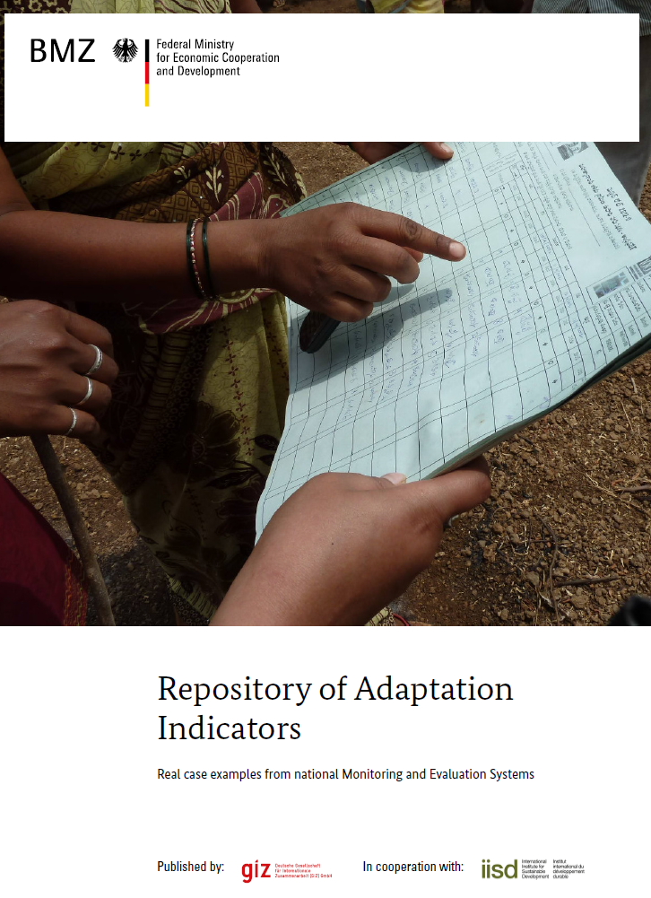
Repository of adaptation indicators at national level
Repository of indicators used in national adaptation M&E systems:
Focus: climate parameters, climate impacts, adaptation action, adaptation result
Adaptation relevance
Application example
Data needs & sources
Calculation
References
Illustrative rather than prescriptive: indicators need to fit the context!
Available on:
Notes:
To illustrate how adaptation indicators look like in practice GIZ & IISD (2014) compiled a comprehensive repository of adaptation indicators which have been proposed by the countries and organisations investigated in the comparative analysis study (cover on the bottom right). Because adaptation is context specific, for each indicator there is a detailed table describing why the indicator is of relevance to adaptation in the particular example. The repository aims to provide ideas for indicators and should not be taken as a complete list of ready-to-take adaptation indicators. Rather, indicators need to be tailored to the specific M&E context!
Repository of adaptation indicators (IISD & GIZ , 2014):https://gc21.giz.de/ibt/var/app/wp342deP/1443/index.php/knowledge/monitoring-evaluation-2/national-level-adaptation-me/repository-of-adaptation-ndicators/

Slide 80
Session 5:
Operationalisation
No. | Title | Key content
5 | Operationalisation | Reflect on institutions and resources you will work with Explore how you can synthesise data and information Make use of existing M&E systems, if suitable

Slide 81
Four building blocks for setting up a national adaptation M&E system
Focus of this session
Notes:
Further details can be found in GIZ’s national M&E Guidebook: https://gc21.giz.de/ibt/var/app/wp342deP/1443/wp-content/uploads/filebase/uploads/giz2015_Developing_national_adaptation_M&E_systems_-_A_guidebook.pdf

Slide 82
Institutional arrangements and resources
Multiple institutions are involved in operationalization
  Communicate the benefits of the M&E system and secure buy-in from institutions
  Clearly define and communicate the roles and responsibilities of each institution
Resources (financial, human) needed for data collection and processing
  What resources and capacities are available?
  Is operationalisation feasable in light of this?

Slide 83
Compiling and processing data&information
How will data be collected and put together?
  Data sharing arrangements need to be made
  Is quality assurance of data needed? Does data need to be processed or combined?
  The process is typically managed by a particular unit in charge of the adaptation M&E system
    In the Philippines for example this is done by the Climate Change Commission
Who is intepreting the data and producing knowlegde products?
  Building block 4 „Products“ deals with dissemination of the information

Slide 84
Synthesis across scales
The M&E system may involve combining information from multiple geographical levels (national, subnational, local)
Three practical approaches:
  Use standardized (i.e. the same) indicators at all levels
  → easy to aggregate, but limited meaningfulness because standardized indicators are not context-specific → Examples: Adaptation Fund, GCF, PPCR
  Use different indicators at every level which refer to predefined themes
  → Provides flexibility whilst still having a common framework → Examples: Mexico, South Africa
  No formal linkages at all, just synthesize any available information → Provides highest flexibility, suitable to facilitate learning
Source and further details: Leiter, T. (2015): Linking Monitoring and Evaluation of Adaptation to Climate Change across Scales: Avenues and Practical Approaches. New Directions for Evaluation, 147.
Notes:
Explanation on the limitations of standardized indicators: because adaptation is such a wide ranging topic area attempts to define indicators which still apply to this diversity often end with indicators on the lowest common denominator, for example „Number of beneficiaries“ or „Number of tools developed“. These standardized indicators are lacking any context-specific elements.
A more detailed description of the three avenues can be found in the article: Leiter, T. (2015): Linking Monitoring and Evaluation of Adaptation to Climate Change across Scales: Avenues and Practical Approaches. In: D. Bours, P. Pringle & C. McGinn (Eds.), Monitoring and Evaluation of Climate Change Adaptation: A review of the landscape. New Directions for
Evaluation, 147. Link: http://onlinelibrary.wiley.com/doi/10.1002/ev.20135/abstract (Users who do not have access may request a copy by emailing Timo.Leiter@giz.de)

Slide 85
Make use of existing M&E systems
Rationale:
Resources and capacities to collect data are limited
Unwillingness by some actors to launch new monitoring activities
  The use of existing data sources and/or M&E systems should be considered
Relevant questions:
What data and information are being already collected are relevant for M&E of adaptation?
Which already existing data sources refer to vulnerabilities, adaptation strategies, response measures, etc.?
What could be done to make other data relevant for adaptation M&E – potentially through adjustments or combinations?
Notes:
An example for a combination of data to enhance the relevance to adaptation is to combine data on traffic disruptions with data on the timing and ocurrance of extreme weather events. This would help to ientify in how far traffic disruptions are caused by extreme weather events.

Slide 86
Exercise
Your task:
Explore the Inventory of existing data and monitoring systems as shown in Exhibit 3.
Use Matrix 6 to answer the following 2 questions:
  Which monitoring / data system are of thematic relevance for adaptation M&E? In what regard are they relevant?
  Is it possible to make the monitoring / data systems potentially more useable / more relevant for adaptation M&E through some changes/adjustments?

Slide 87
Session 6: Products
No. | Title | Key content
6 | Products | Reflect on how you will present outputs and results of the M&E system Which formats are most appropriate for the target audience(s)
Notes:
Products refers to the packaging and dissemination of the M&E results, i.e. of the information generated by the adaptation M&E system.

Slide 88
Four building blocks for setting up a national adaptation M&E system
Focus of this session
Notes:
Further details can be found in GIZ’s national M&E Guidebook: https://gc21.giz.de/ibt/var/app/wp342deP/1443/wp-content/uploads/filebase/uploads/giz2015_Developing_national_adaptation_M&E_systems_-_A_guidebook.pdf

Slide 89

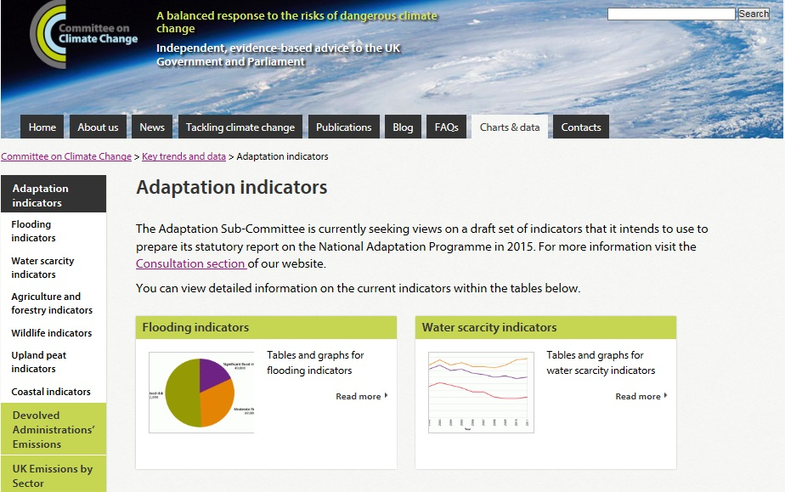
Outputs and Reporting
Kenya‘s National Communication to UNFCCC with adaptation component
  How are information presented in a way that best meets the intended purpose?
  Appropriate presentation of results is crucial!
Frequency and timing of outputs may depend on data availability.
Example: UK‘s web portal with adaptation indicators

Slide 90
Outputs and Reporting
  M&E purpose and target users determine how results should be presented.
  Timing and frequency of outputs should correspond to relevant decision making processes.
    Example: The Philippines
    For adaptive management purposes annual monitoring reports on the progress of the National Climate Change Action Plan are produced, which serve as a basis for government agencies to set their priorities and annual budgets.
    In addition, the release of evaluation reports (published every three years) is aligned with the consultation process for updating the National Development Plan.

Slide 91
Exercise
Your task:
You are asked to suggest specific outputs and reporting formats for the M&E systems in Khoresia and Zanadu
Review examples of different output formats (Exhibit 4) as a basis for your suggestions.
Refer back to the purpose and target users of the M&E systems you identified in Session 3 and make sure the suggested outputs are appropriate.
Use Matrix 7 for this task.

Slide 92
Module 6b
M&E for adaptation at project / programme level

Slide 93
Overview of Sessions
Module 6b
Secquence of sessions of module 6b (project level M&E)
No. | Title | Key content
9 | Planning implementation | Analysing the adaptation context Defining goals and objectives Identifying steps for implementation
10 | Development of a results framework | Get to know a results framework Define outputs and outcomes
11 | Development of indicators | Formulate adaptation-specific indicators for project outputs and outcomes Quality check indicators using the SMART rule
Notes:
Trainers, please refer to the Trainer‘s Handbook for further instructions about the sessions.

Slide 94
Session 9:
Planning the implementation of adaptation measures
No. | Title | Key content
9 | Planning the implementation of adaptation measures | Analysing the adaptation context Defining goals and objectives Identifying steps for implementation

Slide 95
Overview: M&E at project level
The principal aim of M&E is to demonstrate the benefits of adaptation.
M&E needs to be already considered during the planning and design phase of a project
Adaptation M&E at the project level does not require a completely different M&E system, but some adjustments to fit its characteristics.
Particular challenges for adaptation M&E at the project level are, among others:
  Designing meaningful adaptation indicators beyond the output level.
  Dealing with the uncertainty in climate and socio-economic development.
  Evaluating project results after the project lifetime.

Slide 96
GIZ’s Adaptation made to measure: Five-step model:
1. Describe the adaptation context
2. Identify the contribution to adaptation
5. Operationalise the M&E system
3. Developing a results framework
4. Define indicators and set a baseline
Notes:
The approach is described in detail in the GIZ guidebook Adaptation made to measure . The second edition (November 2013) is available in English, French and Spanish on AdaptationCommunity.net under Monitoring & Evaluation.

Slide 97
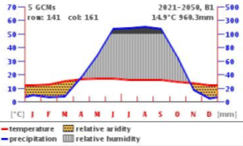
1. Describe the adaptation context
Analysing the context: What do we know about vulnerability?
  Which factors drive vulnerability?
  Who or what is most at risk?
  How do climate and non-climatic factors interact?
What do we know about climatic factors?
  Are historic records and projections available for key parameters like temperature and precipitation?
  Can we obtain further information on climatic development
  e.g. through online platforms like cigrasp.org
  Provides a feeling for adaptation needs
  Helps determining what to do

Slide 98
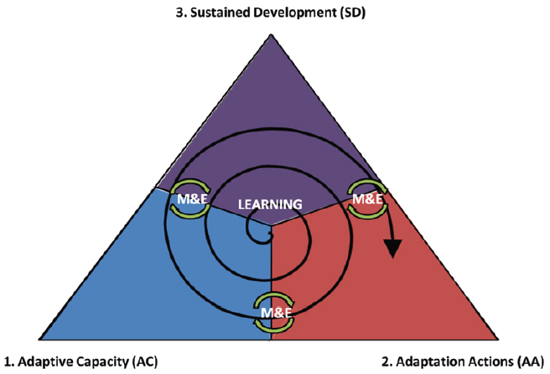
Three dimensions of adaptation which build on each other:
Adaptive capacity
  Building the capacity to adequately
  address climate change
Adaptation actions
  Reducing vulnerability to climate change
Sustainable development
  Securing development successes
  Helps determining the project focus
  Illustrates what can be monitored
  Supports identifying the indicators in step 4
2. Identify the contribution to adaptation
Source: WRI & GIZ, 2011
Notes:
Use examples for each of the three dimensions

Slide 99
3. Develop a results framework
Define:
  Based on steps 1 and 2, what are the anticipated results of the project?
Create a ‚theory of change‘
  Map how change is intended to be achieved
  Most commonly used: results chain or theory of change
  Make assumptions explicit
  Defines the logical connection of project activities, outputs, outcomes and objectives.
  Helps determining at which point within the results framework adaptation actiivties and reults of the project should be monitored.

Slide 100
Example of a results chain:
Village facing drought and soil degradation
Source: WRI & GIZ (2011)

Slide 101
4. Define indicators and set a baseline
Choose indicators
  Focus indicators on the crucial spots of the results chain or theory of change
  Check indicators along the SMART rule: Specific, Measurable, Attainable, Relevant and Time bound
  Together indicators need to reflect the contribution to adaptation
Set a baseline for each indicator
  Record baseline values for the chosen indicators (refer to step 1).
  Choose target values to be achieved by the end of the project.
  Indicators define what to measure.
  They do not necessarily provide an explanation of WHY changes occured.

Slide 102
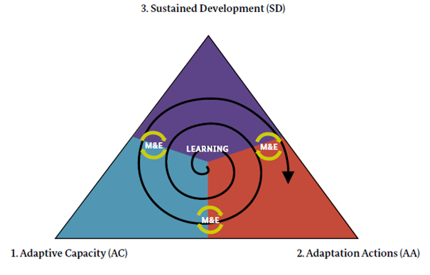
Example: Indicators for the 3 dimensions:
Agricultural yields in project area stabilised amidst a changing climate.
Farmers knowledge improved about drought resistant crops.
Irrigation schemes established and being utilised in project area.
Source: WRI & GIZ, 2011
Notes:
Key message:
The illustration examplifies how indicators in the 3 dimensions could look like.

Slide 103

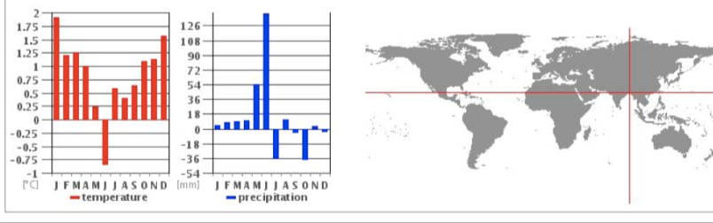
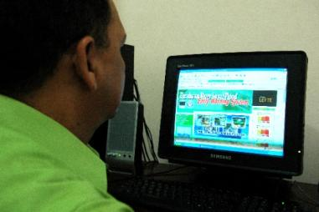
5. Operationalise the M&E system
Where does the data come from?
  How is the data being gathered? Who does the job with which resources?
How is the data being analysed and by whom?
  Responsibility for analysis, communication, data storage etc.
Knowledge management
  Connecting M&E results to project management
  Disseminating lessons learned beyond individual projects

Slide 104
RECOMMENDATIONS from evolving experiences:
Define clear and robust results chains (including relevant assumptions)
Reflect on how outcomes were really achieved in addition to looking at indicators alone
Ensure that M&E is really used for learning and improvements.
Avoid too many and too complex indicators. Ensure that indicators can really be measured.
Clarify responsibilities and provide resources (incl. finances and training) for the M&E.
Use as much as possible existing data sources and M&E structures.
In order to identify long-term and synergistic results of the project try to link to national level M&E systems that reflect the adaptation process over longer time-scales [if such a system is available, compare module 6a].
Source: Workshop Report „Tracking successful adaptation“ (GIZ, 2012).
Notes:
http://www.bonn-perspectives.de/en/dialogue-events/tracking_adaptation/results.html

Slide 105
Exercise
Context:
The government of Zanadu wants to take climate change into account when implementing its NDP
The adaptation measure drip irrigation technology is to be piloted on cotton farms in the West State of Zanadu
Your task
  Based on the information in Exhibit 4 and Exhibit 5, outline an implementation plan for the pilot measure of drip irrigation
  Address the questions in Matrix 8

Slide 106
Session 10:
Development of a results framework
No. | Title | Key content
10 | Development of a results framework | Get to know a results chain Define outputs and outcomes

Slide 107
Different types of results models:
Results models describe a way to logically map results of a project to understand how a project can bring about its intended objectives.
There are different types of results models:
Results Chain: linear chain of different categories:
Theory of change:
  Illustrates the relationship between project activities and results in a non-linear way. The approach is explained in GIZ‘s guidebook Adaptation made to measure.
Inputs
Outputs
Outcomes
Impacts
Notes:
The purpose of this slide is to explain that results chains are not the only possible method to illsutrate results. This also helps participants understand that Step 3 in Adaptation made to measure is basically what they do in session 10, just using a different underlying model.

Slide 108
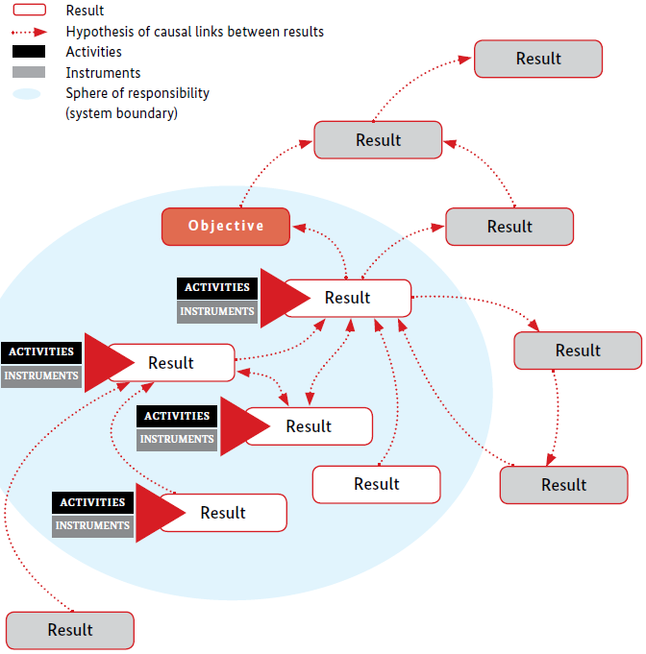
  Results model:
  Not a linear but a systemic understanding of development processes
  Key is “theory of change” = plausible assumptions about a change process
  Only one category: results (no distinction into outputs or outcomes)
Source: GIZ (2013)
Notes:
Key message: The GIZ Results Framework provides a tool for analysis of a comparably complex result network.

Slide 109
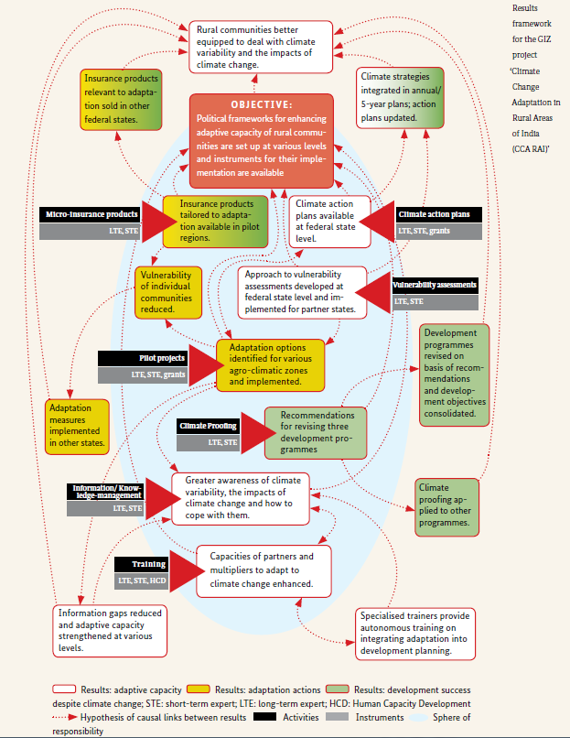
GIZ‘s results framework applied to an adaptation project in India.
Every box describes a result (no distinction is made between outputs and outcomes)
Arrows show how the results are connected
The blue shaded area denotes what can be directly influenced by the project
The colours correspond to the adaptation dimension (adaptive capacity, adaptation actions, sustained development)
Source: Adaptation made to measure (GIZ, 2013) p. 23.
Notes:
Key message:
The previous approach of a results framework is examplified here for a project in India. The goal ist not to understand / explain the complex network in detail but to highligh the different categories such as different activities (black boxes) leading to different results (bubbles in different colors).

Slide 110

Exercise
Context:
The MoA has defined three components for the implementation of the pilot project for drip irrigation:
  1: Awareness raising for the benefits of drip irrigation
  2: Assistance for farms to participate in the pilot including economic incentives
  3: Use of drip irrigation in 10 pilot farms and ongoing assessment of its benefits
Your task
  Formulate one outcome and two outputs for each component using Matrix 9.
  Articulate what assumptions are made about how each output leads to the associated outcome

Slide 111
Session 11:
Development of indicators
No. | Title | Key content
11 | Development of indicators | Formulate adaptation-specific indicators for project outputs and outcomes Quality check indicators using the SMART rule

Slide 112
Developing high-quality indicators
Overall, adaptation indicators of a project need to be able to clearly demonstrate the adaptation-specific results, i.e. in how far adaptive capacity has been increased or vulnerability been reduced
Adaptation indicators need to comply with the same quality criteria as general development indicators do, e.g. validity and reliability
During indicator formulation it should already be considered:
  How the indicator can be measured (calculation and data collection method)
  If the necessary data is already available (e.g. already gathered by government institutions/bureau of statistics) or if new data collection is necessary
  What (financial) resources and capacities are available

Slide 113
Key features of indicators
Indicators specify what to measure
Indicators can be quantitative or qualitative
Indicators should usually include:
  Baseline value at the beginning of the project
  Target value
  Time-horizon
  Regional reference
  Means of verification
Example: The area of irrigated farmland increases in district [name] from 10 ha in 2010 to 25 ha in 2015 (verification source: land-survey in project area).

Slide 114
The SMART rule for indicators and targets
Criteria for the selection of good indicators
S Specific: the indicator is valid and describes the underlying issue; indicator is precisely formulated.
M Measurable (practicability and objectivity): data obtained through reproducible methods independent from the individual collectors of the information.
A Attainable (referring to targets), Agreed by stakeholders (referring to indicators).
R Relevant: address an important issue for the users and related to the objective of M&E.
T Time-bound: a temporal reference is given so that progress can be measured during the course of implementation

Slide 115
What makes a good indicator?
SMART rule for validating quality of indicators:
Exemplified for goal: ‘food security ensured’
Specific: Does the indicator measure the respective result?
Counter example: ‘Annual yield’ (does not necessarily indicate food security)
Measurable: Is it possible to measure the indicator?
Counter example: ‘Happiness of people’.
Agreed: Is the indicator agreed upon by stakeholders?
Counter example: Important stakeholders disagree with an indictor
Relevant: Is the indicator closely linked to the goal?
Counter example: ‘No. of flights of international experts’.
Time bound: Is indicator related to a time scale?
Counter example: ‘Hunger crisis occuring’.

Slide 116
Excercise: Check if the indicators are SMART
In 6 pilot regions, two of three beneficiary representatives and two of three representatives of different governmental institutions confirm the adequacy of local adaptation measures for dealing with climate stresses and their relevance for up-scaling.
% increase in people with improved access to clean water supplies; and % increase of which are women.
% of people (by gender) in the county permanently displaced from their homes as a result of flood, drought or sea-level rise.
% of current delegated public service contracts in which vulnerability to climate change has been identified.
Notes:
OPTIONAL exercise
Instructions for trainers: Discuss in plenary if the criteria are SMART. In some cases it depends on information not available and assumptions have to be made. Instead of doing this in PowerPoint, you can also use FlipChart or other materials. Do 2-3 examples together to ensure that participants have understood how to do this as it is the content of the following exercise.

Slide 117
Indicators can address different elements of a results chain:
Annual income of small farmers per year.
Funds provided for training
No. of small scale dams under operation
Source: WRI & GIZ (2011)
Notes:
Key message:
This slide exemplifies how indicators could be formulated along the results chain as provided by the WRI/GIZ Guidance.

Slide 118

Standard indicator lists (Example from the Adaptation Fund Results framework)
GIZ position:
Indicator repositories useful for ‚inspiration‘.
Standard indicators need to be used with care due to very different contexts of adaptation projects.
Notes:
Standardized indicators are only one approach to aggregate adaptation across scales. For further approaches compare slide 84 on Synthesis (building block 3: Operationalization)

Slide 119

Indicator Factsheets
Example from Germany
Specifies:
Definition
Calculation
Data sources
Guidance for interpretation
Source: Schönthaler et al. (2010)
Notes:
Indicator Fact Sheet exemplifies an approach of documenting well-chosen indicators in a very systematic way. A more detailed description of the factsheet is psovided in the publication of the German Environment Agency (UBA): Establishment of an Indicator Concept for the German Strategy on Adaptation to Climate Change: http://www.umweltbundesamt.de/publikationen/establishment-of-an-indicator-concept-for-german

Slide 120

Exercise
Context:
The intended outputs and outcomes of the components defined in Session 10 form the basis for the development of indicators
Your task
  Develop for each output and outcome and adequate indicator and record them in Matrix 10
  Check whether your suggested indicators comply with the SMART rule described in Box 4.

Slide 121
Session 13:
Roadmap development
No. | Title | Key content
13 | Roadmap development | Transferring knowledge to real work context Define next steps

Slide 122
Exercise
Context and task
The development of a results chain including indicators in practice will be confronted with various challenges.
You are not advisor in Zanadu anymore but invited to reflect the situation in your real working environment.
Prepare a roadmap on how to enhance capacities and conditions for development of the adaptation M&E system.

