Slide 1

Integrating climate change adaptation into development planning
A practice-oriented training
based on an OECD policy guidance
Trainer team:
XX
XX
‘Date’

Slide 2
Imprint
As a federally owned enterprise, GIZ supports the German Government in achieving its objectives in
the field of international cooperation for sustainable development.
Published by
Deutsche Gesellschaft für
Internationale Zusammenarbeit (GIZ) GmbH
Dag-Hammarskjöld-Weg 1-5
65760 Eschborn, Germany
T +49 61 96 79-0
F +49 61 96 79-1115
Contact
E climate@giz.de
I www.giz.de
GIZ Climate Protection Programme
Responsible
Ilona Porsché, GIZ; Michael Scholze, GIZ
Authors
Jennifer Frankel-Reed, Barbara Fröde-Thierfelder, Ilona Porsché
Contributions by
Alfred Eberhardt, Mark Svendsen, Lea Herberg, Martin Baumgart,
Udo Höggel, Michael Scholze, Alexander Fröde, Nana Künkel, members of the OECD Task Team on Climate Change and Development Co-operation
Coordination
Ilona Porsché, Barbara Fröde-Thierfelder
Photo credits
© GIZ/Climate Protection Programme and Claudia Altmann,
Dirk Ostermeier, Florian Kopp, Georg Buchholz, Ira Olaleye,
Jörg Böthling, Manuel Hauptmann, Markus Kirchgessner,
Michael Gajo, Michael Netzhammer, Nicole Herzog, Peter Korneffel, Richard Lord, Robert Heine, Rüdiger Behrens, Ulrich Scholz,
Ursula Meissner, Uwe Rau
Design
Ira Olaleye
Articles written by named authors do not
necessarily reflect the views of the editors.
Notes:
Terms of use
This training material is property of GIZ. You may not alter this slide, add or delete any content nor change the master slides. The GIZ logo may not be removed or displaced nor may any other logo or information be placed in the header or footer area of the master slides. Before adding any information to this training mazerial, please contact climate@giz.de.

Slide 3
Terms of use
This training module has been developed by GIZ on behalf of BMZ.
If you would like to adapt this presentation to your needs, please respect the following terms of use:
  The slide master and imprint are mandatory. They may neither be altered nor removed from the presentation.
  The GIZ logo must not be moved or removed. No other logos or further information may be placed in the header or footer area.
  If you wish to add your own content, please use the blank slide at the end of this presentation. (You can copy it to add slides.)
  If you would like to make substantial changes to the content of this presentation, please contact climate@giz.de.

Slide 4
Overview
  About the OECD guidance
  Objectives of the training
  About the Harvard case method
  Presentation of material

Slide 5

OECD policy guidance on Integrating Climate Change into Development Co-operation (1)
  Jointly developed by Environment & Development
  Cooperation Committees at the OECD in 2009
  Targeted at policy makers and practitioners in
  donor countries and developing countries
  In line with Paris Declaration on Aid Effectiveness, to align support with the strategies, institutions and procedures of partner countries
OECD policy guidance:
  Audience – aimed at agencies and developing countries, takes the perspective of developing countries, in line with Paris Declaration principles.
  Format – two part guidebook:
  1) the challenge,
  2) mainstreaming guidance into a) national, b) sector,
  c) project and d) local level policy processes.
Download: www.oecd.org/dataoecd/0/9/
43652123.pdf

Slide 6
OECD policy guidance on Integrating Climate Change into Development Co-operation (2)
Objectives
  Promote understanding of climate change and its impacts
  Define appropriate entry points for integrating adaptation
  to climate change into development co-operation activities
  Assist developing country partners in their effort to reduce
  their vulnerability
Notes:
CC and adaptation challenge:
CC is a complex issue that needs to be understood, including the possible threats or adverse effects
→ reduction of complexity
Solutions are manifold but practice shows: top-down solutions are often not effective
→ adaptation needs participatory approaches, skilled and transparent communication of threats and possible solutions
Adaptation is a multi-level and cross-cutting issue,
→ decisions need to facilitate and moderate competing interests and development objectives
No need for new tools
→ but wise application of existing instruments
→ learn from experiences

Slide 7
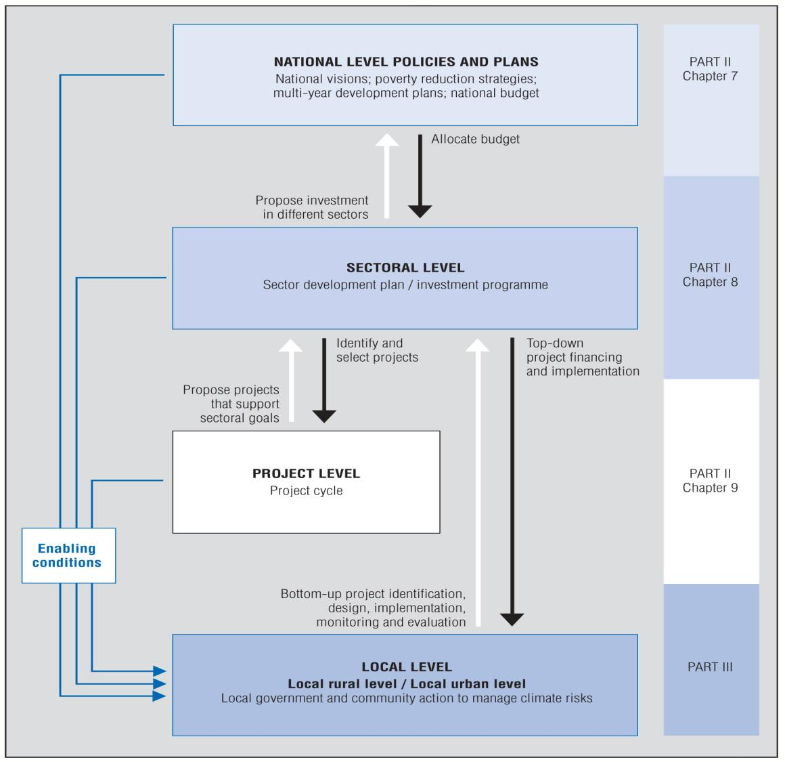
OECD guidance (3)
Source: OECD policy guidance
Notes:
The guidance is structured along 4 major entry points:
national level
sectoral level
local level
project level
The training takes up all 4 entry points,
the key modules 3 – 6 work at sectoral level.
‘Entry points’: points within policy cycle where climate
change risks need to be considered and adaptation
can be integrated.

Slide 8
The training
  Aim: to enhance capacities among development practitioners
  in taking action on climate change adaptation
  Developed by GIZ Climate Change Task Force
  on request of OECD Climate Task Team
    with support from BMZ
    in close cooperation with OECD and cooperating experts
  Test training phase: October 2009 – June 2010
  Pilot phase: July 2010 – January 2011

Slide 9


Learning objectives of the training
  Understand what climate change is, and how
  it is interlinked with development co-operation
  Understand entry points for ‘adaptation’
  in policymaking, planning and programming
  Learn about systematic steps aiming at defining
  concrete adaptation options at national, sector,
  local and project level, and according necessary
  institutional capacities to carry out a change process
  Learn about relevant climate information

Slide 10
The modules
Additional to Guidance
  M 1 – Apply a climate lens
  M 2 – Interpret climate data
  M 3 – Assess vulnerability
  M 4 – Identify adaptation options
  M 5 – Select adaptation measures
  M 6 – Develop an M&E-framework
  M 7 – Develop institutional capacity
  M 8 – Local climate stresses, vulnerability, resilience
  M 9 – Take action at local level and beyond
  M 10 – Integrate adaptation into the project cycle
  Action Learning Exercises
4-step approach
Notes:
» For description of modules, see introduction in Training Manual
Select modules according to training program
M1 Apply a climate lens
Identify the relevance of climate change to a policy, programme, plan or project.
M2 Interpret climate data
Understand how to interpret and use different standard climate data sources.
M3 Assessing vulnerability
Identify factors contributing to vulnerability in a system. Review past and current climate, look for thresholds of vulnerability.
M4 Identify adaptation options
Identify a range of adaptation options to adjust or improve planning and management. Brainstorming.
M5 Select adaptation measures
Evaluate and prioritize options using selected criteria. OECD suggests effectiveness, costs and feasibility. Others can be added
M6 Develop an M&E-framework
Develop elements of a monitoring and evaluation framework for adaptation.
M7 Build institutional capacity
Identify institutional capacities needed to deal with adaptation as a continual change process.
M8 Local climate stresses, vulnerability, resilience
Identify local information on climate change vulnerability.
M 9 Take local action
Identify action at the local level and how it links to sub-national, national and other actors.
M 10 Integrate adaptation into the project cycle
Identify key steps to integrate adaptation according to the various steps of the project cycle.
4-step approach is closely related to the GIZ tools

Slide 11
Harvard case method
What?
  Intensive examination and discussion of a particular
  case of practical relevance to trainees
  In this training: fictitious case ‘Zanadu’
How?
  Participants explore the given case and develop
  conclusions independently
  trainers offer support on demand
Why?
  Supports learning success through practice-oriented
  interactive exercises
  Encourages to act and make decisions under uncertainty
Image source: ????

Slide 12
The training sequence per module
Trainers
  Input
    Theoretical frame
    Introduction to case work
  Case work
  Presentation
  Debriefing discussion
  and reflection phase
Participants take role of experts and carry out case work
Facilitated discussion relating experience to daily work
Notes:
Highlight that main focus are case work and reflection session
For a detailed description of the different steps and their implications
for participants and trainers, see Trainers Handbook Chapter 3.3.

Slide 13

Material for training
  Training Manual gives all necessary information
  for each module‘s case work
    Context: baseline situation, problems faced, challenges arising,
    institutional set-up, etc.
    Instructions to case work: detailed instructions on role of
    case work experts and which information should be used
    Your task: step by step instruction how to do the case work
    Information display (exhibits, boxes, tables etc.)
    Matrixes to guide your work
  Handouts
    provide learning points
    provide references
    will be distributed after each module
Notes:
» Add information on
documentation of the workshop
other information you offer to share

Slide 14

Agenda

Slide 15
Title
Text
This slide is not part of the original version of the training material. It was added by [please insert institution].

