Slide 1



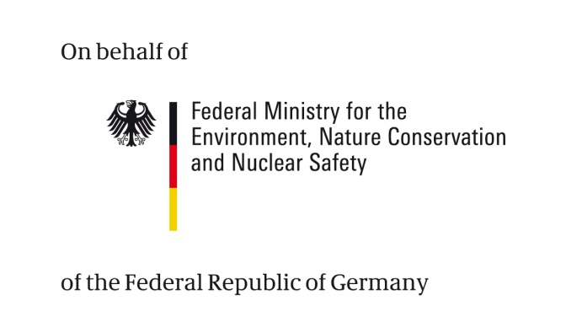

Understanding Climate Science
Notes:
Hints
For a start
Ask the participants when in their normal working life they need climate information. Do this as a brainstorming on flip chart or cards.
The main message is that we need climate information in three areas: to define key challenges as well as strategic options and when selecting technical measures.
A quote to start
Climate changes do not occur without reason. Climate Science offers explanations for past changes which allow for conclusions about the consequences that future climate changes can have. It is important to understand causes and effects, to be able to estimate how human impacts influence the climate system.
(own translation from Rahmstorf/ Schellnhuber 2007).

Slide 2


Imprint
As a federally owned enterprise, GIZ supports the German Government in achieving its objectives in the field of international cooperation for sustainable development.
Published by
Deutsche Gesellschaft für
Internationale Zusammenarbeit (GIZ) GmbH
Dag-Hammarskjöld-Weg 1-5
65760 Eschborn, Germany
T +49 61 96 79-0
F +49 61 96 79-1115
Contact
E climate@giz.de
I www.giz.de
Responsible Michael Hoppe, GIZ
Author Barbara Fröde-Thierfelder
Coordination Barbara Fröde-Thierfelder
Photo credits
© GIZ/Climate Protection Programme and Claudia Altmann,
Dirk Ostermeier, Florian Kopp, Georg Buchholz, Ira Olaleye,
Jörg Böthling, Manuel Hauptmann, Markus Kirchgessner,
Michael Gajo, Michael Netzhammer, Nicole Herzog, Peter Korneffel, Richard Lord, Robert Heine, Rüdiger Behrens, Ulrich Scholz,Ursula Meissner, Uwe Rau
Design Ira Olaleye
Articles written by named authors do not necessarily reflect the views of the editors.
The Training « Integrating climate change adaptation into development planning» has been developed by the GIZ Climate Protection Program, on behalf of the Federal Ministry for Economic Cooperation and Development (BMZ)
This module, part of the existing training “Integrating Climate Change Adaptation into Development Planning”, has been revised with additional financing from BMU.

Slide 3
Terms of use
This training module has been developed by GIZ on behalf of BMZ and BMU.
If you would like to adapt this presentation to your needs, please respect the following terms of use:
  The slide master and imprint are mandatory. They may neither be altered nor removed from the presentation.
  The GIZ logo must not be moved or removed. No other logos or further information may be placed in the header or footer area.
  If you wish to add your own content, please use the blank slide at the end of this presentation. (You can copy it to add slides.)
  If you would like to make substantial changes to the content of this presentation, please contact climate@giz.de.

Slide 4
Overview
  Definitions
  Recap on the basics
    Greenhouse effect
    Carbon cycle
    Emissions – sources of the anthropogenic climate change
  Scientific analyses
    Emission scenarios (IPCC SRES 2001 – IPCC AR5)
    Global climate models
    Regional climate models
  Information needs for decision-making
  Sources of uncertainty
  Dealing with scepticism
  Interpret climate information
  Reflection
Exercise
Case work
Notes:
Hint
Modify this slide to suit the selected contents you will work on. This version includes all possible slides and exercises.

Slide 5
Definitions
  Weather
  Climate
  Climate variability
  Climate change
  the state of the atmosphere at a given time with regard to temperature, rainfall, wind, etc.
  the average weather over a period of time (e.g. 30 years) in a region
  variations in the mean state of the climate, generally natural/historic
  (IPCC 2007): change in climate over time, whether due to natural variability or human activity (UNFCCC): a change of climate which is attributed directly or indirectly to human activity that alters the composition of the global atmosphere and which is in addition to natural climate variability observed over comparable time periods.
Notes:
Hint
Do these definitions together with participants: ask them first and then reveal
Add.info:
To compare weather forecasting and climate projection you can use a nice example:
Imagine a pot with boiling water. Weather forecasting would give indications on where the next bubble will appear. In comparison, a climate statement would be 'the mean temperature of boiling water under normal pressure conditions is 100°C. In high altitudes (with lower air pressure) water boils with 90°C'.
(cf. Rahmstorf/Schellnhuber: Der Klimawandel. 2007)

Slide 6
Recap on the basics

Slide 7
The greenhouse effect
Source: Climate Change 2007. The Physical Science Basis. IPCC Working Group 1. Contribution to AR4
Notes:
Main message:
GH effect by the Earth’s atmosphere is natural effect and necessary for life on Earth
Additional GHG emissions change the atmosphere’s composition and lead to global warming
Explain
Radiation in and out as described on the graph
GH consists of the GHG which work like a shield
Without the GH temperatures on Earth would be -18°C in mean (based on the radiative balance, calculated by the Stefan-Boltzmann-Law for more information see next slide)
Warming beyond radiative balance due to GH: +33°C – which mean that average temperatures on Earth are around 15°C
Changes in the atmosphere= increase in warming
Hints
Give example for 'greenhouse' from real life, e.g. sitting in a overland bus behind the window with the inside heating up

Slide 8
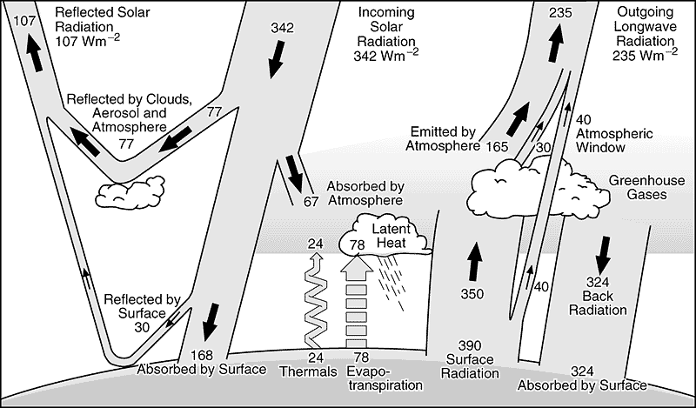
The radiative balance
Source: IPCC. 2001
Notes:
ONLY if time – advanced
Main message
Climate on Earth is a physical process
Explain
The following factors have an influence on the Earth’s climate.
The radiation comes from the sun. Changes in the sun’s own processes or the orbital movements have an influence in the long-term perspective but do not account for the recent climate changes (see add.info below).
Part of the radiation is directly reflected back without absorption, this is called albedo. The Earth’s albedo is influenced by cloud cover as well as the surface colour. Dark colours (e.g. forest, bare land) reflect less than light colours (e.g. ice). Example: agricultural land reflects 10%; ice cover reflects 90%.
The Earth’s re-radiation is proportional to the Earth’s temperature (the radiative balance).
The radiative balance of a body (e.g. the Earth) relates to a physical law called Stefan-Boltzmann (also called Stefan’s law). (for more info see add.info below)
Radiative forcing = the change in the balance between solar radiation entering the atmosphere and the Earth's radiation going out. Positive radiative forcing tends to warm the surface of the Earth while negative forcing tends to cool the surface. GHG emissions lead to positive radiative forcing.
The Earth’s greenhouse (gas shield made from greenhouse gases) absorbs and reflects the Earth’s re-radiation. Without the GH temperatures on Earth would be -18°C in mean (based on the radiative balance), temperatures increase due to GH by 33°C – which means that average temperatures on Earth are around 15°C.
The atmospheric and oceanic circulations distribute the absorbed energy.
Add.info
@ stefan-boltzmann law: This law was detected by the end of the 19th century by two physicians Stefan and Boltzmann. It states that the total energy radiated by a body is directly proportional to the body's own temperature.
Applied to the case of the planet Earth: When you enter the solar radiation arriving on Earth (-30% for the albedo, how much of the solar radiation that hits the planet gets scattered back into space without absorption ) into the Stefan-Boltzman equation, the Earth’s temperature can be calculated as, theoretically, -18 °C.
However, radiation from the surface of the Earth is partially absorbed by GHG in the atmosphere and re-radiated in all directions, part of it back to the Earth’s surface. The Earth’s surface is thus hit by (a) solar radiation and (b) long-wave re-radiation. More radiation arrives at the Earth’s surface, and the surface has to emit more radiation to achieve the radiative balance. As a result, the Earth's actual average surface temperature is about 15 °C. The natural greenhouse effect is thus responsible for the difference of 33°C. (cf. Rahmstorf 2002: http://www.pik-potsdam.de/~stefan/leser_antworten.html)
@ sun: The Earth is tumbling around the sun. Its exposition towards the sun is changing according to the so called Milankovitch Cycles. These, however, in the short term, will have a major impact not on the global climate but on seasons. In the long term, these changes in the Earth’s exposition towards the sun, influence the alternation of ice ages and interglacials.

Slide 9
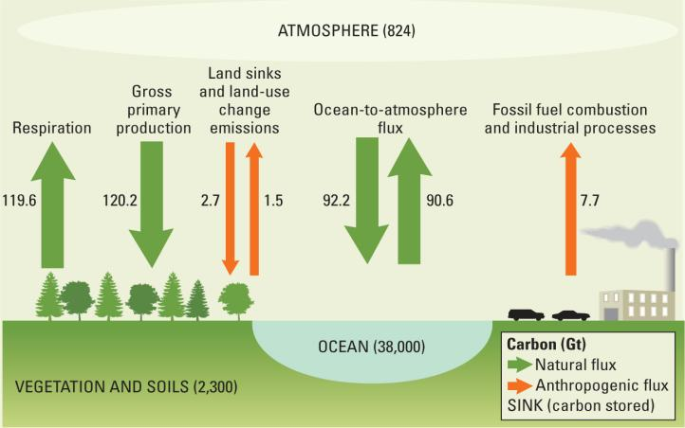
The carbon cycle: stocks and flows
Source: World Development report. 2010. Focus A: The science of climate change. Adapted from IPCC. 2007
Notes:
Main message
The carbon cycle is one of the key processes in the Earth’s system (others are e.g. the water cycle)
Explain
Sources: Fossil fuel burning and deforestation add previously stored carbon to the system (see below if time)
Sinks: Biomass, oceans (see below if time)
If time
Elaborate on the capacity of oceans to sequester carbon, however, if they are warming up they will turn into sources leading to a vicious circle of global warming: e.g. changes in the atmosphere > higher temperatures > ocean warming > release of more CO2

Slide 10
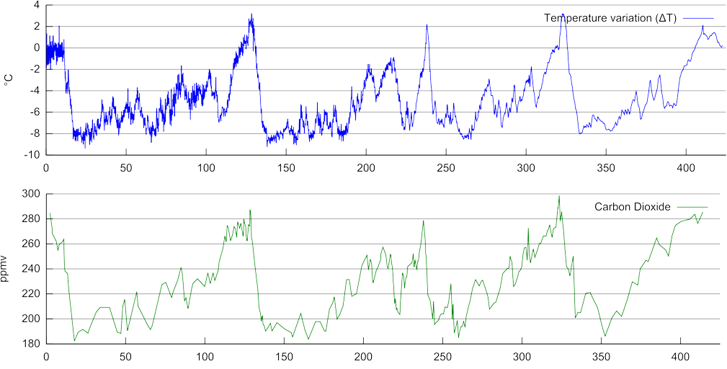
Dealing with scepticism: is the recent climate change natural or anthopogenic? -I
°C
  Source: http://ema.bonn.de/klima/bilder/800px-Vostok_Petit_data_svg.png
ppmv
today -> tousands of years ago
Notes:
Main message
Warming correlates with CO2-concentration in the atmosphere
Explain
CO2 and temperature are interrelated: changing temperatures influence the CO2 concentration, changing CO2 concentration influence the temperature
The CO2-temperature-correlation relates to a physical law called Stefan-Boltzmann (also Stefan’s law) which explains the radiative balance. (for more info see add.info note page slide 'radiative balance')
The changes between ice ages (cold periods) and interglacials (warm periods) relate to the changes in the Earth’s orbital movements (the so-called Milancovitch Cycles, for more info see add.info note page slide 'radiative balance')
Ice core drills in the Antarctica are the source of information are (see add.info below)
Hint
Note that this graph shows the time line from right (past) to left (recent). The next slide shows it the other way round.
Add info
@ the ice cores: contain air bubbles , i.e. snapshots of the composition of the atmosphere at the time the ice accumulated. Through analysis, concentrations of greenhouse gases (dating back thousands of years) can be obtained with a high level of confidence.
@ radiative balance: For a detailed graph on the Earth’s radiative balance see http://www.grida.no/publications/other/ipcc_tar/?src=/climate/ipcc_tar/wg1/fig1-2.htm

Slide 11
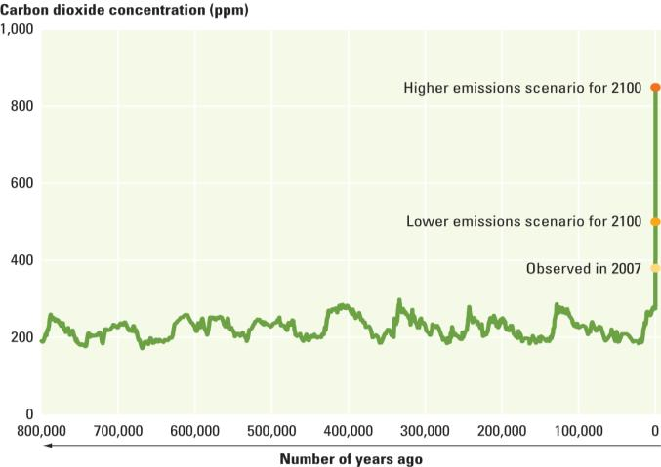
Dealing with scepticism: is the recent climate change natural or anthopogenic? -II
02/2012:
393,65 ppm
tousands of years ago <- today
Sources: World Development report 2010. p 4;
http://www.esrl.noaa.gov/gmd/ccgg/trends/
Notes:
Main message
CO2 concentrations in the atmosphere increase:
Explain
Co2 concentration increased from approximately 280 parts per million (ppm) in pre-industrial times to close to 394 ppm today (National Oceanic and Atmospheric Administration's (NOAA) Earth Systems Research Laboratory).
Present CO2 concentrations are higher than any time in at least the last 650,000 years (IPCC 2007)
All other GHG increase as well

Slide 12
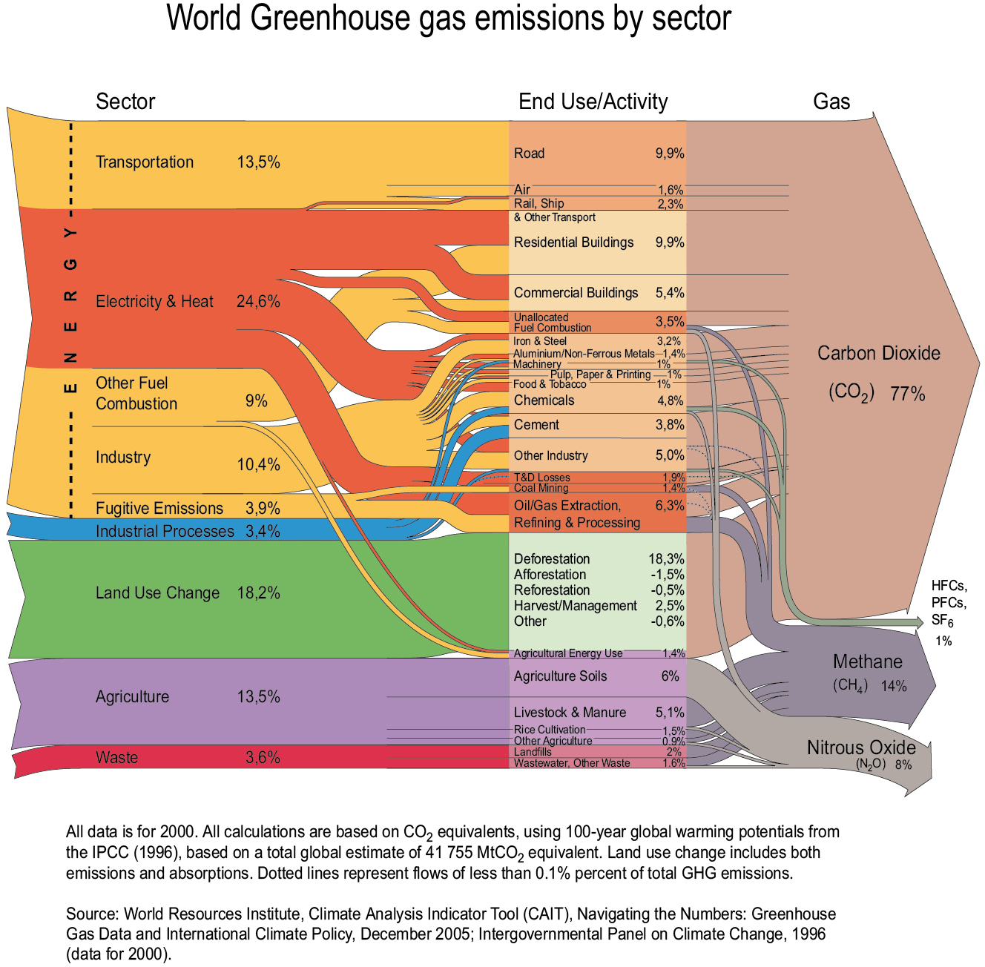
Drivers of global warming: Emissions
World GHG emissions by sector (2000, CO₂ eq.)
Energy total: 61,4%
  Source: http://maps.grida.no/go/graphic/world-greenhouse-gas-emissions-by-sector1
Notes:
Main message
Recent climate change is due anthropogenic resource use,
This resource is linked with our choice of lifestyle
Explain
Different sources of emissions,
Apart from energy use a vast part comes from land use change and logging (LUC is often due to an extension of agricultural land) – to compare: More than the annual emissions of the world’s entire transportation sector
Draw attention to different GHG (main influence: CO2, CH4, N2O). Explain that they have a different lifespan in the atmosphere and for comparison reasons are calculated in CO2 equivalents
Data from 2000: not because we are too lazy to find recent data but data availability is a big issue
Hint
Highlight sectors of specific interest to your participants

Slide 13
Effects of climate change: overview
Climate stimuli
Impacts
  change in temperature patterns
  change in precipitation patterns
  increase in extreme weather events (storms, heat waves...)
  melting of pole caps, glaciers and permafrost
  sea-level rise
  droughts
  droughts
  change of natural systems’ productivity
  increase in forest fires
  exceptional floods
  loss of land
  health issues
  ...
  food insecurity
  loss of income
  ...
-> vulnerable livelihoods
-> economic damages
Notes:
ONLY if time
NOTE: when you use this slide in the frame of the 10 CCA-training modules, please replace 'Climate stimuli' by 'Climate signals' and 'Impacts' by 'Effects' – the meaning is the same but participants might be confused
Main message
There is a logical chain from climate stimulus to impact
Explain
In a logical chain things are not clearly distinguishable, e.g. some see drought as a climate stimulus, others as impact
There are direct and indirect impacts e.g. increase in heat and reduced water availability in the growing season lead to harvest loss and subsequent food insecurity, loss of income…
Make sure that participants see how CC adds to existing development challenges, and which challenges are new
Hint:
Select one example to explain
e.g. increase in extreme rains -> washes away rural infrastructure -> people can no longer transport their goods to the market: loss of income and increase in poverty
e.g. hotter temperatures and less rain = increase in droughts -> higher risk of forest fires -> damage of forest value, threat to livelihoods…
Add. Info
For more detailed information on selected climate change effects and their likelihood see page 51ff in http://www2.gtz.de/dokumente/bib-2009/gtz2009-0175en-climate-change-information.pdf

Slide 14
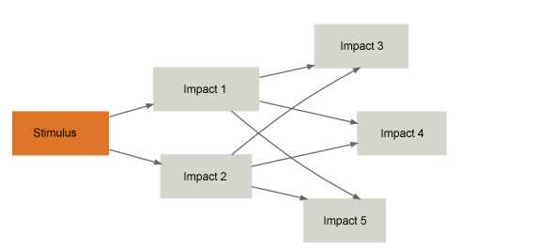
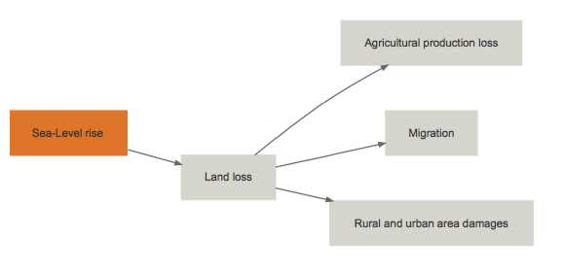
Effects of climate change: impact chains
Notes:
Main message
There is a logical chain from climate stimulus to impact
Explain
Impact chains support the analysis of climate change impacts
ci:grasp provides various impact chains
However, most impact chains are not unilinear but complex (show graph on click). It is therefore important to determine entry points for action precisely within the objectives of your analysis

Slide 15
Scientific analyses

Slide 16
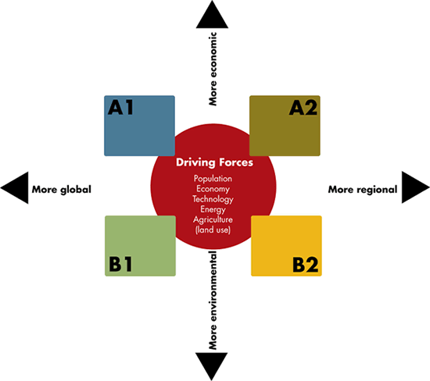
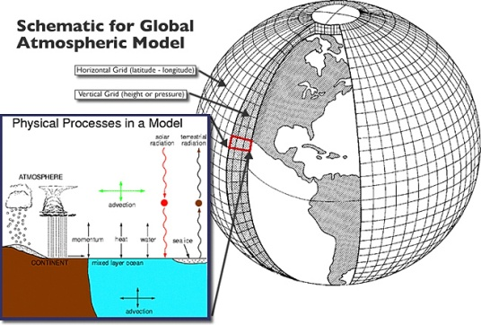
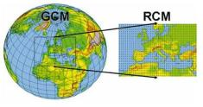
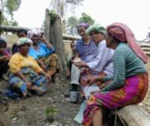
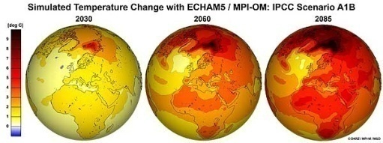
Scientific approach
Emission scenarios
Climate models
23 GCM in IPCC Downscaling
Local knowledge
and experience
Climate scenarios
Impact / vulnerability
analysis
Source: http://upload.wikimedia.org/wikipedia/commons/thumb/4/4a/Global_Atmospheric_Model.jpg/350px-Global_Atmospheric_Model.jpg ; http://www.wmo.int/pages/themes/climate/images/figures/ClimateModelnesting.jpg
http://www.dkrz.de/bilder/bilder-klimaforschung/T2M_A1B_2030_2060_2085ano1961-1990_globe_en.jpg
Notes:
Main message
Scientific analysis happens at different levels
Explain
Different steps
Emissions scenarios are based on narrative storylines describing how the socio-economic future might unfold and calculate how these development paths would influence future emissions of GHGs (IPPC, SRES 2000).
Global Climate Models (GCMs) represent the interrelations between the elements of the earth system (surface, ocean, atmosphere, cryosphere).
Regional Climate Models (RCM) build on the results of GCMs and work at a higher geographical resolution.
The result of GCMs and RCMs running information from the emission scenarios are climate scenarios (not emission scenarios!). This are plausible representations of how e.g. temperature, precipitation or other climatic parameters are expected to change in the investigation area.
The effects such climate scenarios could have on societies and ecosystems are further investigated in impact or vulnerability analysis.
Besides the scientific approach there also is a large amount of local knowledge available in regard to climate variability and adaptation to it. This bottom up information is an important complement, especially in impact .
The next slides will focus on scientific approach
Hint:
Use this slide as an overview , and go into more detail with the next slides

Slide 17
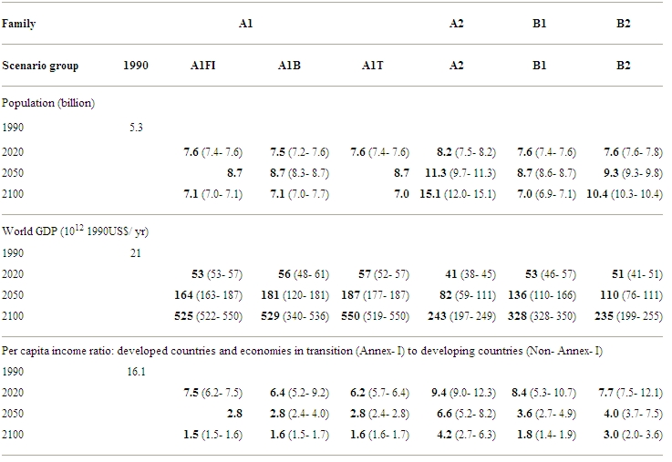
Emissions scenarios
– different storylines for our future
Underlying assumptions (IPCC SRES 2001)
A1 Fl
A1 B
A1 T
Source: www.bom.gov.au/info/climate/change/gallery/images/74.gif
http://www.grida.no/publications/other/ipcc_sr/?src=/climate/ipcc/emission/008.htm
Notes:
Main message
There are different possible futures.
The decisions on the pathway are taken today.
Explain
Emission scenarios are alternative images of how the future might unfold.
Each scenario is quantification of the underlying storyline – a consistent set of assumptions of driving forces, e.g. economic and environmental development, technological change and population growth in the long-run (for a selection of primary driving forces see table right). The storylines include scientific information (year 2000) but do not assume activities under UNFCCC.
It is very unlikely that the future occur as described in one of the scenarios – they are rather mental models/guard rails that help us to get a better understanding of the range of possibilities.
Applied in climate change research, scenarios help to
analyse the response of the Earth system to human activities (climate models)
explore what changes in policy, technology etc. would be required to keep emissions at a certain level.
There are 40 scenarios grouped in families (with A1 having 3 sub-sets according to different energy uses) developed in the IPCC Special report on Emission Scenarios 2001.
In 2000, all were considered equally sound
They have been used in the 4th IPCC AR.
The 5th IPCC AR will be based on new scenarios in order to reflect new insights, information and observations. The new scenarios, called RCPs (Representative Concentration Pathways), are not based on CO2 emissions but on changes in the radiative forcing, which means that effects of climate change as well as human activities leading to relevant changes (e.g. land cover) are also included. The information given by the scenarios will by dynamic (projection for different time horizons) and not static as in AR 4 (changes by 2100).
Hint
If you don‘t do the following exercise, ask participants to read the scenario descriptions from the glossary

Slide 18
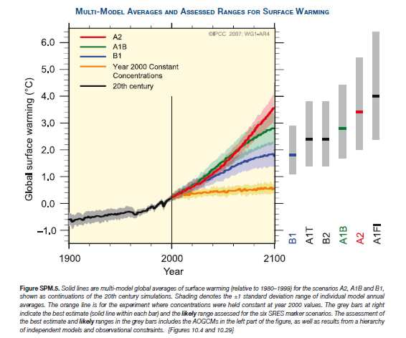
Emissions scenarios
– different storylines for our future
Variability between individual model outputs/scenario
Variabilitiy between scenarios
Source: IPCC 2007
Notes:
If you also show slide 36 make reference
Main message
There are different possible futures.
The decisions on the pathway are taken today.
Explain
Emission scenarios are alternative images of how the future might unfold.
The major part of the variability shown in the graph stems from the different underlying emission pathways and not from differences between models

Slide 19
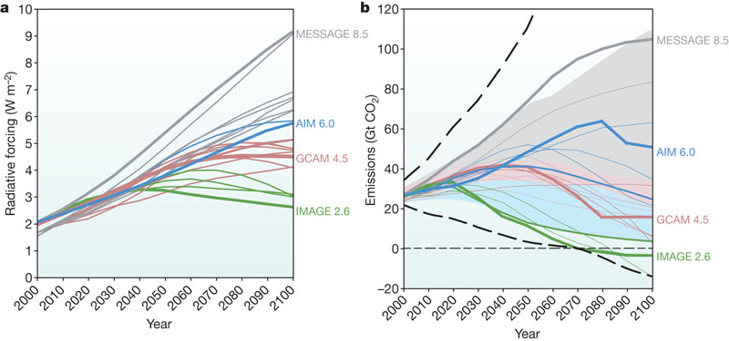
Representative Concentration Pathways
- part of the development of new scenarios
(a) Changes in radiative forcing (relative to pre-industrial conditions)
(b) Energy and industry CO₂ emissions for the RCP candidates
  Source: RH Moss et al. Nature 463, 747-756 (2010)
Notes:
ONLY if time
Main message
The RCP (representative concentration pathways) constitute the beginning of the process of developing new scenarios for the 5th IPCC AR
The question to explore is 'what are the ways in which the world could develop in order to reach a particular RCP?'
Explain
There are four main RCPs by different working groups
The RCPs are not new fully integrated scenarios but focus on the key factors influencing radiative forcing (not land-use change and mineral dust), i.e. the change in the balance between incoming and outgoing radiation to the atmosphere caused by changes in atmospheric constituents, such as carbon dioxide
In a parallel process socioeconomic concepts are being developed to complement the RCPs. The Integration is planned for 2012
NEW: RCPs also consider human responses (mitigation, adaptation) instead of the traditional 'no climate policy' scenarios.
Add. Info
Since 2001 climate models have become more comprehensive, incorporating the oceanic and terrestrial carbon cycle, aerosols, atmospheric chemistry, ice sheets, dynamic vegetation. As physical processes can be modelled more precisely, more detailed information is required on emission scenarios, along with higher resolution data.
(a) Bold coloured lines show the four RCPs; thin lines show individual scenarios from approximately 30 candidate RCP scenarios that provide information on all key factors affecting radiative forcing and the larger set analysed by IPCC Working Group III during development of the Fourth Assessment Report
(b) The range of emissions in the post-SRES literature is presented for the maximum and minimum (thick dashed curve) and 10th to 90th percentile (shaded area). The blue shaded area corresponds to mitigation scenarios; grey shaded area corresponds to reference scenarios; the pink area represents the overlap between reference and mitigation scenarios.

Slide 20
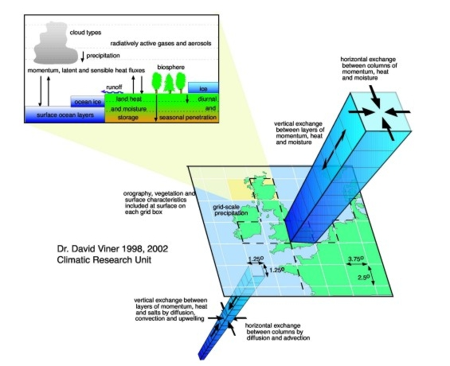
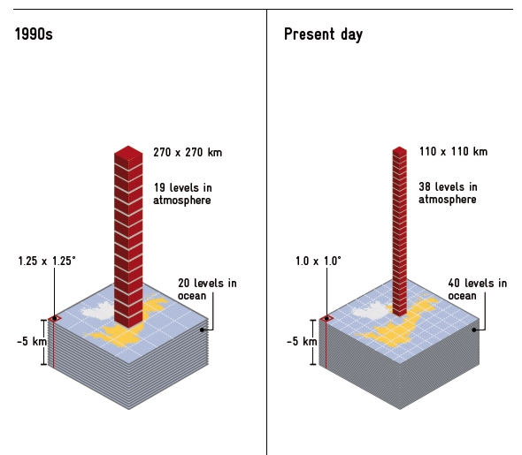
Global climate models/ general circulation models
Sources: www.wmo.int/pages/themes/climate/images/figures/Climatemodelresolutions.jpg
ttp://www.ipcc-data.org/ddc_gcm_guide.html ,
Notes:
Main message
GCM are representations of the Earth’s system – not portrait pictures
Different outputs are not because scientists have made mistakes but because of the complexity and dynamic of the Earth’s system. The different modeling approaches lead to different results.
Explain
A climate model aims to describe climate behavior by integrating a variety of fluid-dynamical, chemical, or even biological equations in the atmosphere, oceans, land and cryosphere.
Information on those processes are either derived directly from physical laws (e.g. Newton's law) or constructed by more empirical means (e.g. mathematical discretisation).
To 'run' a model, scientists divide the planet into a 3-dimensional grid, apply the basic equations, and evaluate the results (graph left). Depending on computer power, the analysis has been constantly refined (graph right)
General circulation models depict components. Atmosphere-ocean coupled general circulation models (AOGCM) with the addition of other components (such as a sea ice model or a land model) are the basis for a full climate model. However, they are often nearly as hard to analyse as the real climate system.
23 different models were taken into consideration for the latest IPCC assessment reports. These vary according to the accentuation of the physical processes represented, and in terms of the grid resolutions.
Global Climate models provide information on changes in quantities averaged over long periods of time (30 years) – GCM forecasts for short periods have no real meaning.
Challenges in modeling
Computational constraints
physical processes, such as those related to clouds, also occur at smaller scales and cannot be properly modeled. Instead, their known properties must be averaged over the larger scale in a technique known as parameterisation.
Difficulties of modeling feedback mechanisms (e.g. clouds and radiation, ocean circulation and ice and snow albedo)
Unreliable projections at smaller scale
Add. Info
A recent trend in GCMs
is to extend them to become Earth system models, that include such things as submodels for atmospheric chemistry or a carbon cycle model to better predict changes in carbon dioxide concentrations resulting from changes in emissions.
Resolution
Models typically have a horizontal resolution of between 250 and 600 km, 10 to 20 vertical layers in the atmosphere and sometimes as many as 30 layers in the oceans
Model components
AGCMs consist of a dynamical core which integrates the equations of fluid motion, typically for:
surface pressure
horizontal components of velocity in layers
temperature and water vapor in layers
Oceanic GCMs (OGCMs) model the ocean (with fluxes from the atmosphere imposed) and may or may not contain a sea ice model.
Reliability:
Models are based on established physical laws
Models are routinely and extensively assessed by comparing their simulations with observations of the atmosphere, ocean, cryosphere and land surface
Models are able to reproduce features of past climates and climate changes
The results of all the models are generally consistent, which enormously increased their apparent trustworthiness, as shown in the latest IPCC (2007) report.

Slide 21
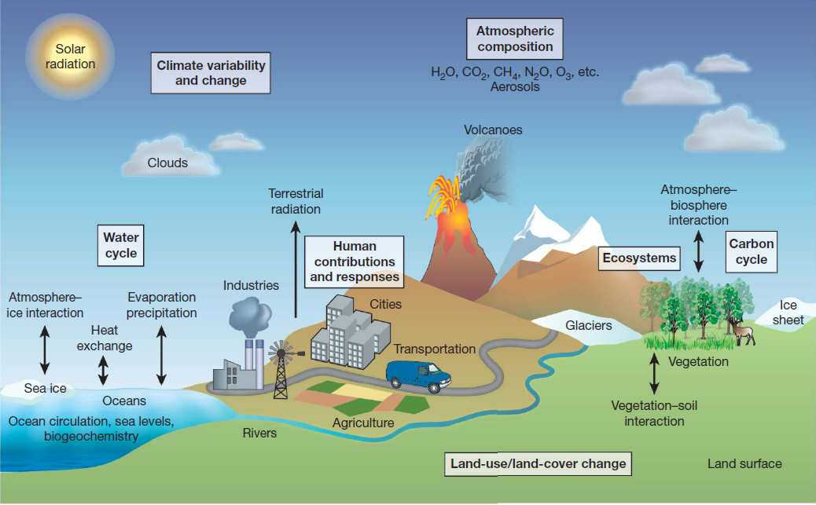
Major processes addressed in climate models
  Source: RH Moss et al. Nature 463, 747-756 (2010)
Notes:
ONLY if time
Main message
The Earth‘s system is highly complex and therefore difficult to represent in one model
Explain
The climate system consists of five interacting components: the atmosphere, the hydrosphere, the cryosphere, the land surface and the biosphere.
Scenarios of emissions and other drivers are used to assess the impact of a range of human activities on these components.

Slide 22
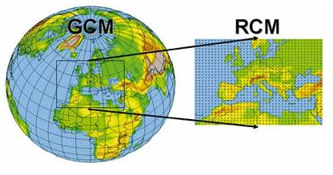
Regional climate models
Source: http://www.wmo.int/pages/themes/climate/images/figures/ClimateModelnesting.jpg
Notes:
Main message
Regional climate models have been developed to include relevant local features and to give information at the requires scale.
Explain
Local assessment require more detailed information than available from GCM.
Local climates are influenced significantly by smaller-scale features and processes, such as mountains, forests or lakes, the heat-island effect of large cities, etc. These features are not represented in detail in global climate models.
For this reason, regional climate models have been developed. There are two main types of regional climate models: statistical and dynamic.
Statistical models analyse empirical climate statistics and extrapolate the results into the future by using climatic trends taken from the GCMs.
Advantage: partly based on empirical local climatic knowledge.
Disadvantage: in developing countries, empirical climate data are often not available for long periods without gaps, due to a lack of observational coverage
Dynamic models (e.g. PRECIS, CCLM, REMO), work in a similar way to the GCM.
Advantage: take info account regional specifics
Disadvantage: The simulation time needed because of the additional processes being represented in more detail; require significant computing skills.
Add. Info
The most relevant advance in nested regional climate modeling activities was the production of continuous RCM multi-year climate simulations.
The primary improvement represented by continuous long-term simulations consists of equilibration of model climate with surface hydrology and simulation of the full seasonal cycle for use in impact models.
In addition, the capability of producing long-term runs facilitates the coupling of RCMs to other regional process models, such as lake models, dynamical sea ice models, and possibly regional ocean (or coastal) and ecosystem models.
The model horizontal grid point spacing varied in the range of 15 to 125 km s.

Slide 23
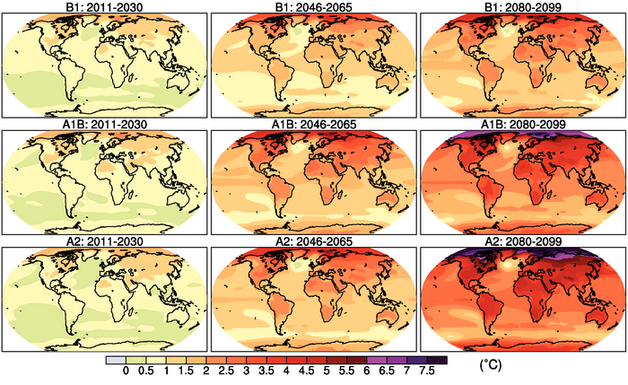
Climate Scenarios
Source: IPCC 2007
Notes:
ONLY if time
Main message
Climate scenarios cannot predict future climate changes.
They can at best give trends.
Explain
The graph shows a multi-model mean of annual mean surface warming (surface air temperature change, °C) for the scenarios B1 (top), A1B (middle) and A2 (bottom), and three time periods, 2011 to 2030 (left), 2046 to 2065 (middle) and 2080 to 2099 (right). Anomalies are relative to the average of the period 1980 to 1999.
The effects of climate change on societies and ecosystems are further investigated in impact, vulnerability or adaptation analysis.

Slide 24
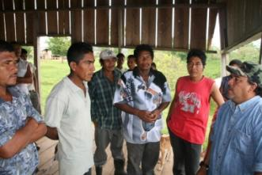
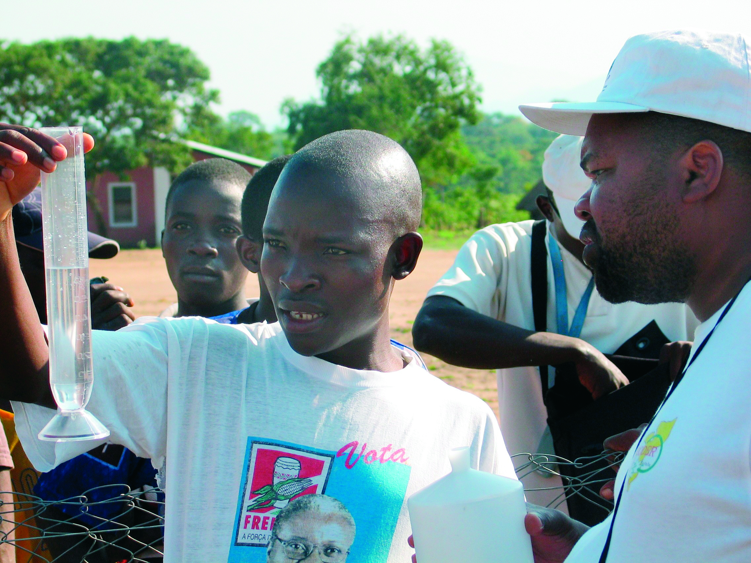
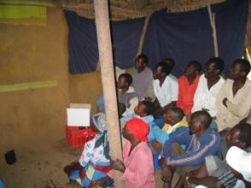
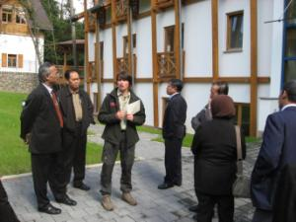
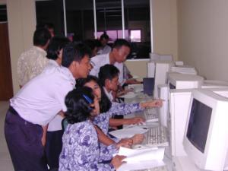
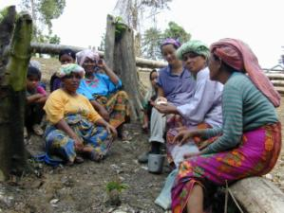
Local climate knowledge
Notes:
ONLY if time
Main message
An important source of information but often neglected.
Explain
Worldwide, over a period of millennia, humankind has responded to catastrophic weather events and changing climatic conditions.
This kind of knowledge has the advantage of being locally and regionally specific and comprehensive.
Especially for defining adaptation options, local knowledge is very useful. Examples:
in Mozambique people had been able to successfully predict floods by observing ants, so when groundwater rise, they leave their ant nests – and people know the water is rising.
Traditional weather forecasting in the Andes: Farmers in some Peruvian and Bolivian communities use observations of the Pleiades star constellation to forecast rainfall during the growing season. Farmers observe the overall brightness, the size and the date of first appearance and position of the brightest star to access when to plant for a successful potato harvest. Scientists have found that the visibility of the constellation is associated with the warm phase of El Niño. Andean farmers have in effect been ‘forecasting’ El Nino for at least 400 years.
However, due to the speed of climate change, traditional forecasts sometimes do not work anymore – traditional knowledge has been tried and tested over hundreds of years but cannot develop in the pace the situation is changing.

Slide 25
Dealing with uncertainty
Part 1: understanding the fundamental limitations of decision-making
Part 2: Managing uncertainty
-> will be discussed in Module C

Slide 26
Information needs for decision making
Policy makers want to know… | Information we can provide (within certain limits) …
What will happen? | Trends for specific climate stimuli (-> be careful about details)
Where? | Geographic extent and resolution (-> difficult for smaller scales)
When? | Time frame (-> makes a big difference whether by 2020 or 2100)
How certain? | Confidence level, i.e. validity of data, agreement in analysis, probability of results
Notes:
Main message
Important to know what policy makers need to know: targeted communication
Keep in mind: the best information basis does not equal a decision!
If time allows
You could discuss with participants about their cultural background, if they feel to live in a very uncertainty-averse society (characterised by many rules) or rather an uncertainty-tolerant society ('go with the flow') and how this is reflected in individual and political decisions

Slide 27
What we know: climate change is real
Example: Rapid Arctic Sea-Ice Decline
(Notz 2010 after Stroeve et al. 2007 GRL)

Slide 28
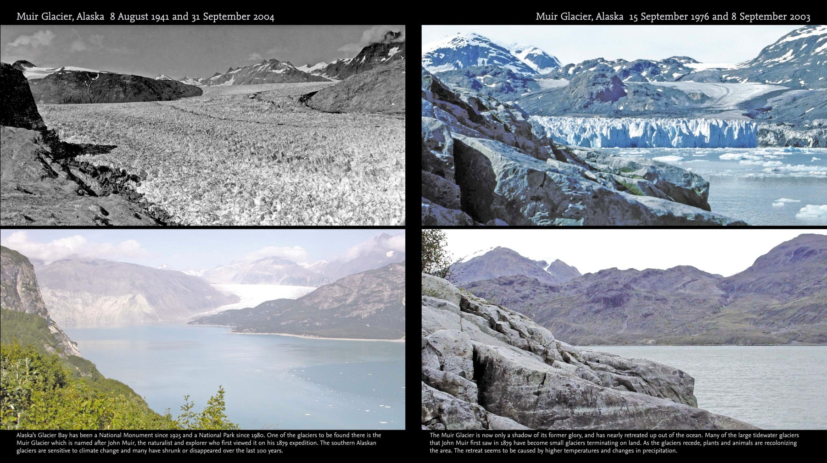
What we know: climate change is real
Example: Muir glacier, Alaska
Source: Fragile Earth. Views of a changing world. http://www.bartholomewmaps.com/fragileearthnew/inside_the_book.htm
Notes:
Add.info
The National Snow and Ice Data Center, Colorado, United States http://nsidc.org/data/glacier_photo/special_high_res_muir.html

Slide 29
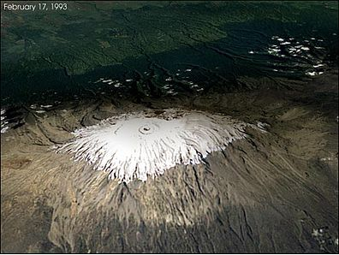
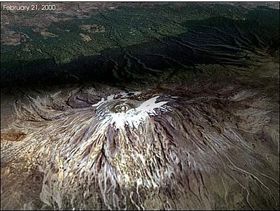
What we know: climate change is real
Example: Kilimanjaro snow cover, Tansania
Source: NASA Earth Observatory
http://ocrl.kordi.re.kr/directory/20021224e.html

Slide 30
What is uncertain: the complex background for decision-making
  Basis of understanding
  Models are representations of the Earth’s system, not portrait pictures
  Limited data availability, esp. at regional/local scale
  Limited data quality, esp. at regional/local scale
  Confidence levels of projections – inherent uncertainty
  Development of GHG emissions
  Depends on decisions today
  Extent of change and vulnerability
  Influenced by the socio-economic and ecological state (sensitivity and adaptive capacity) AND
  Climate trends (exposure)
Notes:
Main message
Yes, there are uncertainties
Science provides all the proof required
Explain
Model restrictions: e.g. computational memory limitations
Lack of understanding: e.g. feedback mechanisms, tipping elements
Data availability: e.g. Small scale data for RCM, observational data to verify model outputs especially in developing countries
Data quality: validity
Loopholes: discuss again all assumptions made to find out if that would change the result
Validity assessment: IPCC assesses all data used by criteria such as probability, agreement and determines the confidence level of a statement
Ensembles: cross-check findings between singular models and the average to see if there could be significantly different results

Slide 31
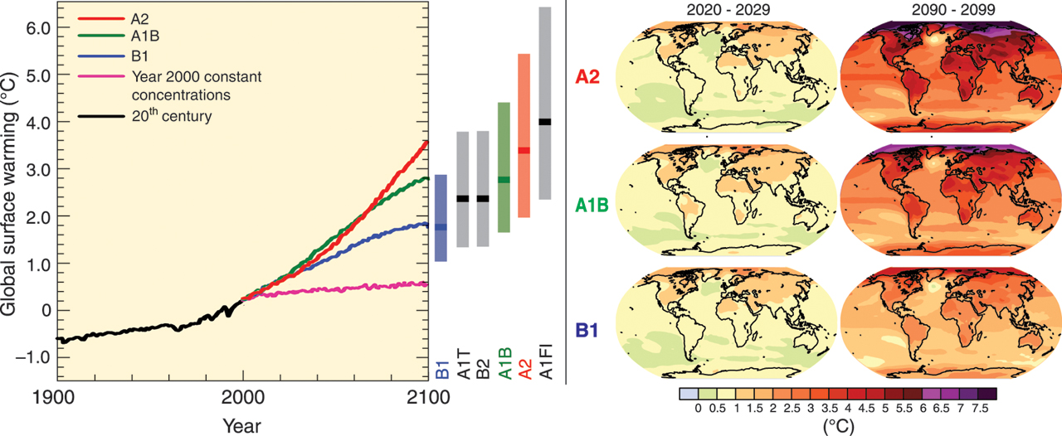
Sources of uncertainty:
Emission scenarios versus model outputs
Source: IPCC 2007
Notes:
Main message
The major uncertainty stems from the development of emissions
These are influenced by decisions today
Explain
The colour lines are different model outputs for surface warming
The variation of model outputs per scenario is less than the variation between the scenarios
For some areas of the world, as well as some climate signals, the model outputs hardly show any difference.
Emissions are determined by driving forces such as demographic and socioeconomic development, and technological change.
A global population of 15 billion people; a mainly fossil fuel-based economy; an adjustment of income levels to match those in developed countries by 2050: all these things would boost GHG emissions.
By contrast, a transformation to a low-carbon economy with seven billion people and moderate increases in income would stabilise GHG emissions.

Slide 32
Exercise
“Dealing with scepticism”

Slide 33
Introduction to the exercise
Working time:
10 min in total!
  Everybody receives one set of information
    Statement by a climate change sceptic
    OR
    Possible answer by a climate change expert
  Find together in the matching pairs
  Discuss the statement, and together develop arguments for a climate change “defender”
  Prepare a very short presentation to the plenary <1 min
Notes:
How to run the exercise
Prepare information sets (copy and cut the prepared sheets, fold over symbol)
Explain by using this slide
Say you are there to help but you won’t intervene
Say you will give a should when there are 2’ left for work
Show the two different sets of information
Bold and italic: statement of climate sceptics
Normal font: arguments by climate change scientists/practitioners
Distribute the information
Once pairing starts, ask people to cross-check by using the (folded ) symbols if they have found the right partner
Let people work on their own but stay present in the room in case of questions
Announce ‘two minutes!’ 2 mins before time is over

Slide 34
Case work
“Interpreting climate information”
Notes:
How to run this exercise
- Prepare the exhibts on boards (depending on the group size you will need 1 or 2 sets of the three exhibits, i.e. 3 or 6 boards)
Depending on the overall group size, divide participants in subgroups of 6-12 people each.
Divide each subgroup in 3 working groups (1,2,3) -> each working group should now consist of 2-4 people
Explain that in order to give everybody more room for contribution, the two subgroups (a,b) will do the same 3 tasks, but in two separate circles (a,b).
Give detailed instructions:
The case work is done while standing in front of the boards.
Each group (1,2,3) starts means interpreting the respective exhibit (1,2,3), i.e. groups a1 and b1 start with exhibits 1, a2 and b2 start with exhibits 2, and a3 and b3 start with exhibits 3.
Groups rotate (per subgroup in their circle) from one exhibit to the next after 10 min (group a1 goes to exhibit 2, group a2 goes to exhibit 3, etc.). There they comment on findings from the previous group(s) and add their own ideas.
After 30 min, groups go back to their initial board, and both groups of same topic join (a1 and b1 present exhibit 1) and review cards in order to highlight major common insights, but also discrepancies in interpretation.
See Trainer Handbook for more details

Slide 35
Introduction to the case work
Working time:
3x10 min/exhibit
10 min/summary
Context
  Government of Zanadu: NDP should reflect climate change adaptation priorities
  Government has established a climate change advisory group
  → your working group
Your task
  Examine exhibits
    What does this specific information tell you about rainfall and temperature – what not?
  Summary
    Go back to your first board
    Summarise findings (overlaps and different opinions) and discuss implications of your findings on agriculture and water sector
  Prepare a presentation to the plenary <5 min
Notes:
How to run the exercise
Prepare the exhibits on boards (in case your group is bigger than 12 people double up and pin each exhibit on both sides of a board)
Divide group in as many sub-groups as you have exhibits on display (3 or 6)
Case work is done while standing in front of boards
Each group starts at one display, examines it for 10‘ and notes down findings on cards
After 10 mins ask the groups to rotate to the next display, review their predecessors‘ findings and to add information where necessary
Repeat after another 10‘
At the end of 30‘ ask the sub-groups to go back to their first board (in case you have doubled up, ask groups to join with the twin group) and to prepare a presentation to plenary
If time allows
Ask for judgements on the following aspects
Impacts on agriculture and water sector
confidence level of information
Add.info
For a summary of possible correct findings see extra sheet

Slide 36
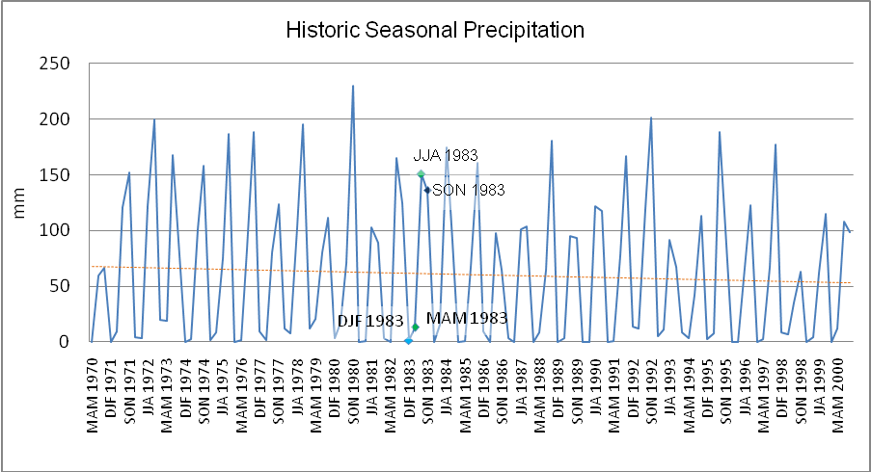
Historic data
Source: GIZ
Notes:
Add.info
Historic precipitation data shows the amount of precipitation (mm) for each seasonal 3-month period (March-May, June-August, September-November, and December-February) based on observations at a meteorological station outside of Maja from 1970 (left) – 2000 (right).

Slide 37
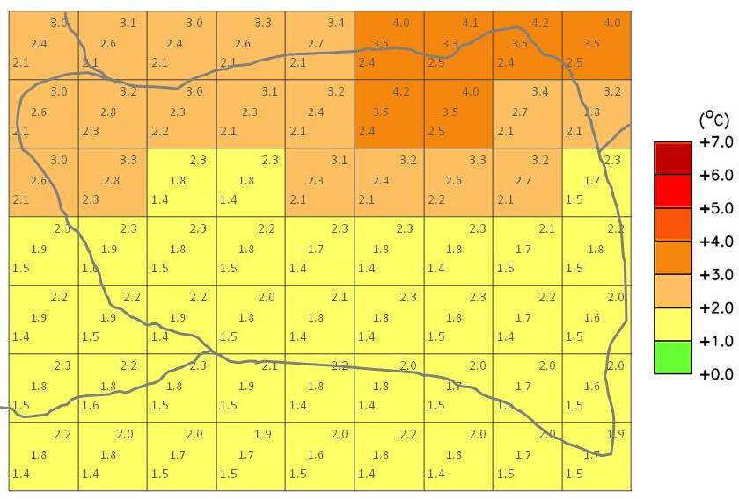
Downscaled model temperature projections
Source: GIZ
Notes:
Add.info
The map shows the spatial pattern of change in mean annual temperature for the 2060s as projected by different available climate models. It is based on the A2 scenario by IPCC. → glossary
The values in the grid boxes are anomalies (changes in temperature) relative to the mean climate of 1970 – 1999.
The map is developed as for each grid box and each time slice, each season, the minimum, maximum and median anomaly values are taken from across the ensemble of models.
In each grid box, the central value gives the median and the values in the upper and lower corners give the maximum and minimum of the range of projections by climate models.

Slide 38
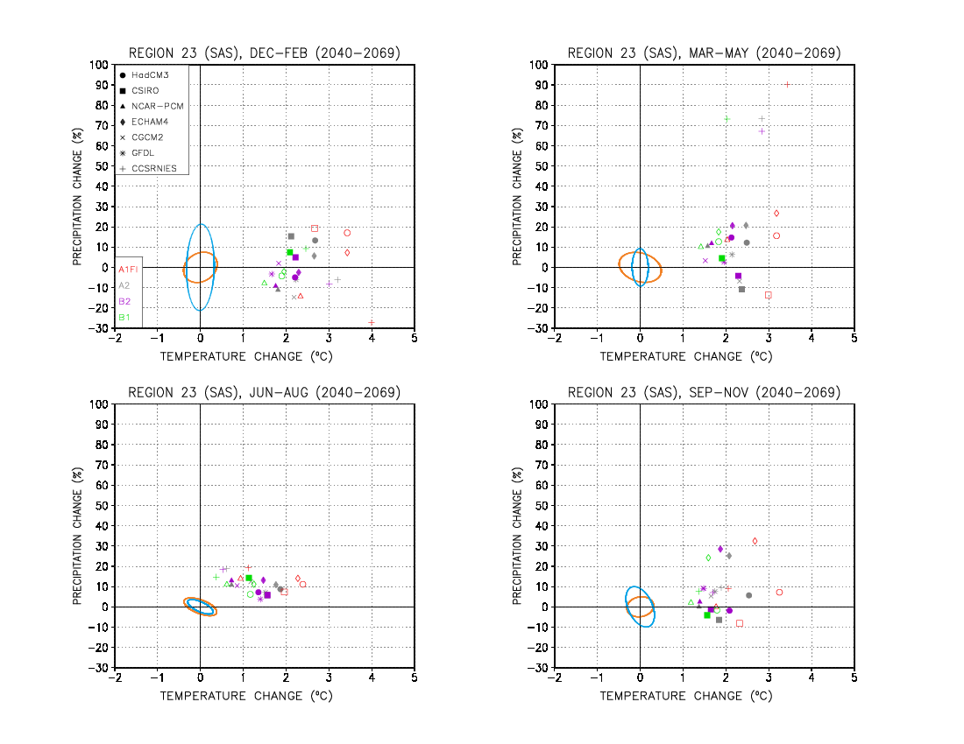
Regional scatter plots
Source: GIZ
Notes:
Add.info
Average projected data for 2040 – 2069 in June, July and August, December, January, February respectively.
Temperature is projected on the x axis and precipitation percentage change along the y axis.
The scatterplots present the data of seven different global climate models (different symbols see legend at the top left in scatter plot b).
The models are based on the four emission scenarios.
The ellipses centred on the origin indicate natural variability of temperature and precipitation based on two historic model outputs.
Each point indicates projected by a specific scenario and model combination (averaged over 2040 – 2069).
the temperature (along the x axis in ºC) and
precipitation (along the y axis as a % change from the historic average)
If a point falls distinctly outside the ellipses, it is significantly different from the historic range of variability.

Slide 39
Reflection
  1st round
    What is my take-home message?
  2nd round
    How can I improve my daily work through the newly acquired knowledge?
Notes:
Hint
Do this last part without showing the slide
Begin with a small recap on all the things discussed in the module (e.g. overview slide)
Discuss in plenary
Present this discussion visually
The main messages that should come across in this module are
Even as non-climate scientists we can understand the basics of climate science
This gives us basic orientation in our decisions
It helps us work with climate experts (e.g. acknowledge the information they bring and critically question their findings)
Climate information does not equal a decision but prepares the ground to take action.

Slide 40
Title
Text
This slide is not part of the original version of the training material. It was added by [please insert institution].

