Slide 1



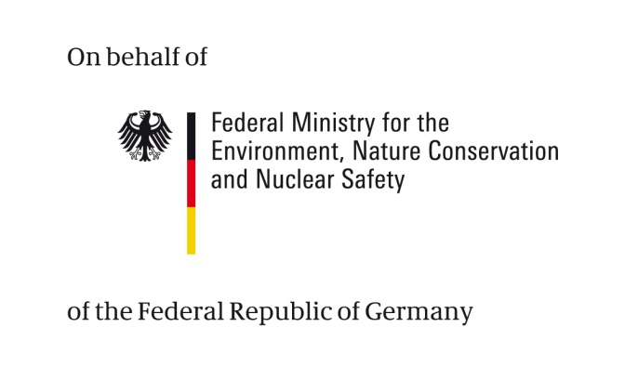

Finding climate information

Slide 2


Imprint
As a federally owned enterprise, GIZ supports the German Government in achieving its objectives in the field of international cooperation for sustainable development.
Published by
Deutsche Gesellschaft für
Internationale Zusammenarbeit (GIZ) GmbH
Dag-Hammarskjöld-Weg 1-5
65760 Eschborn, Germany
T +49 61 96 79-0
F +49 61 96 79-1115
Contact
E climate@giz.de
I www.giz.de
Responsible Michael Hoppe, GIZ
Author Barbara Fröde-Thierfelder
Coordination Barbara Fröde-Thierfelder
Photo credits
© GIZ/Climate Protection Programme and Claudia Altmann,
Dirk Ostermeier, Florian Kopp, Georg Buchholz, Ira Olaleye,
Jörg Böthling, Manuel Hauptmann, Markus Kirchgessner,
Michael Gajo, Michael Netzhammer, Nicole Herzog, Peter Korneffel, Richard Lord, Robert Heine, Rüdiger Behrens, Ulrich Scholz,Ursula Meissner, Uwe Rau
Design Ira Olaleye
Articles written by named authors do not necessarily reflect the views of the editors.
The Training « Integrating climate change adaptation into development planning» has been developed by the GIZ Climate Protection Program, on behalf of the Federal Ministry for Economic Cooperation and Development (BMZ)
This module has been elaborated as an addition to the existing training “Integrating Climate Change Adaptation into Development Planning” with additional financing from BMU.

Slide 3
Terms of use
This training module has been developed by GIZ on behalf of BMU.
If you would like to adapt this presentation to your needs, please respect the following terms of use:
  The slide master and imprint are mandatory. They may neither be altered nor removed from the presentation.
  The GIZ logo must not be moved or removed. No other logos or further information may be placed in the header or footer area.
  If you wish to add your own content, please use the blank slide at the end of this presentation. (You can copy it to add slides.)
  If you would like to make substantial changes to the content of this presentation, please contact climate@giz.de.

Slide 4
Overview
  Different sources of climate information for different purposes
  Presentation of the web platform ci:grasp
    Why and how it was developed
    The main features
      Impact chains
      Maps
      Climate diagrams
    Using information available at ci:grasp
  Reflection
Exercises
Case work

Slide 5
Different sources of information

Slide 6
Climate information is required when...
  Identifying key challenges
  (e.g. which regions/sectors are vulnerable to climate change)
  Selecting strategies
  (e.g. how to reduce vulnerability in a region/sector/ how to achieve development objectives despite climate change?)
  Designing technical responses
  (e.g. define storage capacity of a new reservoir/select irrigation technology)
What information do you need? Which sources are there?
Climate data and information - e.g. ci:grasp maps, PRECIS, UNDP country profiles
At which stage of your process is this relevant?
Policy formulation
Project identification
Process guidance - e.g. ci:grasp impact chains, GIZ CP4Dev, CRiSTAL
Multi-year development planning
Project design
Experiences and lessons learnt - e.g. ci:grasp adaptation projects, weADAPT
Project implementat.
Notes:
Main message
Different information needed for different questions
Do information research systematically
Explain
Three different questions
At which stage of the policy cycle (grey) programme cycle (ice blue) are they relevant?
(Add.info: stages refer to from OECD policy guidance 'Mainstreaming CCA into development cooperation' )
Which information do you need for the three different questions
(Add.info: information tools refer to http://www.climateplanning.org/userguide and http://www.iisd.org/pdf/2011/5kg706918zvl.pdf )
Data and information exist mainly at higher levels, some information is given in already analysed from (UNDP country profiles), some data is provided 'raw' for your own analysis (PRECIS), and in between ci:grasp maps
Process guidance includes several steps of assessment and planning, including the identification of challenges as well as the development of strategic options, there are lots of slightly different tools
Experience and lessons learnt can be useful if you want to learn e.g. from regions that have developed adaptation measures long since (e.g. desertification control in the Sahel). However, as experiences are very specific, it takes a lot of time to draw tangible conclusions from this sort of information.
Add info
Climate compatible development is the connection of development + adaptation + mitigation, defined as 'development that minimises harm caused by climate impacts , while maximising opportunities presented by a low emissions, more resilient, future'.

Slide 7
Guiding principles for research and information management
  Step 1: Define frame of research
  Define the objective of your research, e.g.
    During planning, I need data on vulnerability levels to focus activities
    To select technical solutions, I want to learn from experiences in other regions
  Specify your research: define your area of interest in geographical, temporal and sectoral terms
  Step 2: Check appropriate sources
  Check literature and data bases to get a good overview
  Consult experts on specific questions
  Step 3: Compile findings
  Comprehensible
  Transparent
  Structured
  KISS
Sources: GIZ 2009: Climate information for effective adaptation; adapted.
Notes:
ONLY if time
Main message
Systematic approach is more effective and efficient
Systematic research and reporting is a good vehicle for dealing with uncertainty and social learning
Explain
Ask participants to give examples for research objectives
Check sources: what can you do yourself, where do you need expert input?
Compile findings: make your work a valuable source of information,
Comprehensible: state criteria, explain how you do your analysis, short sentences and precise headlines,
Transparent: e.g. precise in quotations, write in clear text instead of your home-grown abbreviations, beware of jargon and ambiguous statements
Structured: Background - analysis – recommendations;
KISS: keep it short and simple

Slide 8
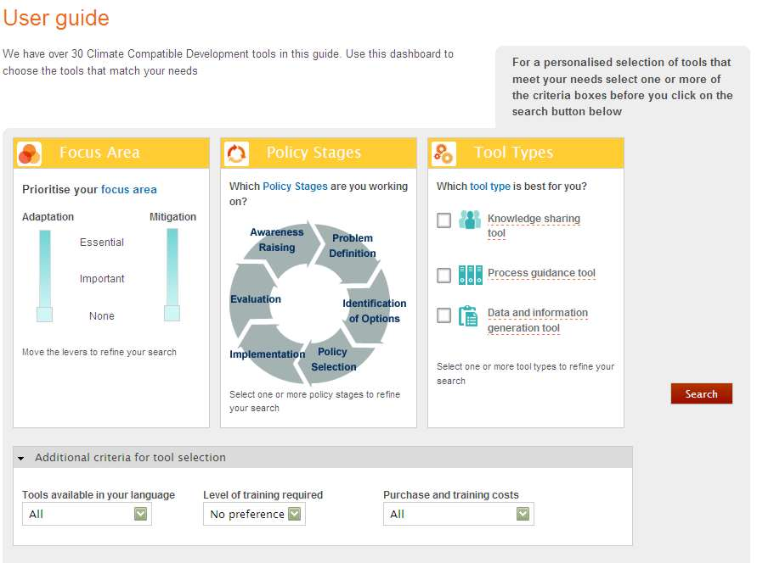
Example of information sources and tools www.climateplanning.org
Your focus area:
mitigation or adaptation?
Your working step in the policy cycle?
What kind of tool for what kind of information?
http://www.climateplanning.org/userguide
Notes:
Main message
There is a website offering support to access different climate information provision tools
Proliferation of information portals complicates information access – recent discussions on what comprehensive offers could look like
Explain
The website has been prepared in response to demands from a range of practitioners and government officials in developing countries, including demands expressed through members of the Coordinated Low Emissions Assistance Network (CLEAN). The Climate Development Knowledge Network (CDKN) then commissioned the work.

Slide 9
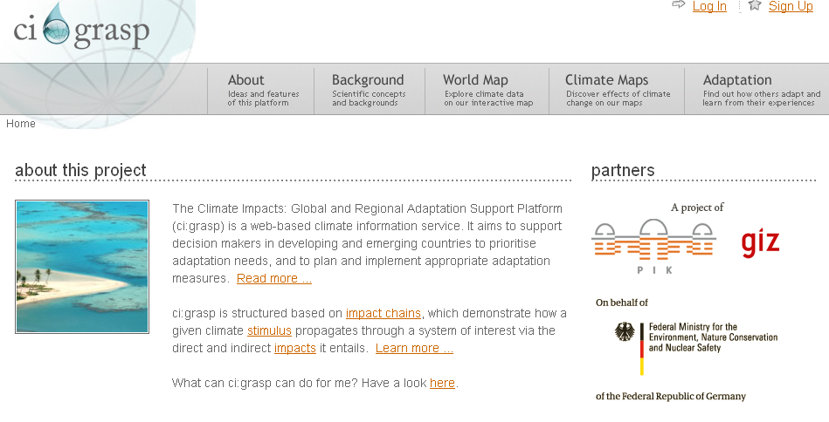
Example ci:grasp
Climate Impacts: Global and Regional Adaptation Support Platform
http://cigrasp.pik-potsdam.de/

Slide 10


Setting
A cooperation project of &
Funded by
International Climate Initiative of the Federal Ministry for the Environment, Nature Conservation and Nuclear Safety (BMU)
First Phase: December 2008 to February 2011
Second Phase: March 2011 to May 2013 within the framework of the new project Inventory of Methods for Adaptation to Climate Change
Notes:
Explain
ci:grasp is jointly implemented by GIZ and PIK
While PIK contributes its scientific expertise, climate data and models, GIZ contributes its strength in capacity building and networking, as well as its portfolio of adaptation projects
Project is funded by ICI and stands out from the other ICI projects as a rather technical project (in contrast to implementation-oriented projects)
First phase predominantly covers the development phase of the platform.
In a second phase the platform will be further developed in the framework of the new BMU ICI project …(see slide).

Slide 11
Rationale & Objective
Situation
Knowledge for climate change adaptation is available but not structured and not easily accessible
ci:grasp operates as an open and interactive information system; it assists in prioritising adaptation needs, and in planning and implementing appropriate adaptation measures
Target Group
ci:grasp targets decision makers and their advisors as well as consultants, research institutions, NGOs and international development agencies
Goal
An “information problem” at least as much as a “knowledge problem”
Notes:
Explain
Background: ci:grasp grew out of earlier cooperation work of PIK and GIZ on climate proofing and climate information; the ci:grasp project was initiated based on the insight that knowledge (… see slide)
Goal: the project goal was to develop an open and interactive tool (…see slide) designed to close a gap in the provision of climate information
Target Group: decision-makers in government, ministries and research agencies, but also … (see slide).

Slide 12
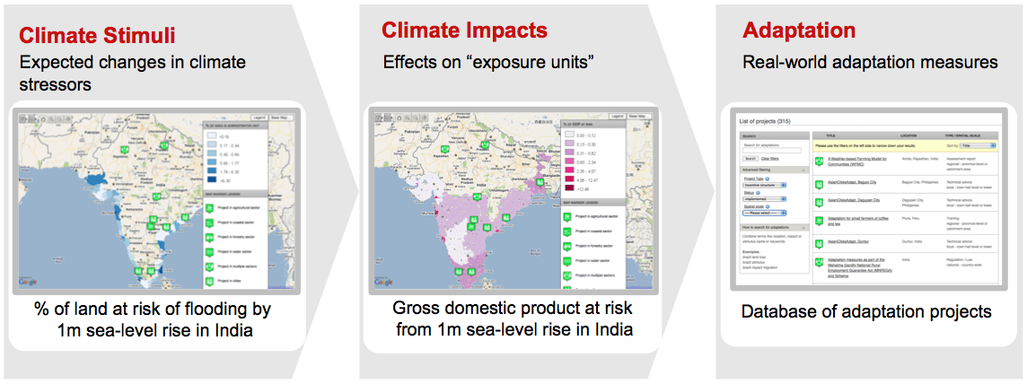
Structure of Information
Three layers:
Science (PIK)
Practice (GIZ)
Notes:
Explain
Structure of the platform addresses the challenge that climate information and knowledge is not always available in a structured way.
Information is structured along three main categories…
PIK – with its expertise in climate science – provides climate data and maps and ensures that all information are scientifically robust
GIZ contributes its portfolio of adaptation projects and connections to further projects within international development cooperation and ensures that the user perspective is adequately taken into consideration.

Slide 13
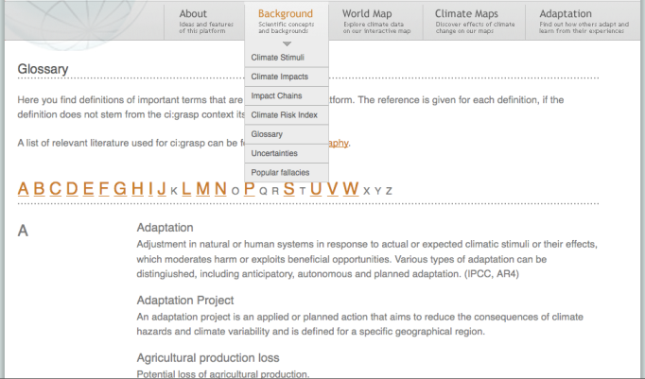
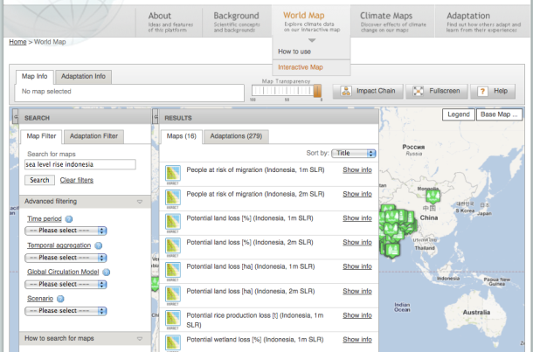
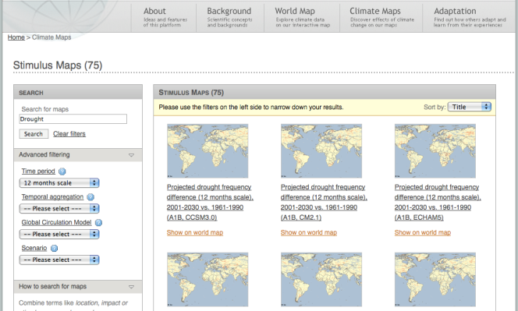
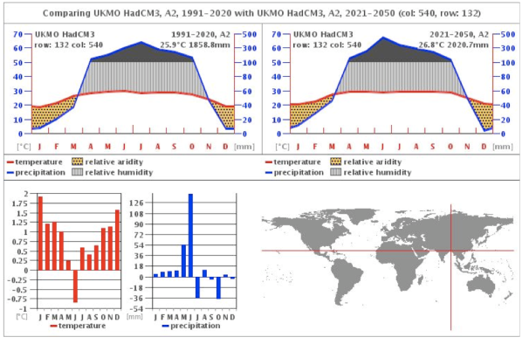
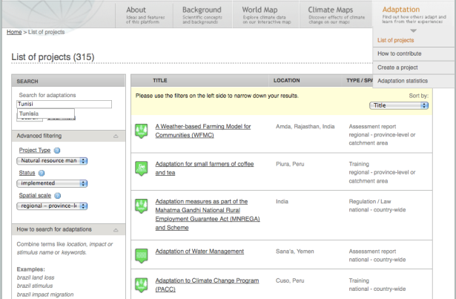
Main Features: Overview
Background Information & Glossary of Climate Terminology
Interactive World Map
Stimuli, Impact & Emission Maps
Climate Diagrams
Adaptation Database
Notes:
Explain
The main features of the ci:grasp platform:
Background Information provide users with an introduction to the scientific concepts (Climate stimuli, impacts and impact chains) and information on the terminology of climate science
Interactive world map is the centrepiece of the platform: it allows the user to display all climate maps on a world map and zoom in for specific regional information
ci:grasp provides stimuli, impact, and emission maps which can all be displayed in a static form or on the interactive world map
A climate diagram generator enables comparisons between different scenarios and timeframes
Finally, the adaptation database provides information on concrete projects and allows users to share adaptation experience with a global community by contributing their adaptation projects to the database.

Slide 14
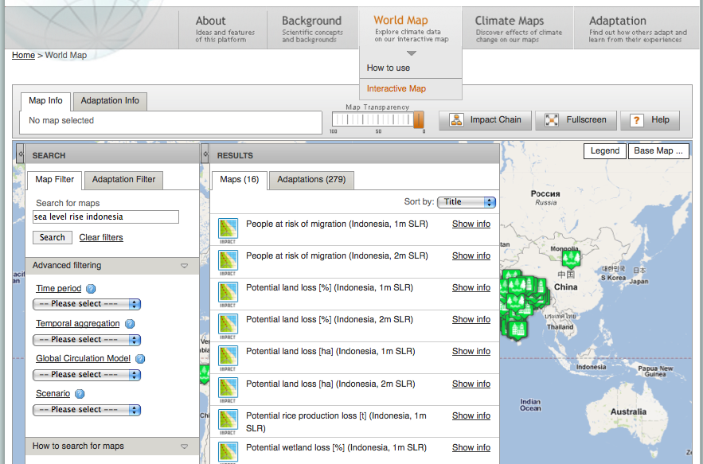
Interactive World Map
Notes:
Explain
A more detailed look at the features:
The interactive world map is the centrepiece of ci:grasp.
Free text search allows to search for countries, impacts or stimuli.
The search for maps can be specified by time period (e.g. annual scale or a specific quarter of the year), temporal aggregation (30-year periods from baseline 1961 until 2098), Climate Model (5 are available) and Scenario (3 SRES scenarios are available – best and worst case, in between those two).
Example chosen here: sea-level rise in Indonesia. Let’s now have a look at this map.

Slide 15
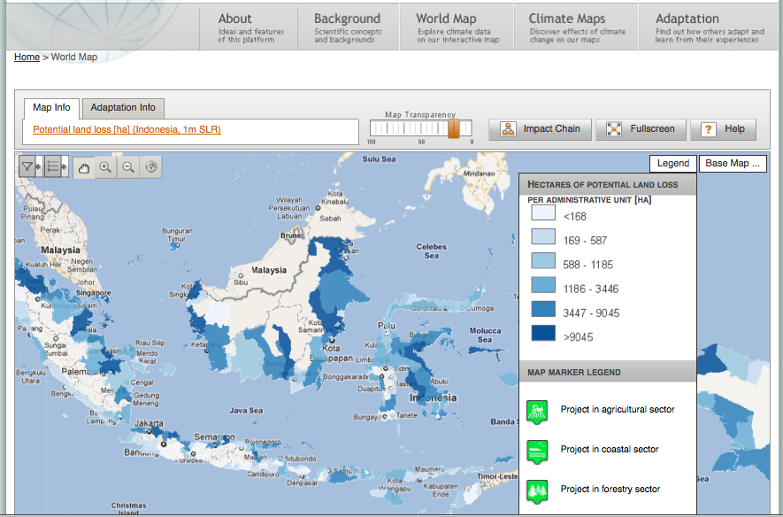
Interactive World Map: Potential land loss in Indonesia
Notes:
Explain
Selected map shows potential land loss in Indonesia in ha with an expected sea-level rise of 1 metre.
Impact maps are available for all partner countries (Brazil, Chile, China, India, Indonesia, Philippines, Peru, South Africa, Tunisia).
Stimulus maps (temperature, precipitation, drought, water availability, sea-level rise) are available on a global scale.
By clicking on the Map Info (highlighted on the slide) users get more information on the map and on how to interpret the results.

Slide 16
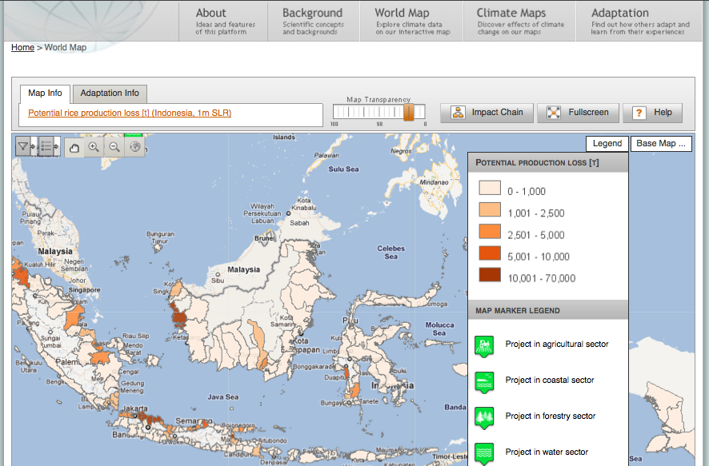
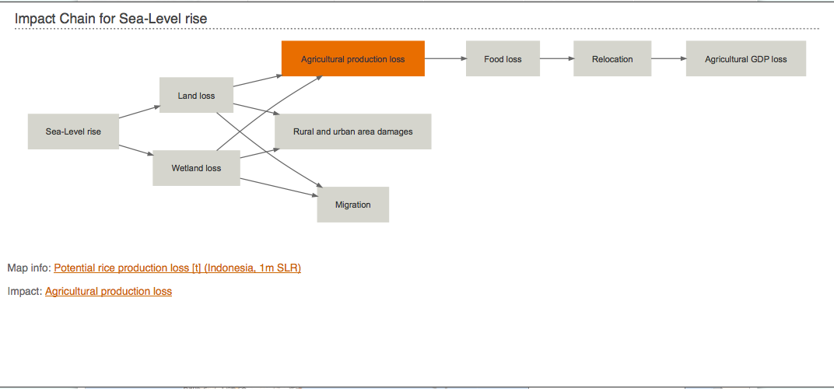
Interactive World Map: Potential rice production loss
Notes:
Explain
This is another example of an impact map for Indonesia: Potential rice production loss in tonnes with an expected sea-level rise of 1 metre. On this example, we will analyse the impact chain related to this climate impact.
The respective impact chain and additional information can be accessed by clicking on the impact chain icon. All elements of the impact chains lead to impact details, related maps and adaptation projects.

Slide 17
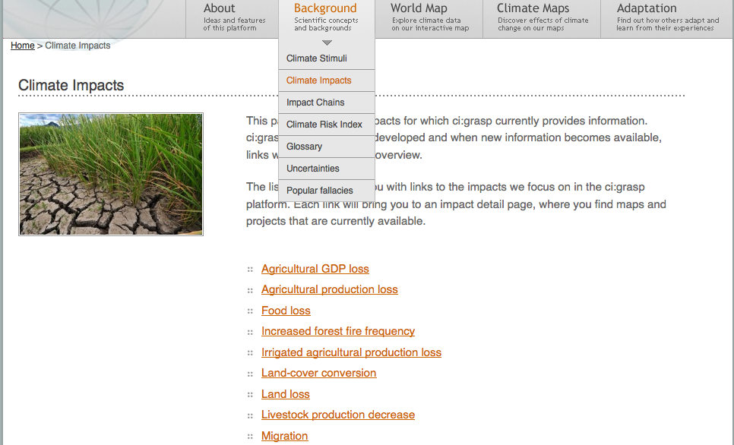
Background: Climate Impacts
Notes:
Explain
Another way of entering ci:grasp is to access background information on climate stimuli or climate impacts in the Background navigation point.
This is very helpful when users already identified climate risks for their region and want to get detailed information on specific stimuli or a climate impact.
Here, climate Impacts are chosen as an example (list of impacts on the website is longer).
By clicking on the impact of interest, e.g. food loss, users receive impact details, the respective impact chain, and a list of related maps and adaptation projects, which can directly be accessed from here.

Slide 18
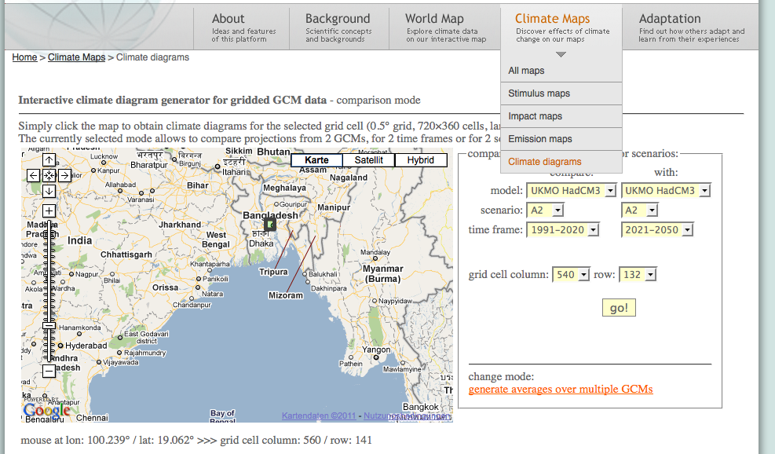

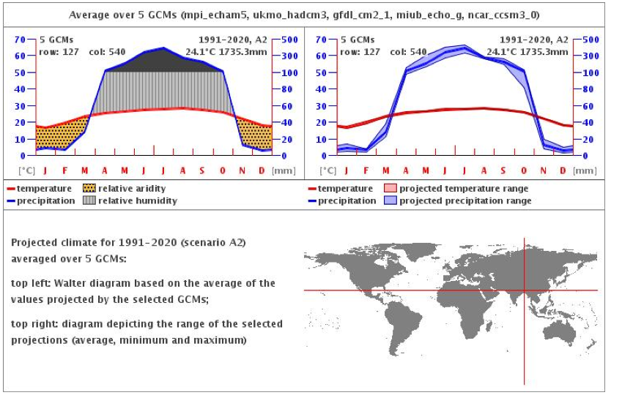
Climate Diagrams
Notes:
Explain
The climate diagram generator is a very helpful tool for a detailed analysis of the climate change stimuli temperature and precipitation.
Two climate models, time frames or emission scenarios can be compared for every location worldwide (example here: Bangladesh).
You can also analyse the average and range over multiple climate models and identify the level of uncertainty and the range of predictions.
Diagrams: in the back comparing two timeframes, in the front average over all five climate models.

Slide 19
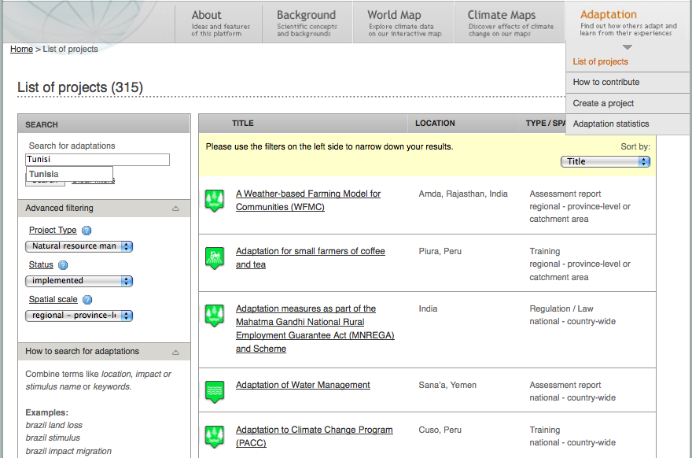
Adaptation Project Database
Notes:
Explain
In the adaptation project database users can search for peer-reviewed adaptation measures, which can help adaptation practitioners to identify and design appropriate adaptation measures.
Projects can be searched by project type (e.g. building/installing structure or natural resource management), status (e.g. implemented or planned) and geographical scale, or by using the full text search.
Example here: Search for a regional and implemented natural resource management project in Tunisia.

Slide 20
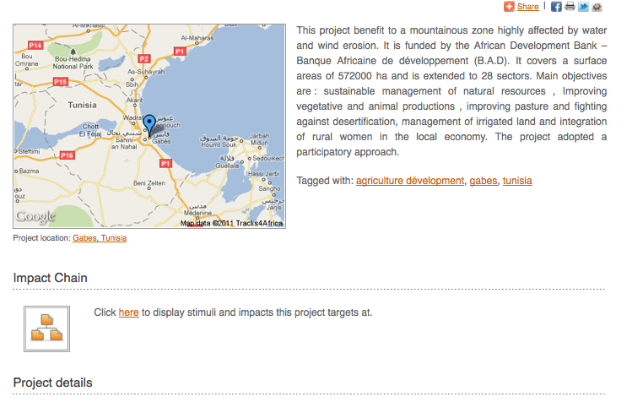
Project Example: Agriculture Development in Tunisia
Notes:
Explain
Project Example chosen here: agriculture development in Tunisia.
All projects are geotagged and information provided on the projects is structured along predefined categories allowing to compare different adaptation alternatives.
Project details include a classification of the project (type, status, spatial scale etc), project costs, evaluative information (such as success and limiting factors) as well as contact information of the responsible organisation.

Slide 21
Exercise
“Impact chain puzzle”
Notes:
How to run the exercise
Distribute the information (see separate file)
Ask participants to find their group and to organise themselves in an impact chain
Once, both groups are organised, ask the other group look at the impact chain: Do they see other ways of organising the factors? How can they explain them?
Make sure that participants understand the value of an impact chain : the logical connection of causes and effects. An impact chain is an expert tool, i.e. it is not cast in stone but has to be adapted according to the circumstances of the assessment (exposure unit).
At the end of the exercise show participants where to find impact maps on ci:grasp

Slide 22
Exercise
“Finding climate information on ci:grasp”
http://cigrasp.pik-potsdam.de/

Slide 23
Case work http://cigrasp.pik-potsdam.de/
  How to do the tasks
    “Context” gives background information for your role play
    “Your task” describes your specific assignment for this task
    Follow the instructions
    1.A.1 -> questions to answer
  3 tasks
    Task 1A+B: Analysis of Climate Change Stimuli on the example of Tunisia
    ~ 25 min
    Task 2: Analysis of Climate Change Impacts on the example of Indonesia
    ~ 25 min
    Task 3: Understanding Causes and Effects with Climate Impact Chains
    ~ 20 min
Do one task at a time.
Between each task we will take time to discuss your results.
Notes:
How to run the exercise
Make sure that all participants have access to the ci:grasp website
Explain the first task
Let participants work and take the time they need to complete the tasks
Discuss the results
Then explain the second task
Let participants work and take the time they need to complete the tasks
Discuss the results
Then explain the third task
Let participants work and take the time they need to complete the tasks
Discuss the results

Slide 24
Task 1A+B:
Analysis of Climate Change Stimuli
  Context
  You are an official in the Ministry of Agriculture in Tunisia. Your field of work includes the strategic development of the agricultural sector.
  Your superior requests you to prepare a background paper about the influence of climate change - in particular about the impacts of temperature and precipitation changes by 2035.
  The climate model HadCM3 is the official standard in your Ministry.
  Your task
  Part A: Use the Interactive Map as a starting point
  Part B: Use the Climate Diagram Generator to verify your findings

Slide 25
Task 2:
Analysis of Climate Change Impacts
  Context
  You have been appointed a member of the Climate Change Advisory Group to the Government of Indonesia.
  Sea-level rise is expected to be a major threat to the country but possible impacts are not yet being considered in Indonesia’s coastal and small islands management.
  You are asked to prepare a background paper outlining the impacts of sea-level rise on social and ecological systems and the most vulnerable areas as a basis for the revision of the management plans.
  Your task
  Find and analyse the information on the impacts of sea-level rise in Indonesia available on ci:grasp.
  Use the information to determine which areas are most vulnerable to these impacts.

Slide 26
Reflection
  What is my take-home message?
  Where in my work life is this important?
  How can I improve my daily work through the newly acquired knowledge?
Notes:
Hint
Do this last part without showing the slide
Begin with a small recap on all the things discussed in the module (e.g. overview slide)
Discuss in plenary (e.g. first round by 'talking stick' on the questions on the slide then dig deeper to work out the main messages below)
Make sure to portray this discussion visually
The main messages that should come across in this module are
Make sure that participants understand the value of an impact chain : the logical connection of causes and effects. An impact chain is an expert tool, i.e. it is not cast in stone but has to be adapted according to the circumstances of the assessment (exposure unit).
There are different sources of information for different questions concerning climate change
Knowing precisely what you want to find out makes your research much more efficient and effective
Some climate information is readily available, even for non-scientists, some information requires additional expertise
Some take home messages for dealing with climate information (to be complemented)
Build on existing assessments and studies before doing lots of new research
Cross-check and/or complement by drawing upon different sources, e.g. including weather station observations, first-hand experiences of local people and projections
Use online data portals for a first, easy and un-expensive overview – then later see for which detail questions you need expert support
Use historical analogues to interpret the significance of potential future climate change, e.g. historical thresholds (e.g. for drought or flood damage) can give an idea about the severity of future climate conditions without detailed impact modeling.

Slide 27
Title
Text
This slide is not part of the original version of the training material. It was added by [please insert institution].

