Slide 1





Managing uncertainty in decision making
Notes:
Main message
There is room and need for action:
Today’s actions (early adaptation as well as mitigation) influence the future need for adaptation
We know enough to get started:
Uncertainty does not justify waiting for ‘better times’ in decision making
Possible quotes for starting this module
‘Science does not give exact or certain forecasts of the future climate, and will never be able to do so. […] the challenge that faces adaptation practitioners is to manage rather than overcome the uncertainty!' (Kropp/Scholze 2009)
'Policymaking nearly always requires judgment in the fact of uncertainty and climate change is no different' (Schneider 2011)
'Don’t let the perfect be the enemy of the good'
Hint if time
Ask participants what decision making techniques they usually use, in the professional or private lives
e.g.: flip coin, pro-con-lists, ask your mum/dad/friend,

Slide 2


Imprint
As a federally owned enterprise, GIZ supports the German Government in achieving its objectives in the field of international cooperation for sustainable development.
Published by
Deutsche Gesellschaft für
Internationale Zusammenarbeit (GIZ) GmbH
Dag-Hammarskjöld-Weg 1-5
65760 Eschborn, Germany
T +49 61 96 79-0
F +49 61 96 79-1115
Contact
E climate@giz.de
I www.giz.de
Responsible Michael Hoppe, GIZ
Author Barbara Fröde-Thierfelder
Coordination Barbara Fröde-Thierfelder
Photo credits
© GIZ/Climate Protection Programme and Claudia Altmann,
Dirk Ostermeier, Florian Kopp, Georg Buchholz, Ira Olaleye,
Jörg Böthling, Manuel Hauptmann, Markus Kirchgessner,
Michael Gajo, Michael Netzhammer, Nicole Herzog, Peter Korneffel, Richard Lord, Robert Heine, Rüdiger Behrens, Ulrich Scholz,Ursula Meissner, Uwe Rau
Design Ira Olaleye
Articles written by named authors do not necessarily reflect the views of the editors.
The training course ‘Integrating Climate Change Adaptation into Development Planning’ has been developed by the GIZ Climate Protection Programme, on behalf of the Federal Ministry for Economic Cooperation and Development (BMZ)
This module has been elaborated as an addition to the existing training course on ‘Integrating Climate Change Adaptation into Development Planning’ with additional financing from BMU.

Slide 3
Terms of use
This training module has been developed by GIZ on behalf of BMU.
If you would like to adapt this presentation to your needs, please respect the following terms of use:
  The slide master and imprint are mandatory. They may neither be altered nor removed from the presentation.
  The GIZ logo must not be moved or removed. No other logos or further information may be placed in the header or footer area.
  If you wish to add your own content, please use the blank slide at the end of this presentation. (You can copy it to add slides.)
  If you would like to make substantial changes to the content of this presentation, please contact climate@giz.de.

Slide 4
Overview
  Climate change: a management challenge
  Uncertainties: the complex background of decision-making
  Key elements strengthening governments’ capacity for adaptation decisions
  Tools to manage uncertainty
  Using scenarios in making decisions
  Reflection
Case work

Slide 5
Climate change: a management challenge
  Responding to climate change impacts […] will challenge decision makers at every level of government and in every sector.
  In the choices policy makers must make, trade-offs will be necessary between the urgency of today‘s problems and the need to prepare for future risks.
  However, integrating climate risks into governmental decision making will be essential if development and others goals are to be met.
  National-level decisions play key roles in enabling local and private-sector adaptation efforts, especially by providing information and guidance.
Source: World Resources Report (2011)
Notes:
Main message
political decision making has to adapt
Explain
We all find forward-looking proactive decision making challenging
Political systems are often slow to react, learn from and foresee changes
Existing planning processes tend to prioritise current risks (tendency to discount the future, i.e. to treat future costs and benefits as less important)

Slide 6
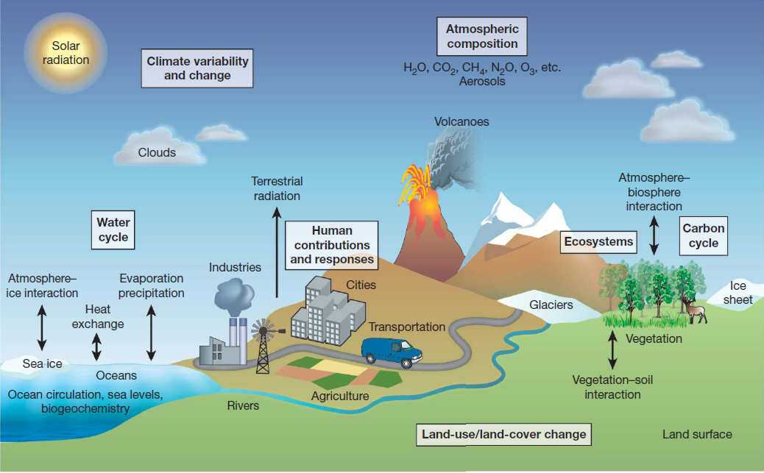
Dimensions of uncertainty -1a
  Basis of understanding
  – limited understanding of complex systems
  Source: RH Moss et al. Nature 463, 747-756 (2010)
Notes:
Main message
Yes there are uncertainties, yet it is impossible not to act (e.g. economic crisis)
It is therefore important to know more about uncertainties and what you can do about them
Explain
The picture shows the major processes addressed (to various extent) by climate models.
What advisors can do: specify the system of interest/exposure unit for the respective questions. (Recall: you can do a detailed portrait or a broad landscape picture, but not both in one time)

Slide 7
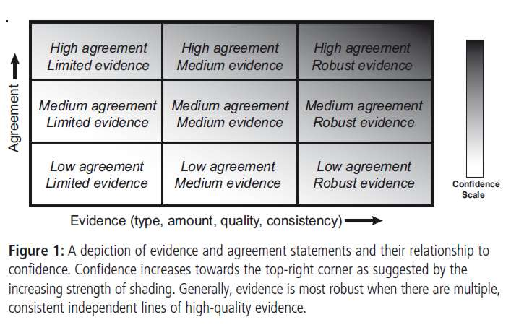
Dimensions of uncertainty -1b
  Basis of understanding
  – limited understanding of complex systems
  – validity of data input and interpretations
IPCC guidelines for consistent evaluation and communication of uncertainties:
Confidence in a finding =
evidence + agreement
Source: Maestrandrea M et al (2011)
Notes:
Main message
Yes there are uncertainties, yet it is impossible not to act (e.g. economic crisis)
It is therefore important to know more about uncertainties and what you can do about them
Explain
Scientific analysis provides the basis for political decisions: IPCC has established a rigorous and transparent review process to ensure the data used as well as the finings are valid.
IPCC author guidance provides a detailed list of criteria how to evaluate findings
Confidence is a relative function of Evidence (related to the type, amount, quality, and consistency of a finding) and agreement between findings. This is a qualitative judgement.
-> What technical advisors can do: ensure that the information they work with has been validated

Slide 8
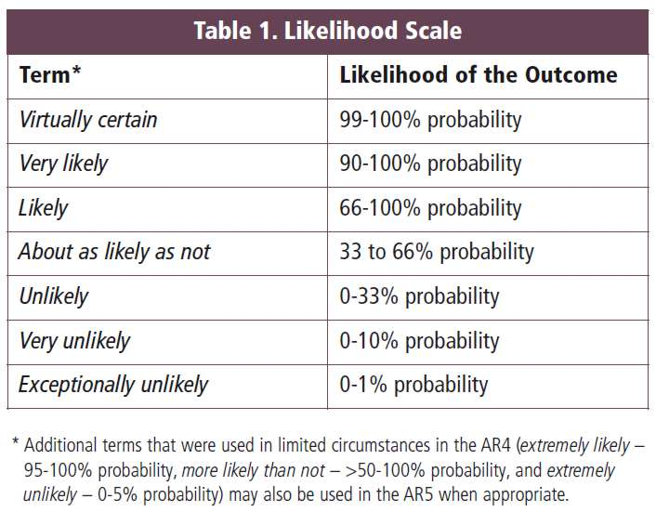
Dimensions of uncertainty -1c
  Basis of understanding
  – limited understanding of complex systems
  – validity of data input and interpretations
IPCC guidelines for consistent evaluation and communication of uncertainties:
Confidence in a finding =
evidence + agreement
Likelihood
Source: Maestrandrea M et al (2011)
Notes:
Main message
Yes there are uncertainties, yet it is impossible not to act (e.g. economic crisis)
It is therefore important to know more about uncertainties and what you can do about them
Explain
Scientific analysis provides the basis for political decisions: IPCC has established a rigorous and transparent review process to ensure the data used as well as the finings are valid.
IPCC author guidance provides a detailed list of criteria how to evaluate findings
Likelihood expresses a probabilistic estimate of the occurrence of a certain event, e.g. a projected change lying within a range. This is a result of quantitative analysis.
-> What technical advisors can do: ensure that the information they work with has been validated

Slide 9
Dimensions of uncertainty -1d
  Basis of understanding
  – limited understanding of complex systems
  – validity of data input and interpretations
  – inherent uncertainty
Notes:
Main message
Yes there are uncertainties, yet it is impossible not to act (e.g. economic crisis)
It is therefore important to know more about uncertainties and what you can do about them
Explain
The combination of graphs shows the complexity of the system as well as the scientific challenges. No research on Earth will ever clarify all the processes related to this system, some uncertainty will always remain, they are part of the game. This is called inherent uncertainty.

Slide 10
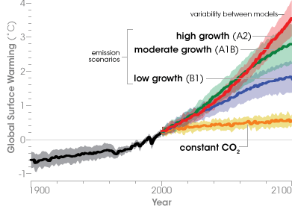
Dimensions of uncertainty -2
  Basis of understanding
  – limited understanding of complex systems validity of data input and interpretations
  Emission development
  – the extent of change in the atmosphere
Variability between different
model
outputs per scenario
Variability between emission
scenarios
Source: http://www.epa.gov/climatechange/science/images/ipcc_scenario_prediction.gif
Notes:
Main message
Yes there are uncertainties, yet it is impossible not to act (e.g. economic crisis)
It is therefore important to know more about uncertainties and what you can do about them
Explain
Emission development: are political decisions of today; stabilisation of emission level is not enough – significant reduction (80% until 2050) is necessary
-> What technical advisors can do: keep in mitigation in mind when planning adaptation, always look for low-emission solutions

Slide 11
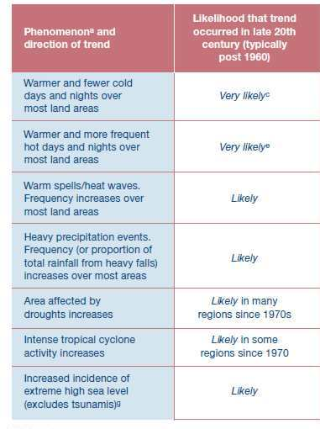
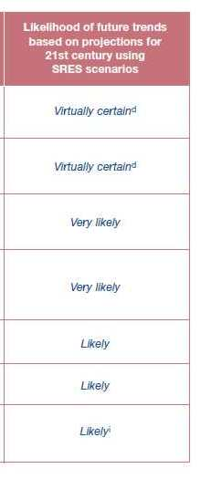
Dimensions of uncertainty -3
  Basis of understanding
  – limited understanding of complex systems; validity of data input and interpretations
  Emission development – the extent of change in the atmosphere
  Impacts and vulnerability
  – effects of climate change
  – what are successful measures to prevent increased vulnerability
Source: IPCC 2007
Notes:
Main message
Yes there are uncertainties, yet it is impossible not to act (e.g. economic crisis)
It is therefore important to know more about uncertainties and what you can do about them
Explain
Impacts are the fact that politicians need to manage today and in the future:
Some climate signals are clear (esp. temperature related signals); for some regions precipitation trends are not clear at all: could be increase or loss.
Some regions will be more affected than others,
Some regions are already vulnerable – have less adaptive capacity – than others (e.g. cyclones in Australia or Bangladesh) – CC impact is related to current development situation!
-> What technical advisors can do: be precise what you are talking about (e.g. region and time frame) and clearly name remaining uncertainties (statistical probability), use appropriate management tools

Slide 12
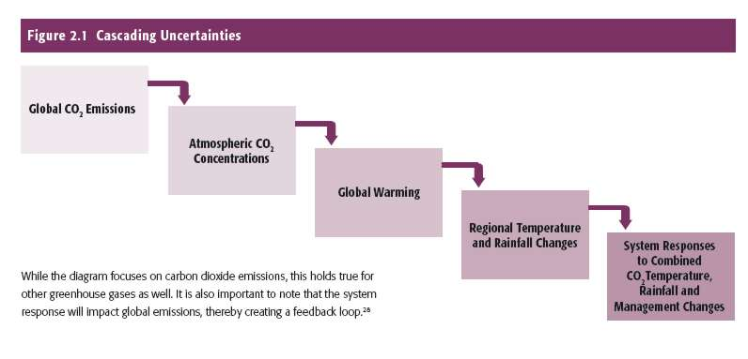
Uncertainties: the complex background for decision-making
  Scientific analyses
  –the validity of data input and interpretations as basis for decisions
  Emission development – the extent of change in the atmosphere
  Impacts and vulnerability
  – effects of climate change
  – what are successful measures to prevent increased vulnerability
Source: World Resources Report (2011)
Notes:
ONLY if time
Main message
Yes there are uncertainties, yet it is impossible not to act (e.g. economic crisis)
It is therefore important to know more about uncertainties and what you can do about them
Explain
We will now focus on what decision makers can do

Slide 13
The confidence levelof projections
High confidence
= low uncertainty
 | HIGHER >> >> >> | >> >> >> LOWER
Climate signal | Temperature | Precipitation
General | Trend of change | Magnitude of change
Scope | Average values | Variability Extreme events
Timing | Yearly Long-term | Seasonal Short-term
Scale | Global | Local
Example | Global annual mean temperature | Local precipitation during next harvest season
Source: based on UKCIP (2003): Climate Adaptation: Risk, uncertainty, decision-making.
Notes:
Main message
With limited data and model outputs, some projections entail higher likeliness than others
Explain
Table
Hint
look for examples together with participants

Slide 14
Uncertainty:
Consequences for decision-making
  Unwillingness to decide and act
  Over-confidence
  in unreliable information
  Inefficient and unsystematic action
  Mal-adaptation
  Mis-investments
  Conflicts
Notes:
Hint
You could do this slide as a brainstorming exercise together with the participants, if you do it on a flipchart, bear the points mentioned on this slide in mind, or do it on a board with cards and have cards pre-prepared
Main message
For most human beings, perhaps apart from scientists, uncertainty is hard to bear. This leads either to over-confidence in uncertain facts or omission of uncertain facts in decision making.
Politicians and the public especially see uncertainty not only as unacceptable but also as someone else‘s fault

Slide 15
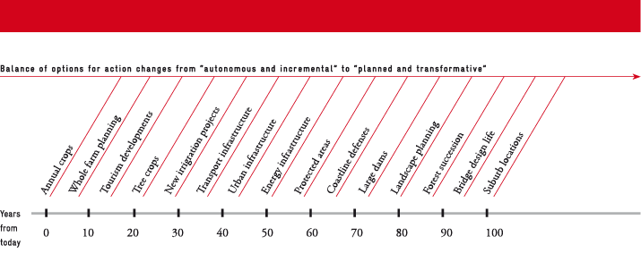
Today’s decisions shape the future
Source: Stafford Smith et al. (2010)
Notes:
ONLY if time
Main message
Climate change is an additional challenge for planning, not the only one.
Taking climate change into account in a systematic manner is essential to ensure development
Explain
Show different investments (best: related to your audience‘s focus)
Explain timespan for investments: especially expensive and long-lasting investments such as infrastructure reach far into the future
They especially have to take CC-impacts into account
Challenge: they especially rely on plausible projections but often information levels are inadequate

Slide 16
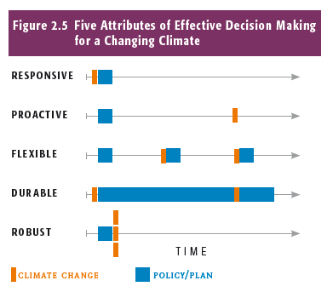
Characteristics of effective decision making approaches
  Responsive: react quickly
  Proactive: prepare for impacts
  Flexible: learn and re-adjust
  Durable: embrace long time horizons
  Robust: relevant for different futures
Source: World Resources Report (2011)
Notes:
ONLY if time
Main message
CC requires new or adapted ways of decision making
Explain
Responsive: improve reaction after a CC-incident as occurred, e.g. disaster risk reduction
Proactive: anticipate extremes, variability and long-term changes and their consequences to meet development goals, e.g. climate proof investments
Flexible: take new information and experiences into account, e.g. revise major strategies on a regular basis
Durable: include long-term perspectives into policy making, beyond election periods, project commitment phases, e.g. make long-lasting plans and invest in revisions instead of short-term perspectives
Robust: be effective under multiple climate scenarios, e.g. a comprehensive set of electricity suppliers instead of one large hydroplant
Add info:
See World Resources Report 2011

Slide 17
Key elements strengthening governments’ abilities for adaptation decisions
  Public engagement in order to
    Define adaptation needs
    Prioritize and select options
    Define acceptable levels of risk
  Decision-relevant information, i.e.
    Accurate, accessible, updated, cost-effective
    Available = Collected and distributed
  Institutional design, i.e.
    Coordination: vertical and horizontal
    Leadership
    Clear mandates
    Integration into ongoing processes
  Tools for planning and policymaking, i.e.
    Risk / vulnerability assessments
    Decision support tools
  Resources, i.e.
    Financial
    Human
    Ecological
    Decision support tools
Source: World Resources Report (2011)
Notes:
ONLY if time
Main message
Research provides us with a selection of factors relevant to making adaptation decisions – the majority of these factors are already known and true for all development decisions
Dealing with uncertainty is influenced by cultural issues – be sensitive as well as determined
In this module we will focus on one specific element > tools > scenarios
Explain
tools: assessment prepares decision making
if time
Public engagement – how to
Inform the public about climate risks, incl. uncertainties in order to build support for decisions, activities
Include public expertise to make decisions, activities better
Include views from affected communities include likelihood of choosing acceptable and relevant activities
Decision-relevant information – how to
Engage with users to define information needs
Also include economic and social information – climate change adaptation requires more than climate data
Institutional design – how to
Mainstream climate change into relevant ministries (esp. Finances and Planning)
Build a dedicated central agency to coordinate efforts
Review mandates
Tools – how to
Integrate climate risk management into existing tools (e.g. environmental impact assessments)
Include new tools whenever needed, e.g. scenario planning, simulation exercises
Build capacities to use this tools
Resources – how to
targeted and sustained funding; fit-for-purpose mechanisms
Train human capacities to create, implement, manage, monitor and enforce adaptation strategies
Protect and maintain ecosystem services as a buffer / adaptation service
In this module we will focus on one specific element > tools > scenarios

Slide 18
Steps in decision making
Is XXX (climate change/ effects) sth we should deal with?
Strategic
What should we do?
How should we do it?
Operational
Who? When? Financing? Etc..
Notes:
Main message
Even if all the information were available: the main task would be still to analyse and process it – and make a decision
Explain:
There are different kinds of decisions that require different tools, especially depending on if the decision is strategic or operational in nature

Slide 19
Tools for managing uncertainty in decision making/problem-solving
  Everything relates to everything: lost between causes and effects?
  -> Systematic adaptation (needs) assessment
  Decision basis unclear?
  -> Statistics
  -> Triangulation
  -> Possibility ranges
  Not enough information for decisions on adaptation activities?
  -> Work on decisions that are necessary now, go step by step
  -> Flexible strategies/corridors, adaptive management/M&E
  Projections show disasters with tremendous effect but rather unlikely occurence?
  ->Contingency planning
    Scenarios
Notes:
Hint:
To make this more interactive and benefit from the group’s experience, you could set up the main questions on boards and ask participants to stroll around and write cards on their suggestions for tools they use to deal with certain questions in the work or private life – have some cards prepared (with the content of this slide) to add to participant’s ideas
If questions are not clear, try and find examples from work and private life together with participants. Document examples on board
Ask participants to explain their suggestions in plenary
Main message
Even if all the information were available: the main task would be still to analyse and process it – and make a decision
There are usually several right answers when you are faced with a complex decision. When you've found the best solution you can find, get on with it, make it work, and it most probably will.
avoid analysis paralysis and go ahead!
Explain:
Different questions require different tools, e.g.
Systematic adaptation needs assessment: refer to GIT climate proofing using other similar tools, explain they work according to an impact chain (refer to M3-5)
Statistics: understand what means 30% probability of a certain event?, understand the need to use average as well as extreme values for decision making
Triangulation: take in another data source, expert judgement
Possibility ranges: evaluate different possible futures, e.g. take the highest and lowest estimate e.g. for sea level rise and see if the exact figure would make a big difference for your decision now
Not enough information?
Reconsider the necessity of a decision now: when do you have to decide? Decisions on adaptation are best made when a plan, project is under revision.
Proceed step by step: start with no-regret solutions that point into the right direction but leave space for corrections. Not suitable for investments with a long investment span.
Flexible strategies: management by objective and corridor -> include no-/low-regret options and make sure to keep windows open for dealing with future risks
Adaptive management: continuously improve your knowledge base and adapt as you go (needs support by M&E)
Contingency planning: explore and plan for a potential worst case, even if highly unlikely
Scenarios are a tool to support strategic decision making, they take into account different futures while being precise on the corridors of getting there

Slide 20
Introduction: What are scenarios
???
  Scenarios are different plausible combinations of a set of circumstances and thus describe different future situations
  Scenarios are NOT predictions
  They help
    to sensitise decision makers for factors influencing future development
    to anticipate future threats and opportunities for development
    to enhance collective learning and exchange
    to - in due course - make decisions for activities (limit threats, secure against negative effects, enhance opportunities)
NOW
later
Notes:
Main message
by dealing with the future in transparent ways, you extend your possibilities to act
it’s like playing chess – you try to find out what to do best in a certain situation in order to achieve your objective
Explain

Slide 21
Exercise: 'Designing scenarios'
Notes:
ONLY if time
How to run the exercise
Note the different steps of how to develop scenarios (next slide) on a board and cover all but the first one
With the first step (question) ask participants which situations from their professional or private life they can describe in which they had to make a decision that reaches into the future, e.g. defining the study subject after highschool or moving house or going on holiday, and note this question into the chart (you can ask all participants to work on one question or leave it to them to define their own example)
Explain step 2 -4 and ask participants to determine factors and values and find out how they influenced their decision.
Show slide that explains the task
Give a short alert 2 mins before time is over

Slide 22
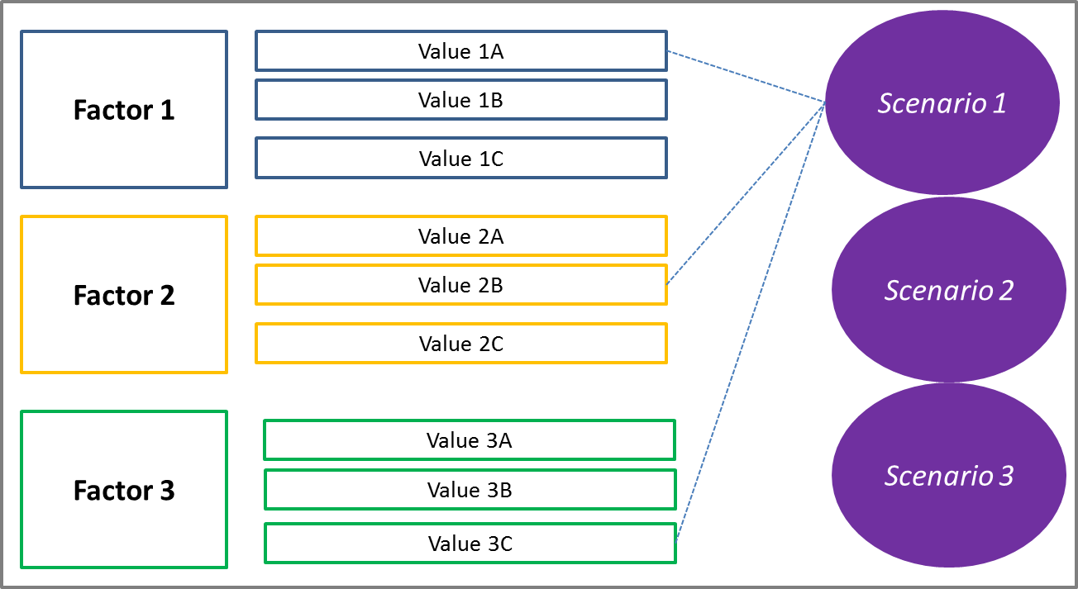
Introduction: how to develop scenarios (linear)
  Determine the question you want to deal with,
  Determine influencing factors, that differ according to your decisions
  Define different values for factors,
  Combine factors/values
  Describe plausible storylines
Notes:
Hint
Do this on a board.
Show the steps one by one as you explain how to develop scenarios
The graph belongs to step (4)

Slide 23
Introduction to the exercise
Working time:
20 min in total!
  Form buzzgroups of 3-4 with your neighbors
  Discuss steps 2-4 for the given question
    Factors
    Values
    Combination
  Prepare a very short presentation on your approach for the plenary <2 min

Slide 24
Introduction: how to develop scenarios (linear): Example: Zanadu’s agriculture development
  Determine the question you want to deal with,
  e.g. possible futures for agriculture in Zanadu
  Determine influencing factors, that differ according to your decisions
  e.g. investments, political orientation
  Define different values for factors,
  e.g. high investments from global agro business players, development cooperation support combined with efficiency efforts in local governments and local taxes
  Combine factors/values
  Describe plausible storylines
Investments
in ACC
low
S1:
'Growth and technology'
middle
high
Development perspective
growth
S2:
'Balancing growth and resilience'
growth balanced with resilience
climate proof
Political Orientation
S3:
'Climate proof '
reactive
initiative
proactive
Notes:
Explain
Re factors: in other circumstances, especially when climatic trends are not clear, you can also take different climatic trends as factor. In this case, as for Zanadu the trends are clear but not the extent of change, we skipped this factor.
The factors chosen for this case work are more 'political'

Slide 25
Motivate decision making - formula for change
Dissatisfaction
w/ situation
COST OF CHANGE / RESISTANCE
Vision =
desirable future
Concrete steps
how to get there
Notes:
Hint
Do this slide by cards on a board or on a flipchart and leave this visible during group work.
Ask participants for examples
Main message
the energy formula helps you to detect missing elements in your argumentation
Explain
Change will only be possible if: dissatisfaction with a certain situation (usually: current situation) is big enough, people have a clear vision of how they want the future to be ('the cathedral we are building'), and what they can do to get there (first steps). These three factors need to be sufficiently strong to outweigh the costs of change.
Add. Info
http://en.wikipedia.org/wiki/Formula_for_Change

Slide 26
Case work
'Prepare a decision on the future of Zanadu’s agriculture'
Notes:
How to run the exercise
See trainer info

Slide 27
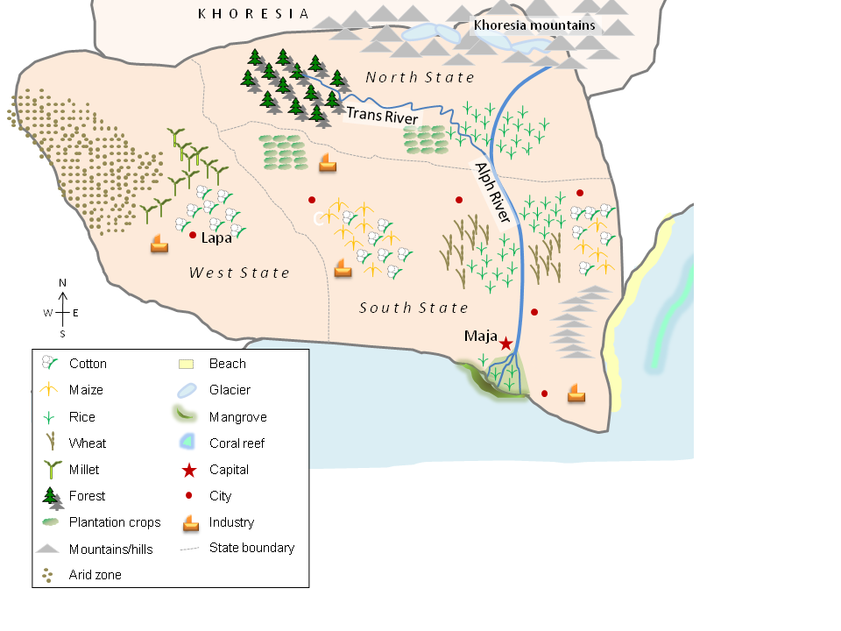
Source: GIZ
Notes:
Zanadu is a fictitious country based on real life conditions.*
The training manual provides all relevant information but not every detail.
Highlight that even for well known countries, you don’t have all the data at hand.
» For discussions on the fictitious case see Trainer Handbook, chapter 3.2.

Slide 28
Exercise (1)
  Context
  The Ministry of Agriculture has gained knowledge about climate change in Zanadu – and especially the impacts on agriculture. However, the directors are at an impasse with the decision on which policies and activities they should favour.
  They have formed an expert task force (your group) to assist them in making a decision on the development pathway to plan for.
  In a first step you have prepared 3 scenarios. Now you have to evaluate them against a set of criteria given by the MoA.
  Exhibits
  Climate information for agriculture in Zanadu
  3 Scenarios

Slide 29
Exercise (2)
  Your task
  Read the exhibits carefully
  Evaluate the 3 scenarios against a set of criteria (matrix 1)
    You have the chance to add a 4th criterion – discuss and choose
    Discuss how you want to approach the evaluation
    Conduct and document the evaluation
  Prepare your presentation at the Ministry (e.g. poster)
  Prepare a convincing rationale for your decision
    Recall the objective, criteria and selection process
    Explain why you have selected scenario X (why the others don’t match)
    If possible, give examples of what kind of activities and/or decisions this would require from the Ministry

Slide 30
Exercise (3)
Results
  Evaluation of 3 Scenarios
  Presentation of findings
Logistics
  Case work (including reading time) – 80min
  Presentation of results (at the Ministry) – 10 min/group

Slide 31
Reflection
  1st round
    What is my take-home message?
  2nd round
    How can I improve my daily work through the newly acquired knowledge?
  3rd round
    What are the rules for communicating climate change in order to motivate action?
Notes:
Hint
Do this last part without showing the slide
Begin with a small recap on all the things discussed in the module (e.g. overview slide)
Discuss in plenary (e.g. 'talking stick' in rounds 1 and 2; leave room for discussion to work out the main messages below); make sure to portray this discussion visually,
Ask participants to brainstorm in buzz groups for the 3rd round and then collect cards and pin them in plenary – (better have some cards prepared based on the pre-prepared handout to add to participants ideas)
The main messages that should come across in this module are
There are tools to manage uncertainties and make their respective frames transparent, e.g. scenarios. This motivates action (you can make a choice!).
There is no neutral way of communicating – be clear about you objectives
You want to change the mind of your audience NOT yours – they may listen to different arguments. Try to find their 'entry point'

Slide 32
Title
Text
This slide is not part of the original version of the training material. It was added by [please insert institution].

