Slide 1


Open toolbox in full screen mode to be able to make full use of all functions!
Monitoring & Evaluation of Adaptation to Climate Change
An Introduction and Toolbox
Version: December 2016

Slide 2
Imprint
Imprint
As a federally owned enterprise, GIZ supports the German Government in achieving its objectives in
the field of international cooperation for sustainable development.
Published by
Deutsche Gesellschaft für
Internationale Zusammenarbeit (GIZ) GmbH
Dag-Hammarskjöld-Weg 1-5
65760 Eschborn, Germany
T +49 61 96 79-0
F +49 61 96 79-1115
Contact
E climate@giz.de
I www.giz.de
GIZ Division Climate Change, Environment and Infrastructure
Responsible
Julia Olivier
Authors
Timo Leiter, Malte Maaß
The concepts expressed in this tool are those of the authors and do not necessarily represent the views of the German government, or the endorsement of any approach described herein.

Slide 3
Home
Getting started
Project Background
Getting in touch
How to use guide
M&E at a glance
What is adaptation M&E
Why adaptation M&E
Approaches to adaptation M&E
Experiences with adaptation M&E
More information
Tool Overview
National-level
  Guidebook national M&E
  10 national M&E systems
  Assessing climate resilience study
  Repository of adaptation indicators
Multi-level
  M&E Navigator
  Adaptation M&E Training
  Vulnerability Sourcebook
Project level
  Adaptation made to measure
  MACC-Tool
  Saved health/ Saved wealth
  Impact evaluation guidebook
Start End

Slide 4
Getting started
Project Background
The increasing focus on adaptation finance, planning and implementation leads to a growing need for robust monitoring and evaluation (M&E) in order to ensure that investment in adaptation to climate change actually contributes to climate resilient sustainable development.
Therefore the GIZ Project Climate Finance - Transparency and Impact Orientation (M&E Adapt) on behalf of the Federal Ministry for Economic Cooperation and Development (BMZ) supports partner governments to develop and operate M&E systems to track their adaptation progress.
The project also develops methods and tools for monitoring and evaluation (M&E) of adaptation and disseminates them to partner countries and to the international community.
The tools developed by the project can be found in this toolbox as well as on the website www.AdaptationCommunity.net under “Monitoring and Evaluation”.

Slide 5

Getting started
Getting in touch
If you have any further questions or enquiries regarding this Toolbox or the M&E Adapt Project please contact:
  Julia Olivier
  E: julia.olivier@giz.de
  T: +49 61 96 79-4027
  Timo Leiter:
  E: timo.leiter@giz.de
  T: +49 61 96 79-1903

Slide 6
Getting started
Getting Started
About the toolbox
This toolbox provides an overview of the GIZ support tools available for monitoring and evaluation of adaptation to climate change. It first answers general questions about M&E of adaptation and then gives a brief description of the available GIZ M&E support tools. Links to download the resources are provided.
You do not have to follow the proposed order, but can freely navigate through toolbox, to get to the tool that interests you. To find out how to navigate click on
‚How to use guide‘.
If you want to get in contact with the GIZ M&E Adapt team please click on ‚Getting in touch‘ and if you are interested in more information about the GIZ Project M&A Adapt please click on ‚Project background‘.

Slide 7
How to use guide
Go directly to the Tool Overview, to M&E at a glance, Getting started or Imprint by clicking here:
Go to the home slide by clicking here:
Go back to last viewed page by clicking here:
Go back and forth chronologically by clicking here:
Navigate through M&E tools by clicking here:

Slide 8

How to use guide
Yes you got it!!!
The Tool-box is not designed to be read from start to finish. Instead, follow the path you want to take by clicking on the links, forward arrows and back arrows.
You can follow , as well as to gather more detailed information about the indicated topic. Some links will lead you to external Websites.
It might prove helpful to experiment with the navigation for a minute before starting to use the content of the tool. You will see - It is quite easy to comprehend.
highlighted links
Boxes

Slide 9
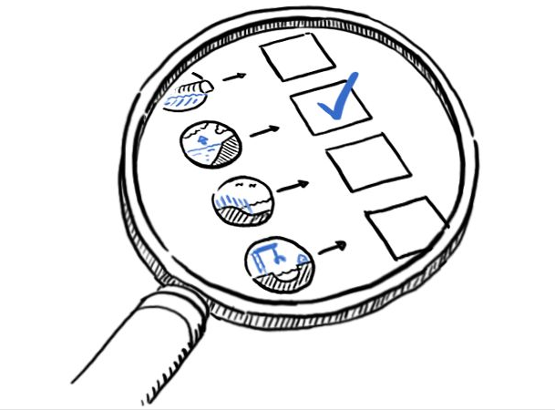
M&E at a glance
Monitoring & Evaluation „at a glance“
What is adaptation M&E?
Why adaptation M&E?
What are different approaches to adaptation M&E?
What experiences exist with adaptation M&E?
Where is more information available?

Slide 10

M&E at a glance
What is Adaptation M&E?
What is Adaptation M&E?
Monitoring and Evaluation (M&E) of adaptation supports keeping track of the implementation of adaptation plans and actions and assessing their effectiveness and outcomes.
Adaptation M&E can focus on the process of adaptation (is implementation taking place) as well as on its outcomes, i.e. whether the objectives of adaptation actions get achieved.
Why adaptation M&E?
What are different approaches to adaptation M&E?
What experiences exist with adaptation M&E?
Where is more information available?

Slide 11
M&E at a glance
Why adaptation M&E?
Why adaptation M&E?
Adaptation M&E can support the ongoing management of adaptation interventions by assessing progress and pointing out needs for adjustments.
Adaptation M&E can also support learning and exchange about what works well and what does not, thereby helping to improve adaptation actions.
Adaptation M&E can also provide accountability by demonstrating and reporting on results.
What is Adaptation M&E?
What are different approaches to adaptation M&E?
What experiences exist with adaptation M&E?
Where is more information available?

Slide 12

M&E at a glance
What are different approaches to adaptation M&E?
What is Adaptation M&E?
Approaches differ based on the purpose for M&E, e.g. projects vs strategies monitoring; focus on accountability or management or learning.
Since adaptation is context specific and there are different purposes for M&E, there is no one-size-fits-all approach to adaptation M&E.
M&E approaches also differ according to the level of application, e.g. project level, national level or multiple levels.
The Adaptation M&E Navigator helps to select an M&E approach according to the M&E purpose.
Why adaptation M&E?
What experiences exist with adaptation M&E?
Where is more information available?

Slide 13

M&E at a glance
What experiences exist with adaptation M&E?
What is Adaptation M&E?
Countries are increasingly developing national adaptation M&E systems. A study by IISD & GIZ (2014) illustrates ten such systems with detailed factsheets.
So far there is more emphasis on monitoring than on evaluation. Methods available for impact evaluation of adaptation projects are summarized in a guidebook.
Lessons learned from early experiences with adaptation M&E at national level are described in a comparative analysis and have informed a guidebook to develop adaptation M&E systems at national level.
Why adaptation M&E?
What are different approaches to adaptation M&E?
Where is more information available?

Slide 14

M&E at a glance
Where is more information available?
Where is more information available?
What is Adaptation M&E?
Why adaptation M&E?
A number of guidebook and tools have been developed and are described in this tool box.
Several webinars and events on adaptation M&E have been conducted.
Further information and links to download the resources can also be found on the website www.adaptationcommunity.net.
What are different approaches to adaptation M&E?
What experiences exist with adaptation M&E?

Slide 15


Tool Overview
Tool-Overview
National level
Multi level
Project level
Assessing climate resilience Study
Adaptation M&E training
Project monitoring Ecxel Tool
Guidebook for national adaptation M&E system
Guidebook for project adaptation M&E systems
M&E Navigator
Assessing „Saved health & saved wealth“
Repository of adaptation indicators
Examples of national adaptation M&E systems
Vulnerability Sourcebook
Impact evaluation guidebook

Slide 16

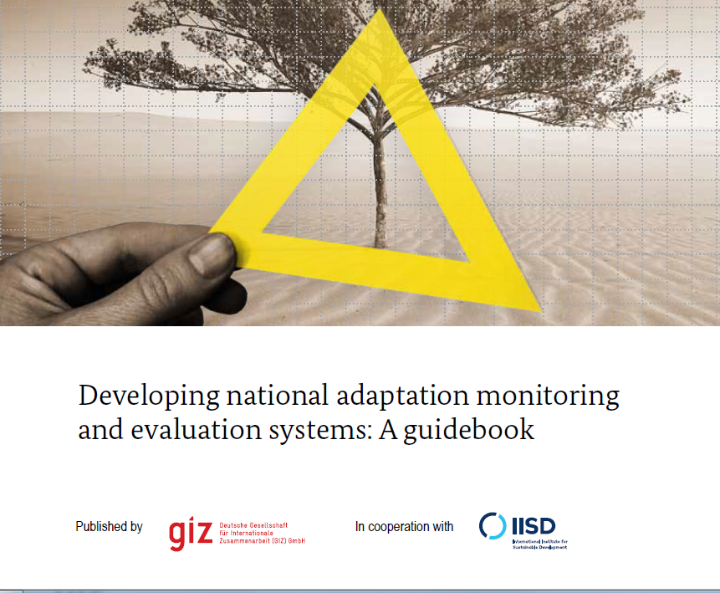
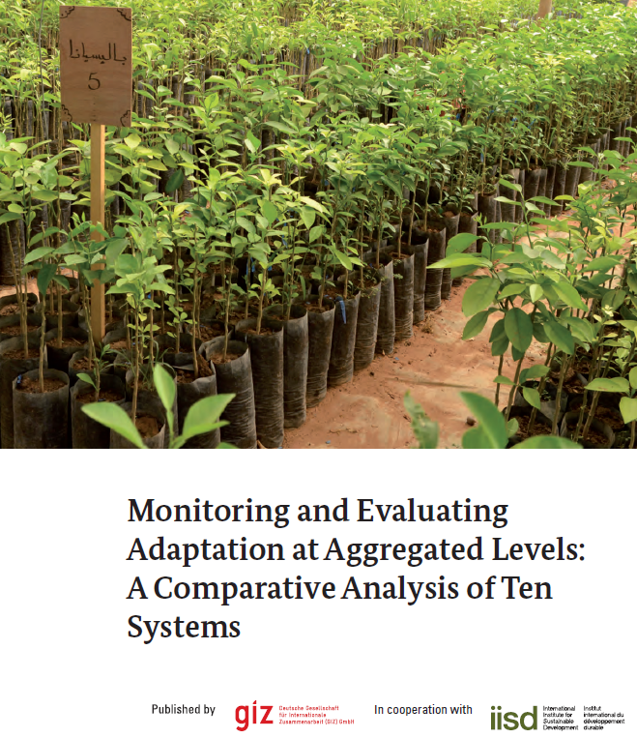
Tool Overview
National-level adaptation
Developing national Adaptation M&E systems
  A guidebook for the development of (sub)national adaptation M&E systems
Monitoring and Evaluating Adaptation at Aggregated Levels: A comparative analysis of ten systems
  An overview and analysis of 10 national adaptation M&E systems.

Slide 17
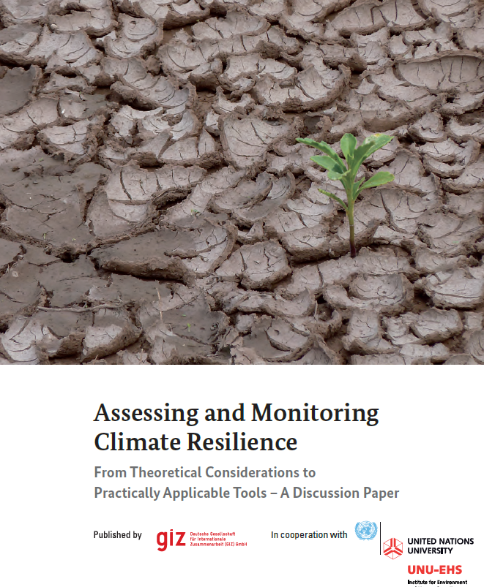
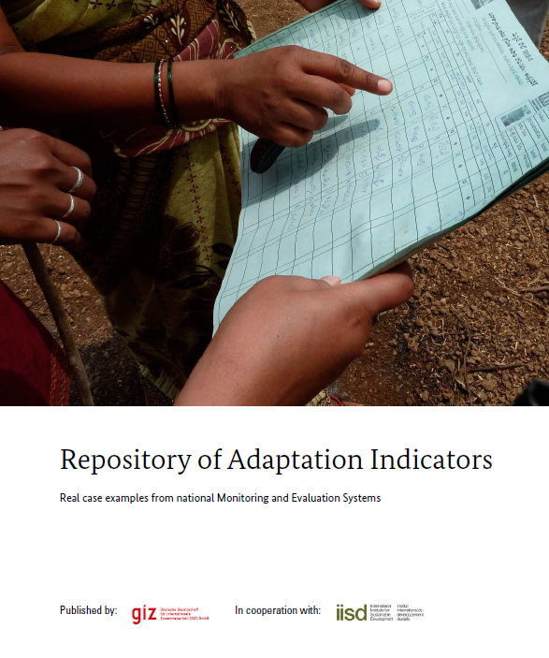
Tool Overview
National-level adaptation
Assessing and Monitoring Climate Resilience
  An approach to monitor climate resilience at the national level.
Repository of Adaptation Indicators
  Systematic collection of adaptation indicators of national-level adaptation M&E systems.

Slide 18


Tool Overview
Guidebook for national adaptation M&E systems
Description
This guidebook provides orientation for the development of (sub)national adaptation M&E systems. It takes a step-by-step approach, providing reference to existing approaches and practical examples at each step. The guidebook serves as supplementary material to the UNFCCC NAP Technical Guidelines established by the Least Developed Countries Expert Group (LEG).
Target Group | Policy-makers and technical advisors involved in the development of (sub)national adaptation M&E systems.
Type of resource | Step-by-step guide
Downloads | English, French

Slide 19

Tool Overview
Monitoring and Evaluating Adaptation at Aggregated Levels: A comparative analysis of ten systems
Description
This study analyses ten national adaptation M&E systems. A factsheet for each country or organisation describes the adaptation M&E system in detail including the institutional arrangements, the M&E method and the data and indicators used. This study serves as an illustration of how national adaptation M&E systems can be designed. Adaptation indicators used are compiled in a “Repository of Adaptation Indicators“.
Target Group | Individuals involved or interested in national adaptation M&E systems
Type of resource | Study and practical case descriptions
Downloads | English, Spanish, French

Slide 20

Tool Overview
Assessing and Monitoring Climate Resilience
Description
The discussion paper by GIZ and the United Nations University specifies resilience as consisting of three different capacities: absorptive, adaptive and transformative capacity. Each capacity can be described along five dimensions: social, ecological, economic, physical and institutional. Taken together, this understanding of resilience leads to the climate resilience matrix (capacities times dimensions) which forms the foundation to assess resilience.
Target Group | Technical advisors and policy makers, implementing agencies and NGOs
Type of resource | Conceptual framework, repository of indicators
Downloads | English, Spanish +List of Indicators (English)

Slide 21

Tool Overview
Repository of Adaptation Indicators
Description
The repository of adaptation indicators is intended to illustrate possible adaptation indicators and their application context, thereby supporting the context-specific formulation of indicators. The repository systematically presents various indicators for four focus areas: climate parameters, climate change impacts, adaptation actions, adaptation results.
For each indicator, its adaptation relevance, limitations, data needs and sources are described. It is an output of the study of ten national adaptation M&E systems.
Target Group | Individuals involved or interested in national adaptation M&E systems
Type of resource | Repository of indicators
Downloads | English, Spanish

Slide 22

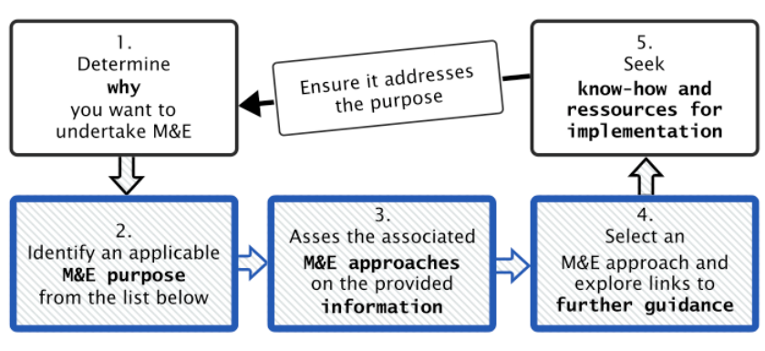
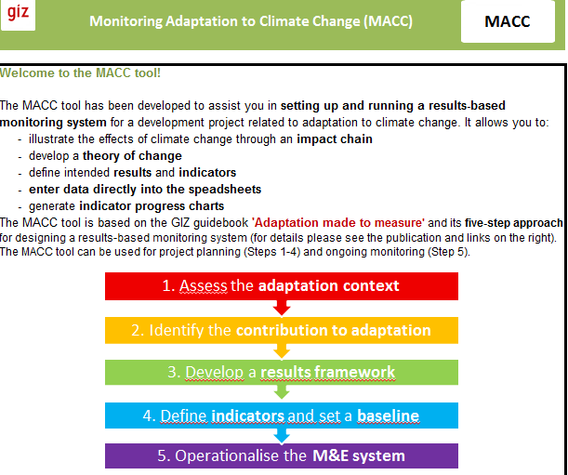
Tool Overview
Multi-level adaptation
Adaptation M&E Navigator
  A decision support tool for the selection of suitable approaches to monitor and evaluate adaptation to climate change.
Adaptation M&E Training
  A training course for developing project- and national-level adaptation M&E systems.

Slide 23
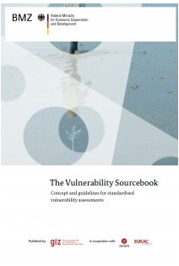
Tool Overview
Multi-level adaptation
Vulnerability Sourcebook
  A standardized approach to identify vulnerabilities and increase in climate resilience in practice.

Slide 24
Tool Overview
Adaptation M&E Navigator
Description
With increasing implementation of climate change adaptation and growing funding for adaptation there is an increasing need to understand the results of adaptation actions. The Adaptation M&E Navigator helps to select an appropriate approach for monitoring and evaluation of adaptation by providing a list of specific adaptation M&E purposes and matching them to relevant M&E approaches. The Adaptation M&E Navigator highlights key characteristics of each approach and provides links to further guidance materials and examples from practice.
Target Group | Users interested in developing adaptation M&E systems
Type of resource | Interactive guide
Downloads | Online version, Book chapter (forthcoming Dec 2016)

Slide 25
Tool Overview
Adaptation M&E Training
Description
This interactive training course (2-3 days) gives participants a systematic introduction to adaptation M&E. They get to know the process of developing adaptation M&E systems and indicators at national and project level. The structure of the training is shown in the illustration below. The course can be combined with the GIZ/OECD training ‘Integrating climate change adaptation into development planning’ or in a stand-alone format (duration: 2-3 days).
Target Group | Project developers and managers, staff of implementing agencies and government representatives
Type of resource | Training
Downloads | English (Factsheet, Trainer‘s Handbook, Training Manual, Training Slides) Spanish (Training Slides)

Slide 26
Tool Overview
Vulnerability Sourcebook
Description
GIZ has developed a standardized approach to identify vulnerabilities and increase climate resilience in practice. The Vulnerability Sourcebook provides step-by-step guidelines to conduct vulnerability assessments and to monitor changes in vulnerability over time. The Sourcebook annex contains supplementary information and practical tools for conducting vulnerability assessments, including sample indicator lists and impact chains. Two Excel spreadsheets facilitate practical application.
Target Group | Governmental and non-governmental organisations; technical and adaptation experts
Type of resource | Guidelines (+ supplementary materials)
Downloads | English, French, Spanish

Slide 27

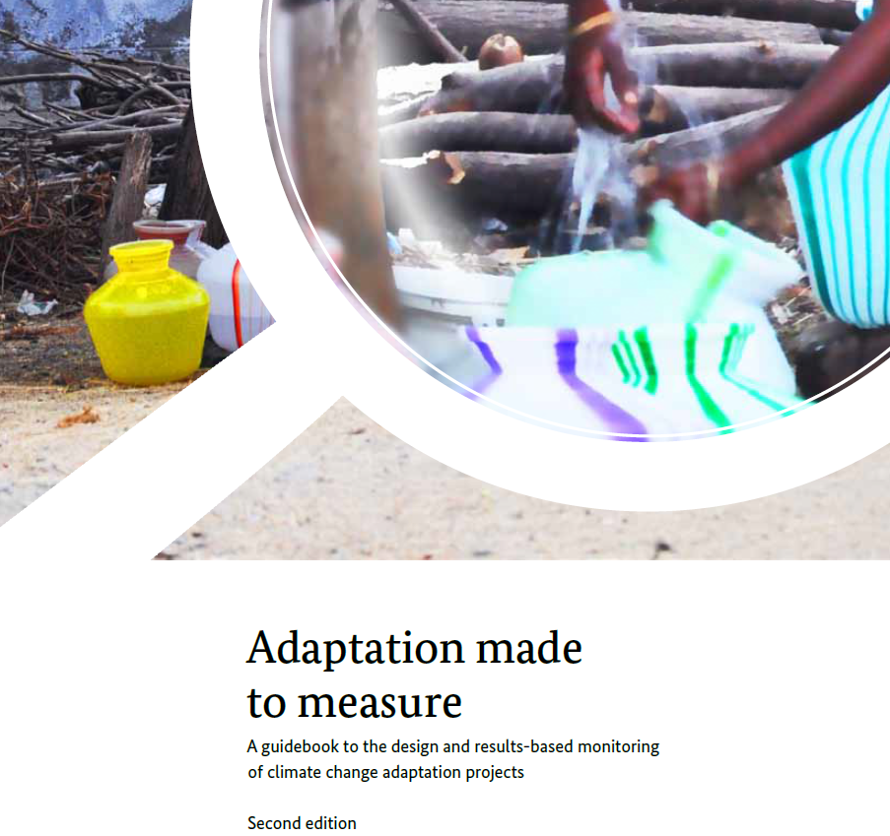
Tool Overview
Project-level adaptation
Adaptation made to measure
  A step-by-step guide to develop results-based monitoring systems for adaptation projects.
Excel Tool Monitoring Adaptation to Climate Change (MACC)
  An excel tool navigating project managers through the five steps of designing adaptation projects and their results-based monitoring systems.

Slide 28
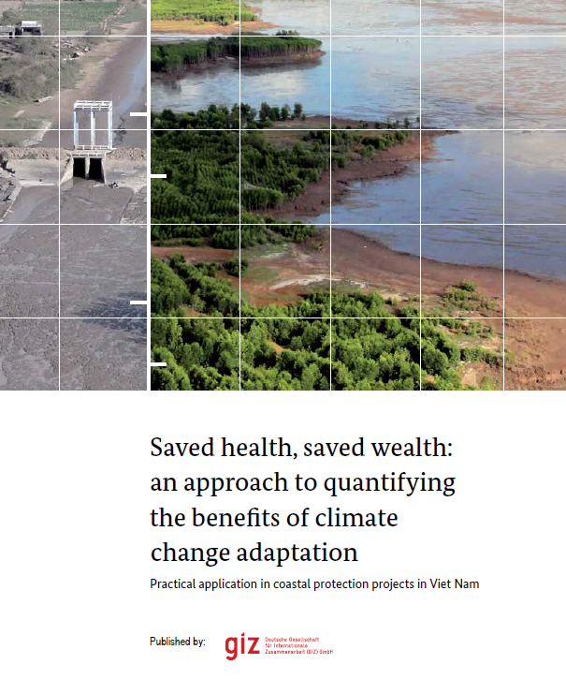
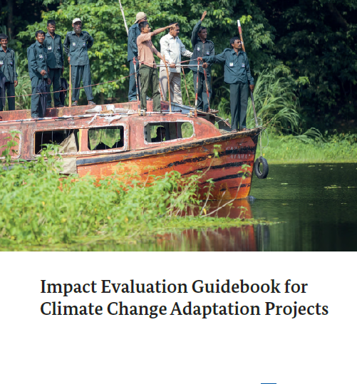
Tool Overview
Project-level adaptation
Saved health / Saved wealth
  An approach to quantify adaptation benefits in terms of avoided economic damages, illnesses and mortality.
Impact evaluation Guidebook for Adaptation projects
  A guide on selecting appropriate impact evaluation methods for climate change adaptation projects.

Slide 29

Tool Overview
Adaptation made to measure
Description
This guidebook describes five steps to design adaptation projects and their results-based monitoring systems. It offers practical advice to the questions “What characterizes an adaptation project?” and “How can adaptation results be measured?”. The five steps are illustrated through a case study from India. The guidebook is accompanied by an Excel Tool to operationalize the five steps (MACC Tool).
Target Group | Project developers and managers, implementing agencies and donors
Type of resource | Step-by-step guide
Downloads | English, Spanish, French

Slide 30



Tool Overview
Monitoring Adaptation to Climate Change (MACC)
?
Description
The excel tool “MACC” leads project managers through the five steps of the guidebook “Adaptation made to measure”. It can be used to directly enter monitoring data and keep an overview of project progress. Based on a theory of change approach the tool allows defining up to 15 intended results with up to three indictors each. Data can be directly entered into the excel file making it a very practical devise for project monitoring. The tool is easy to navigate and video tutorials explain each of the five steps. It is also helpful for planning adaptation projects.
1
2
1
1
Target Group | Project managers, staff of implementing agencies
Type of resource | Practical excel tool
Downloads | English (MACC Tool, Handbook)
2
3

Slide 31

Tool Overview
Saved health/Saved wealth
Saved Health/Saved Wealth is an approach to quantify the benefits of adaptation measures in terms of avoided economic damages, illnesses and mortality. It can be used a priori based on scenarios to select the most promising adaptation options, or as an evaluation tool for ongoing or completed adaptation projects.
Its methodology compares a baseline situation (economic assets and life expectancy) with economic and health losses that have been avoided through adaptation. It is described in detail in the publication and illustrated by comparing two adaptation options (building a dyke or planting mangroves in Viet Nam). Also an excel tool is provided for calculation of Saved Health and Saved Wealth.
Target Group | Project developers and managers, implementing agencies and donors
Type of resource | Step-by-step guide
Downloads | English (Publication, Excel Tool with Example 1 and 2)

Slide 32

Tool Overview
Impact Evaluation Guidebook for Adaptation
projects
Description
This guidebook seeks to support project managers in providing an overview of different impact evaluation methods and how they can be applied to climate change adaptation projects. It provides practitioners with guidance to select the appropriate approach for a particular climate change adaptation project, based on its characteristics and the available resources. The application of the guidebook is further illustrated with a case study of an adaptation project in Bangladesh.
Target Group | Project Managers, staff of implementing and donor agencies
Type of resource | Decision-support-tool, mapping of approaches and methods
Downloads | English

Slide 33
You reached the End
of the Toolbox
To go back to Start click here
To go back to Home click here
To go back to Monitoring & Evaluation „at a glance“ click here
To go back to Tool-Overview click here

